Slide 1



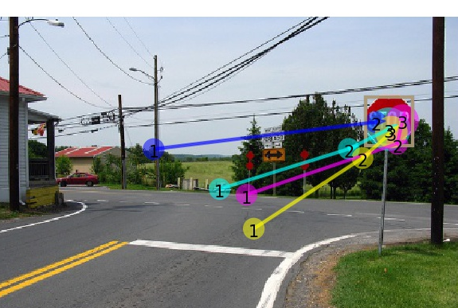
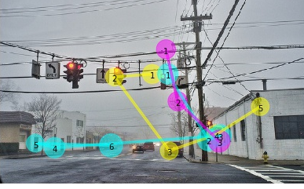
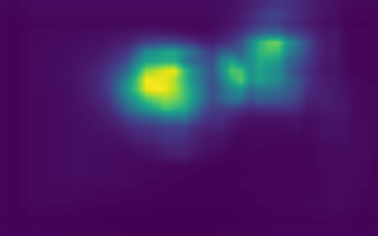


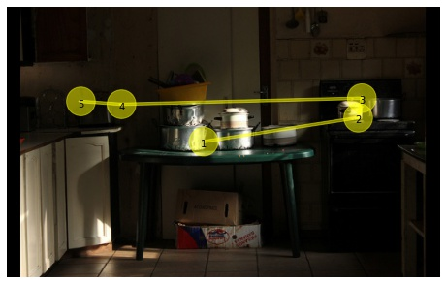
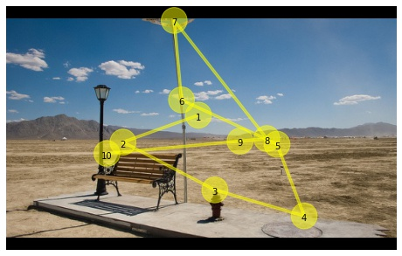
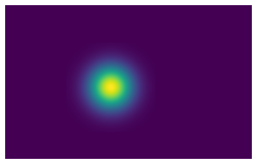
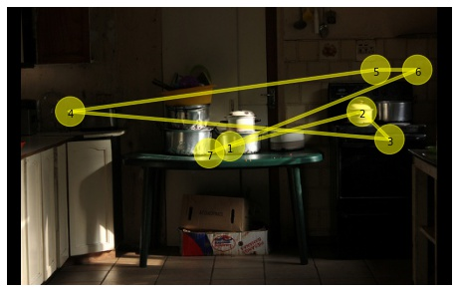
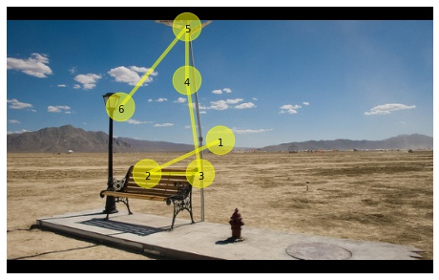
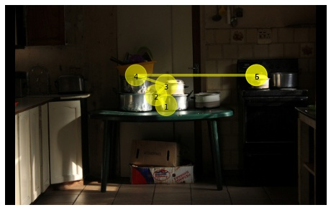
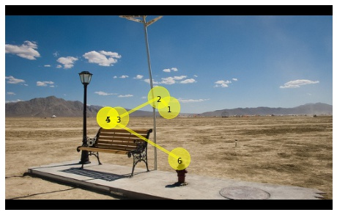
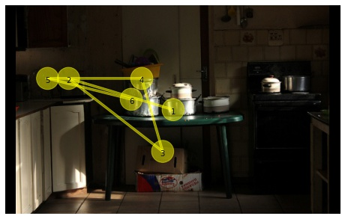
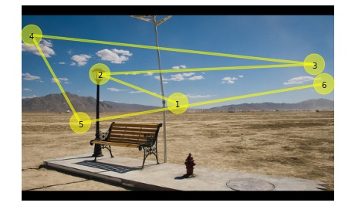
Target-absent Human Attention Zhibo Yang¹, Sounak Mondal¹, Seoyoung Ahn², Gregory Zelinsky², Minh Hoai¹, Dimitris Samaras¹ ¹Department of Computer Science, Stony Brook University ²Department of Psychology, Stony Brook University
1. Motivation
2. Foveated feature maps
Predict the fixations made by people as they search for target objects.
But what about when the target is not in the image?
We propose a model that predicts target-absent human attention.
Existing methods often represent the degraded information in the human peripheral vision by applying networks pretrained on full-resolution images, on blurred images. However, ConvNet performance is sensitive to image blur.
We move the foveation from the image to the feature space. Our Foveated Feature Maps (FFMs) leverage the hierarchical ConvNet architecture.
Stop-sign search
Target-present scanpaths
Target-absent scanpaths
3. Learning paradigm
We train a policy to mimics human gaze behavior using FFMs and inverse reinforcement learning (IRL) with a two-branch network.
Attention maps
18 targets in COCO-Search18
Fixation prediction branch
…
Fixation loss
Foveated feature maps
Object centermaps
4. Experimental results
80 COCO object categories
Tab: Results on COCO-Search18 target-absent test set
Microwave
Stop Sign
Object detection branch
Human
…
Detection loss
The fixation prediction branch is trained to maximizes the expected cumulative rewards that the expert policy can obtain
The object detection branch is trained with pixel-wise focal loss
Combining the two loss terms
Termination Prediction: we train a binary classifier using the number of previous fixations (an approximation of fixation duration) and the Q-values from Q(s, a) are the input.
Ours
Our method outperforms all other methods across all metrics in target-absent scanpath prediction.
The termination criterion is individual: Human gaze behavior generalizes among subjects better in fixation allocation than termination.
Chen et
al. [2]
References
[1] Perry, J.S., Geisler, W.S.: Gaze-contingent real-time simulation of arbitrary visual fields. In: Human vision and electronic imaging VII. vol. 4662, pp. 57–70. International Society for Optics and Photonics (2002)
[2] Chen, X., Jiang, M., Zhao, Q.: Predicting human scanpaths in visual question answering. In: Proceedings of the IEEE/CVF Conference on Computer Vision and Pattern Recognition. pp. 10876–10885 (2021)
Acknowledgements: This project was supported by US National Science Foundation Awards IIS-1763981 and IIS-2123920, the Partner University Fund, the SUNY2020 Infrastructure Transportation Security Center, and a gift from Adobe.
Detector

