Slide 1


Self-supervised Learning with Multi-View Rendering for 3D Point Cloud Analysis
Bach Tran¹, Binh-Son Hua¹, Anh Tuan Tran¹, Minh Hoai^{1,2}
¹VinAI Research, ²Stony Brook University
Notes:
Hi, I am Bach Tran and I am going to present our paper “Self-supervised learning with Multi-View Rendering for 3D Point Cloud Analysis”. This is a joint work with Binh-Son Hua, Anh Tuan Tran, and Minh Hoai

Slide 2
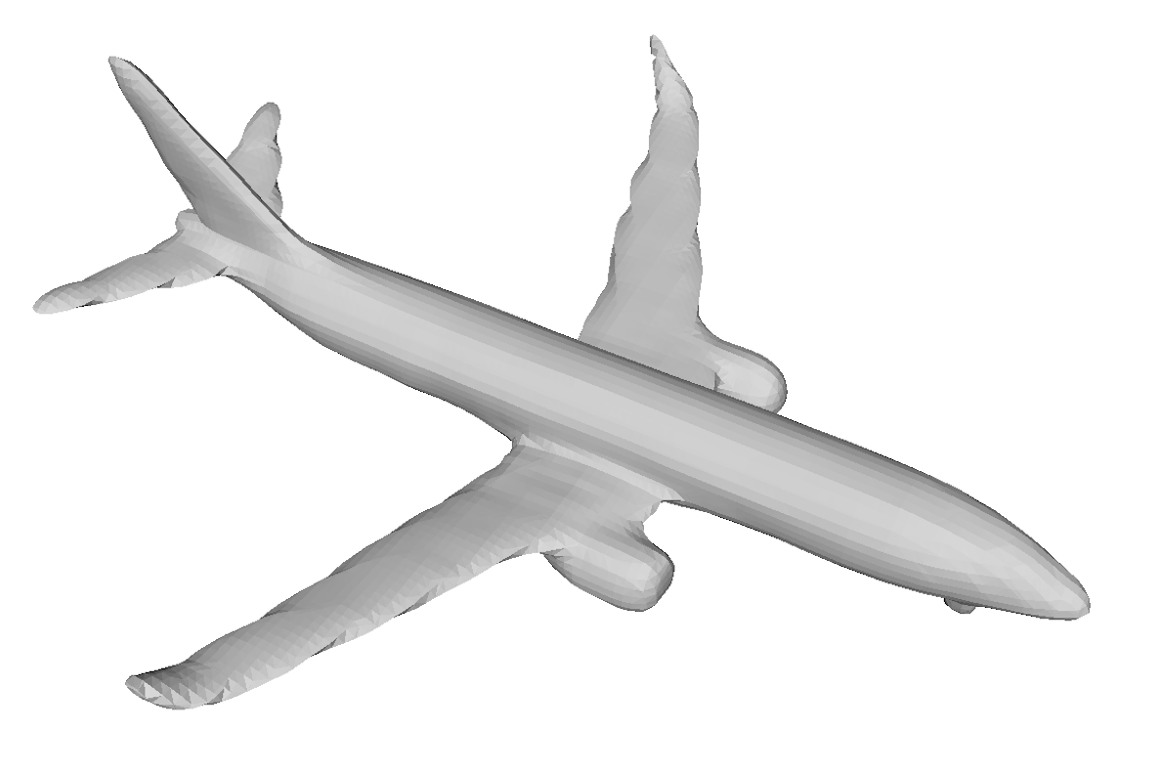
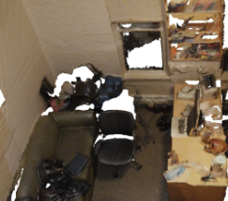


Motivation
3D raw data (RGB-D or Mesh) has become more popular and easy to collect
Modelnet40
ScanNet
It’s too expensive and time-consuming for the labeling process
How to use it?
Self-supervised learning
Notes:
With depth-sensing technologies, including RGB-D and LiDAR sensors, have enabled the acquisition of large-scale 3D data, facilitating the rapid development of visual recognition methods in 3D, notably neural networks for point cloud analysis in the last few years. Unlike images, the annotation for point clouds is generally more expensive due to the laborious process of scene scanning, reconstruction, and annotation.
So how can we use it?
A potential direction to improve the robustness for point cloud neural networks is self-supervised learning. By letting the point cloud network perform some pre-text tasks before supervised learning, a process commonly known as pre-training, the network can perform more effectively than that trained from scratch. With self-supervised learning, the pre-text tasks are designed so that the pre-training does not use additional labels.

Slide 3
Motivation
Previous works
Single modality
Jigsaw (Sauder et al)
OcCo (Wang et al)
PointContrast (Xie et al)
DepthContrast (Zhang et al)
Multi-modality
CM (Jing et al)
STRL (Huang et al)
Prior3D (Hou et al)
Almost all previous works methods ignored local information between point and pixel for 3D self-supervised learning
Notes:
For self-supervised learning on 3D data, it can be divided into two main groups that include single-modality and multimodality.
For single-modality, Sauder et al defined a pre-text task, it can be solving a jigsaw puzzle, where a point cloud is subdivided into randomly arranged voxels and the task is to predict for each point the voxel ID the point belongs to.
Wang et al. proposed a pre-text task as point cloud completion, where a mechanism similar to mask-based pre-training in natural language processing is utilized.
PointContrast is designed by Xie et al., it creates positive pairs and negative pairs for contrastive learning by correspondences between two views of a point cloud.
while Zhang et al. proposed DepthContrast method that learns the representation with multiple 3D data formats including points and voxels.
For multimodality, Jing et al. use 3D data with multi-modality and build cross-modal and cross-view invariant constraints, maximizing cross-modal agreement of the features of the point cloud, mesh, and images, and maximizing cross-view agreement with the image features.
Huang et al. proposed self-supervised learning for a sequence of point clouds that utilizes spatio-temporal cues.
Hou et al. use contrastive learning on multi-view image constraints and image-geometry constraints. However, they only focus on 2D downstream tasks.
However, almost all previous works methods ignored local information between point and pixel for 3D self-supervised learning

Slide 4










Motivation
How to exploit local as well as global information between point cloud and images?
Utilizing multi-view rendering (MVR) to generate pixel/point and images/point cloud pairs
Shading
MVR
RGB
Silhouette
2. Transfer knowledge from 2D pre-trained models to 3D models
Notes:
our work focus on answering the question "How to exploit local as well as global information between point cloud and images?"
We address this problem by utilizing multi-view rendering that can render different types of images like shading, RGB, and silhouette and generate pixel/point and images/point cloud pairs.
Finally, we transfer knowledge from 2D pre-trained models to 3D models that are used in downstream tasks.

Slide 5
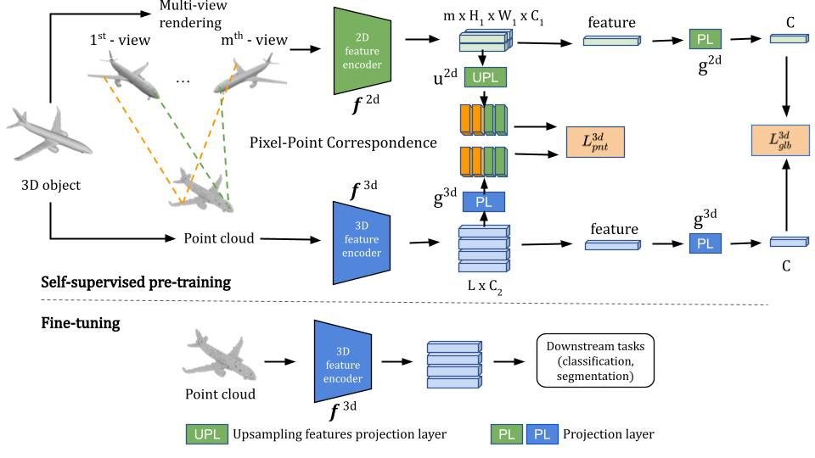
Proposed method
Notes:
Our method consists of two steps.
First, we learn feature representation for 2D images with self-supervised learning by ensuring the similarity between the representation features of two transformed images of the same original image.
Second, we use the feature representation of 2D images to learn the 3D feature representation for 3D point clouds

Slide 6
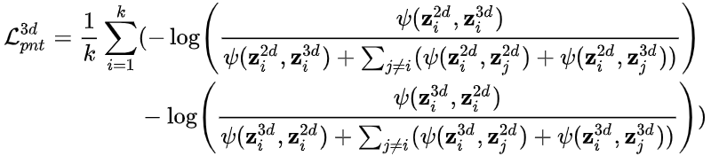
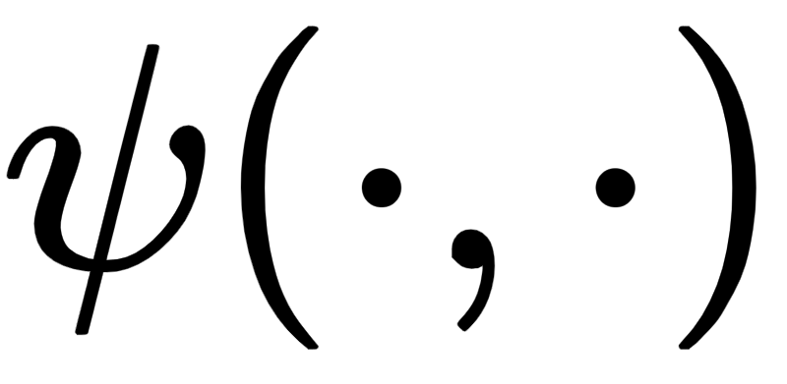
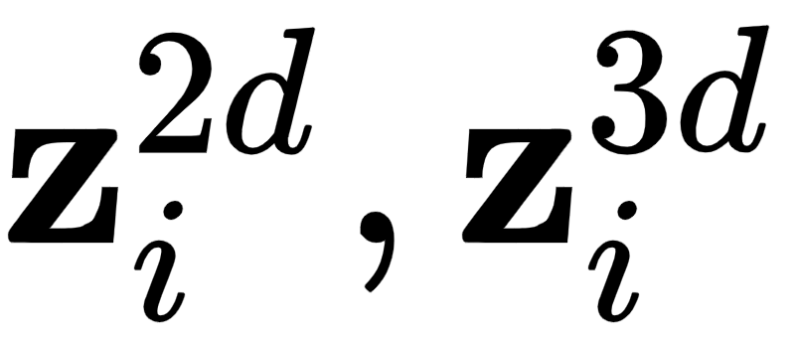
Proposed method
Point-wise knowledge transfer loss: using a loss function inspired from SimCLR to maximize the similarity between the point representation vector and its correspondence pixel representation vector (k pixel-point pairs)
Where:
is the exponential cosine function
are pixel feature and its correspondence point feature
Notes:
For Point-wise knowledge transfer loss.
we use contrastive learning that minimizes the distance between the feature representation of a 3D point and its corresponding 2D pixel. To do that, we utilized a loss function that is inspired by SimCLR.

Slide 7
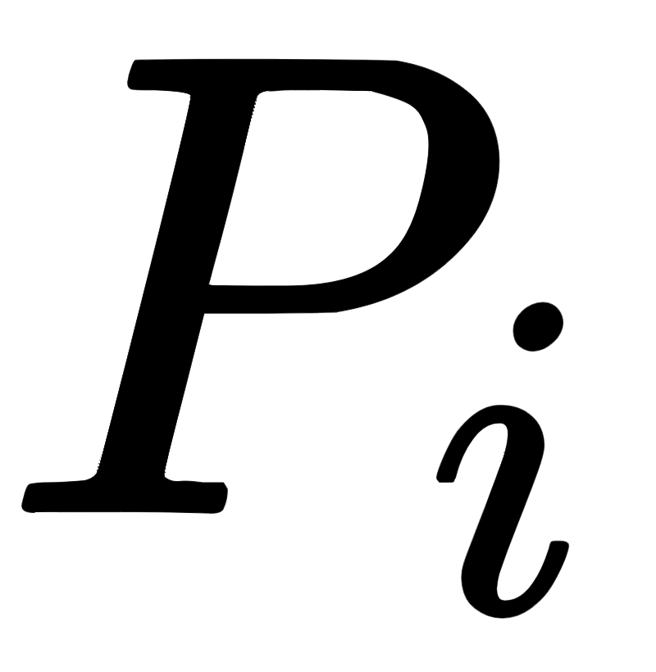
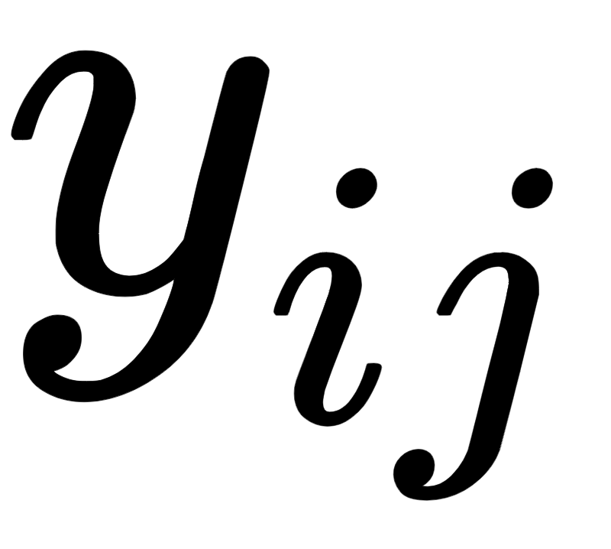
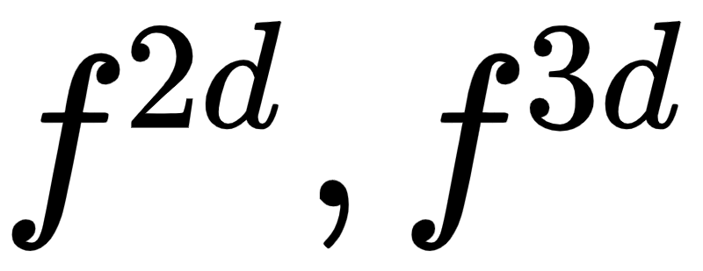
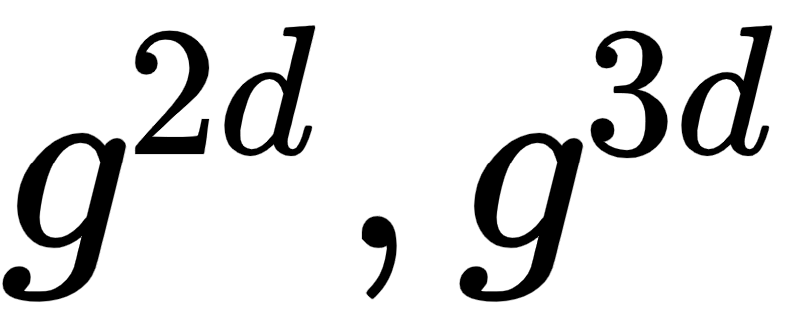
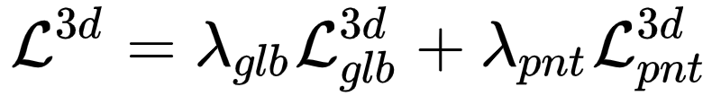
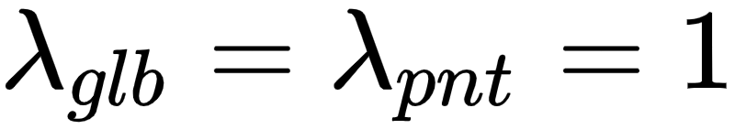
Proposed method
Global knowledge transfer loss: minimizing distance between multi-view 2D feature vector and 3D point cloud feature vector
Where:
is the point cloud of i^{th} object
is the j^{th} view of the i^{th} object
are feature extractor for 2D image and 3D point cloud, respectively
are nonlinear projection layers
Final loss:
Notes:
For global knowledge transfer loss, we minimize the distance between the aggregated 2D feature vector and the aggregated 3D feature vector which are forwarded through nonlinear projection layers
For the final loss function, we combine both point-wise knowledge transfer and global knowledge transfer losses

Slide 8
Experiments
Pre-training datasets:
Synthetic data: ModelNet40
Real data: ScanNet
2D backbones:
Resnet50
3D backbones:
PointNet
DGCNN
SR-UNet
Notes:
For Model Net 40, we use Blender with fixed camera parameters to generate multi-views of each object. After that, we produce pixel-point correspondences by projecting sampled points to images based on the camera parameters,,,,
For ScanNet, we use two view images when their corresponding point cloud pairs have at least 30% overlapping. To define pixel point pairs, we reconstruct a point cloud from the first depth image in an image pair, then project it to two color images to get pixel-point correspondences.
We use res net 50 as a 2d feature extractor. For 3D feature extractors, we use three different backbones that include Point Net, DGCNN, and Sparse Residual U-Net

Slide 9
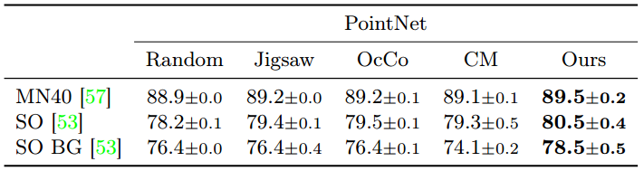
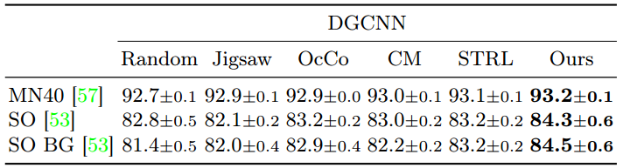
Experiments
Classification task
Notes:
For the classification task, it can be seen that our proposed methods outperform other initialization methods on ModelNet40 and ScanObjectNN datasets with different backbones like PointNet, and DGCNN.

Slide 10
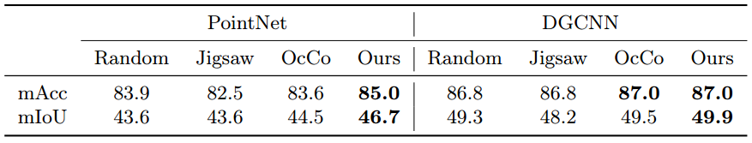
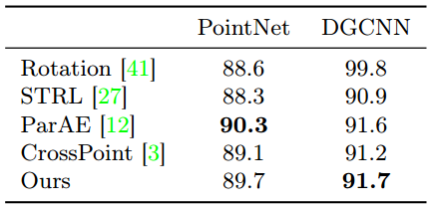
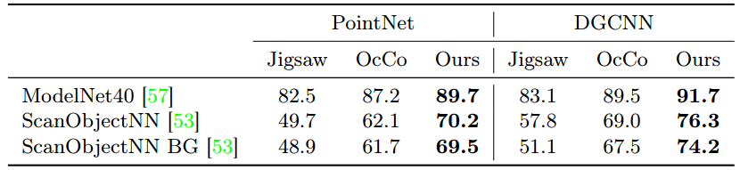
Experiments
Semantic segmentation task
SVM classification on ModelNet40
SVM classification
Notes:
We experiment with semantic scene segmentation on the Stanford Large-Scale 3D Indoor Spaces dataset (S3DIS). We see that models initialized by our method outperform others in both PointNet and DGCNN
For SVM classification, our method outperforms almost other initializations in both DGCNN and PointNet

Slide 11
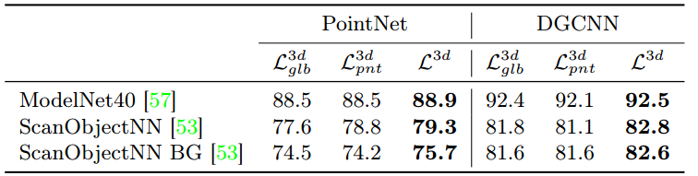
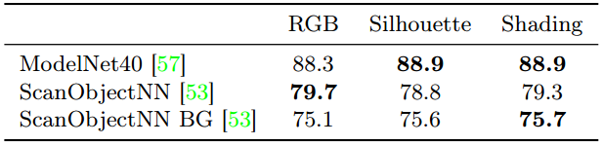
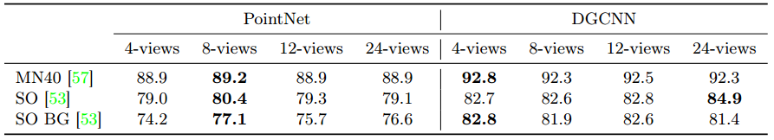
Experiments
Loss functions
Type of image
Number of views
Notes:
Our method achieve the best performance when trained with both losses. Using either global loss or pixel-point loss results will drop
For type of image, there is no best technique overall. Using shaded images results in slightly higher accuracy than other rendering techniques
For number of views, the performance is the best with 8 views in PointNet while for DGCNN t is generally enough to use 4 views

Slide 12
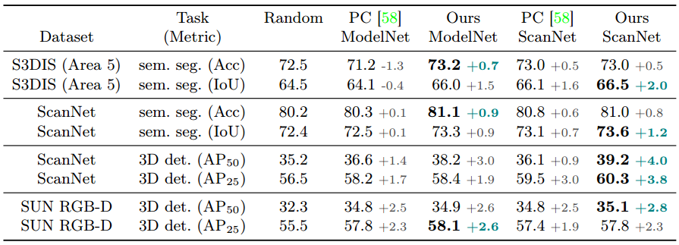
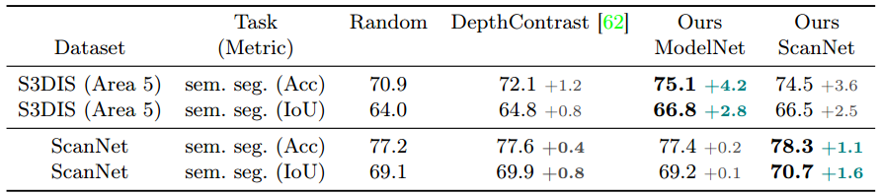
Experiments
Comparison to PointContrast (PC)
Comparison to DepthContrast
Notes:
We also investigate the role of synthetic and real data in pre-training by comparing them with PointContrast and DepthContrast.
For PointContrast, we adapt Model Net 40 to PointContrast by using surface point cloud pairs, formed for every two continuous views, instead of the provided point cloud pairs from ScanNet.
It can be seen that our model on both synthetic and real data outperforms these settings on Pointcontrast and DepthContrast.
With synthetic data, our model is significantly better than Pointcontrast and Random initialization. Because scenes are constituted of many single objects that appear in synthetic data, therefore, when we use reasonably synthetic data for the pre-training process, it still achieves better performance.

Slide 13
Conclusion
a pre-training technique built upon multi-view rendering
a local loss function that exploits pixel-point correspondence in the pre-training
a global loss function that performs knowledge distillation from the images to the 3D point clouds
Notes:
In summary, we make three technical contributions in this paper:
Firstly, a pre-training technique built upon multi-view rendering,
Secondly, a local loss function that exploits pixel-point correspondence in the pre-training,
Finally, a global loss function that performs knowledge distillation from the images to the 3D point clouds

Slide 14

Thank you for your attention!
Notes:
So that is my presentation. Thank you so much for your interest and attention.

