Slide 1





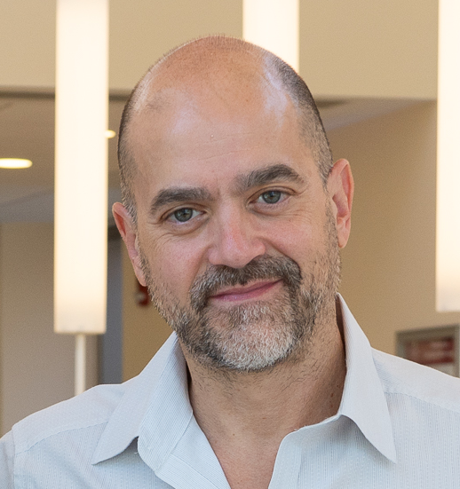




Look Hear: Gaze Prediction for
Speech-directed Human Attention
Sounak
Mondal
Seoyoung
Ahn
Zhibo
Yang
Niranjan Balasubramanian
Dimitris
Samaras
Gregory
Zelinsky
Minh
Hoai
Notes:
Hi everyone! This is Sounak Mondal from Stony Brook University. I am excited to talk about our paper on Gaze Prediction for Speech-directed Human Attention.

Slide 2
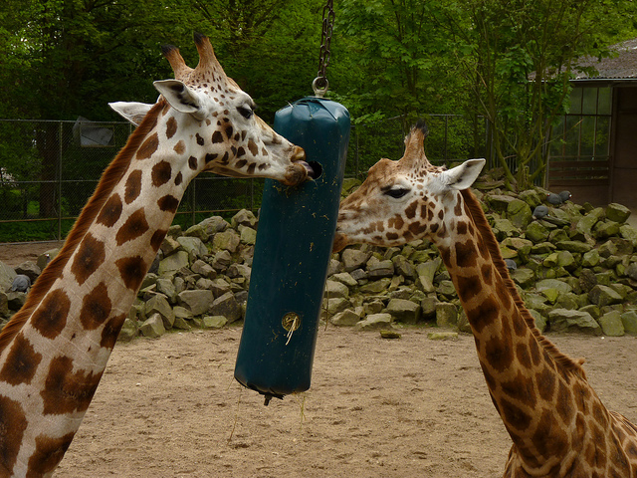
Motivation
Humans use referring expressions to incrementally direct each others’ attention to objects in a scene
Predicting gaze movements will
            Enable voice-assisted HCI applications
            Help generate testable hypotheses about how humans integrate language and vision
right
on the
giraffe
Notes:
Humans have always used referring expressions to incrementally direct attention to objects in a scene
For example, in this scene, one might move their gaze to either animal on hearing the word “giraffe”,
decide to not move gaze for words like “on” and “the” as they don’t add any information
and finally upon hearing the word “right”, they might fixate on the correct.
Predicting gaze movements for spoken instructions would therefore
Enable smooth voice-assisted human-computer interactions
and also help study how humans integrate language and vision

Slide 3
Our contributions
We introduce the incremental object referral task for gaze prediction
We create RefCOCO-Gaze, a large-scale dataset of gaze behavior during the incremental object referral task
We develop Attention for Referral Transformer (ART), a gaze prediction model which offers state-of-the-art performance for incremental object referral
Notes:
In a nutshell, our contributions are three-fold:
We introduce the incremental object referral task for gaze prediction
We create RefCOCO-Gaze, a large-scale dataset of gaze behavior during this task
We propose ART, a gaze prediction model specifically designed for this task

Slide 4
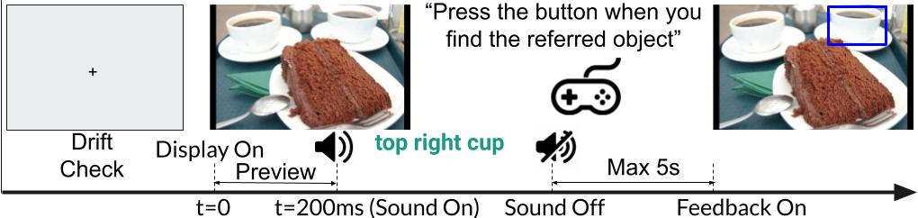
Incremental Object Referral
Standard object referral involves localizing an object referred to by a referring expression
Our task requires predicting gaze of humans searching for the referred target while they are hearing a referring expression
Prediction of gaze fixations on a word-by-word basis
  A word may trigger zero, one or several fixations
Notes:
Standard object referral task involves localizing an object referred to by a referring expression
Our novel Incremental object referral task involves Predicting gaze of humans searching for a target in an image while they are hearing a referring expression
Hence, prediction must be on a word-by-word basis and for our task, a word may trigger between zero and several fixations

Slide 5
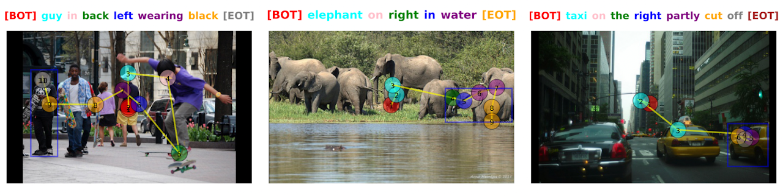
RefCOCO-Gaze Dataset
Based on 2,094 RefCOCO images and their associated referring expressions
Consists of 19,738 scanpaths
Recorded for 220 participants who listened to the referring expressions while searching for the referred object
Notes:
To study the incremental object referral task, we collected a large scale dataset called RefCOCO-Gaze
It is based on RefCOCO dataset
RefCOCO-Gaze has over 19000 scanpaths
Which is collected from 220 participants listening to the referring expressions while searching for the object

Slide 6
Attention in Referral Transformer (ART)
ART is designed for predicting gaze during the incremental object referral task
Key components of ART
  Learning object grounding tasks underlying object referral
  Novel fixation prediction framework
  Pre-training on RefCOCO dataset
Notes:
For computationally modeling human gaze scanpaths for our task, we designed Attention in Referral Transformer Model or ART.
The three key components that set ART apart from previous scanpath prediction models are
It learns object grounding tasks underlying object referral along with gaze prediction
It contains a Novel fixation prediction framework
ART’s design allows it to be Pre-trained on the underlying object referral task on larger RefCOCO dataset

Slide 7
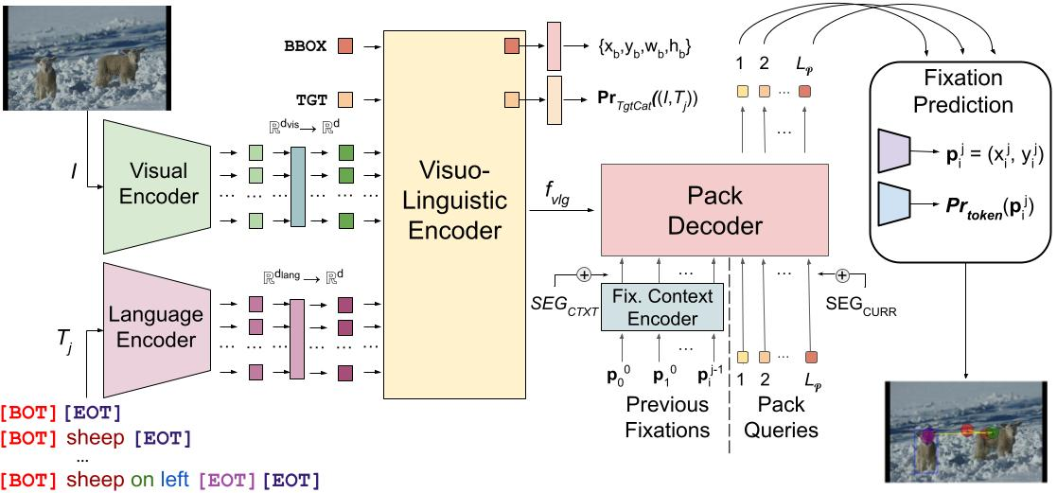
Architecture of ART
Notes:
ART CONTAINS a visual encoder for images, a language encoder for each prefix of referring expression.
Both encodings are input to visuo-linguistic encoder which combines both modalities to predict target location and category along with providing visuo-linguistic context to the decoder. The decoder uses fixation history encodings to generate embeddings of current fixations that are finaly predicted in the prediction module

Slide 8
Attention in Referral Transformer (ART)
Notes:
In order to solve ZeroGaze problem, we propose the novel Gazeformer model which improves scalability, accuracy and efficiency of gaze prediction.
There are three key components of Gazeformer
Language-based Target Encoding
Transformer Encoder-Decoder Architecture, and
Fixation Modeling in Continuous Image Space

Slide 9


Learning object grounding tasks underlying object referral
We hypothesize that two tasks underlie our object referral task
  Object localization – predicting bounding box of referred target
  Target category prediction – predicting object category of referred target
Along with gaze prediction objective, we train ART on both tasks
  For both complete and partial expressions – not possible with previous methods
Object localization
ART
Scanpath Prediction
Target Category Prediction
Cup on the top right of the cake
“cup”
Notes:
We hypothesize that two processes underlie our task:
object localization and
target category prediction
For an image and referring expression input to ART for predicting scanpaths
We expect it to benefit from learning object localization
And target category prediction
So we trrain ART onboth tasks along with scanpath prediction objective
And we do this with both complete and partial expressions – something that is unsupported by previous methods

Slide 10
Novel Fixation Prediction Framework
Under our task, a variable number of fixations may be triggered by a word – zero or one or several
  Each word triggers a “pack” of fixations
  A valid pack contains fixations parameterized by 4 parameters
    x-location, y-location
    pack number (index of the pack)
    order (within-pack index)
  Special packs
  A word may not inspire any fixations at all, yielding a null pack
  A terminal pack denotes the end of scanpath (EOS).
  We predict special packs and parameters of valid fixations in the fixation prediction module
Notes:
Our task is special in that each word may spur a variable number of fixations ranging from zero to several
We call a sequence of fixation triggered by a word a pack of fixations
Every valid pack contains fixations parameterized by 4 parameters
Spatial xy location
Pack number that is the index of the pack
And order which denotes the index of the fixation within the pack
We also define two special packs
A null pack for when a word does not trigger any fixations
And a terminal pack for when the search process has ended – which may or may not occur before the end of the referring expression
We predict the special packs and also the parameters of the valid fixations in the fixation prediction module

Slide 11
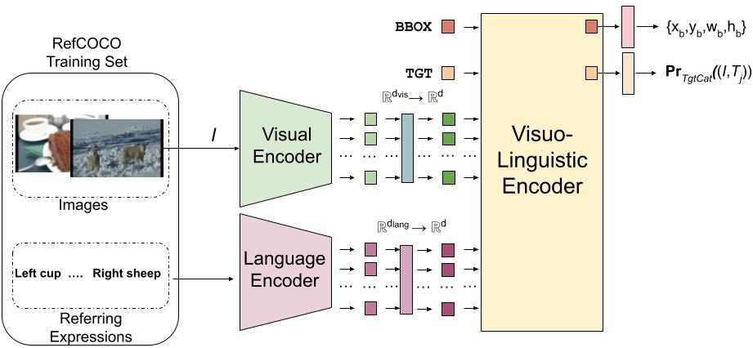
Pre-training ART on object referral
Unlike previous methods, we can pre-train ART on RefCOCO
        Helps generalize better despite training on a much smaller gaze dataset
Object localization
Target Category Prediction
Notes:
Previous methods used a frozen object referral model or lacked one. However, since ART contains an object referral model, we can train and pre-train it.
And we find that this yields better generalization
As shown here, we train the visual, language and visuolinguistic encoders on RefCOCO training data for the object localization and target category prediction tasks.

Slide 12
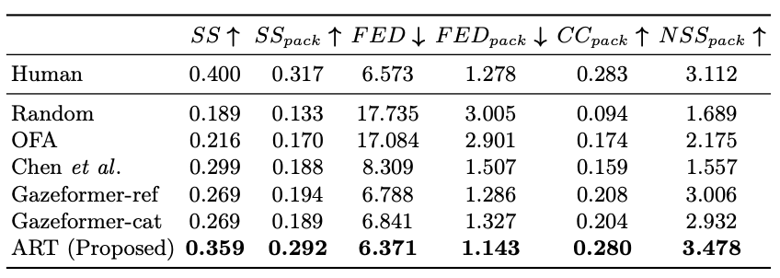
Experimental Results
ART outperforms previous methods on RefCOCO-Gaze
Notes:
Here we present the results of ART and other baseline methods on RefCOCO-Gaze.
As we can see clearly, ART outperforms previous methods by significant margins

Slide 13
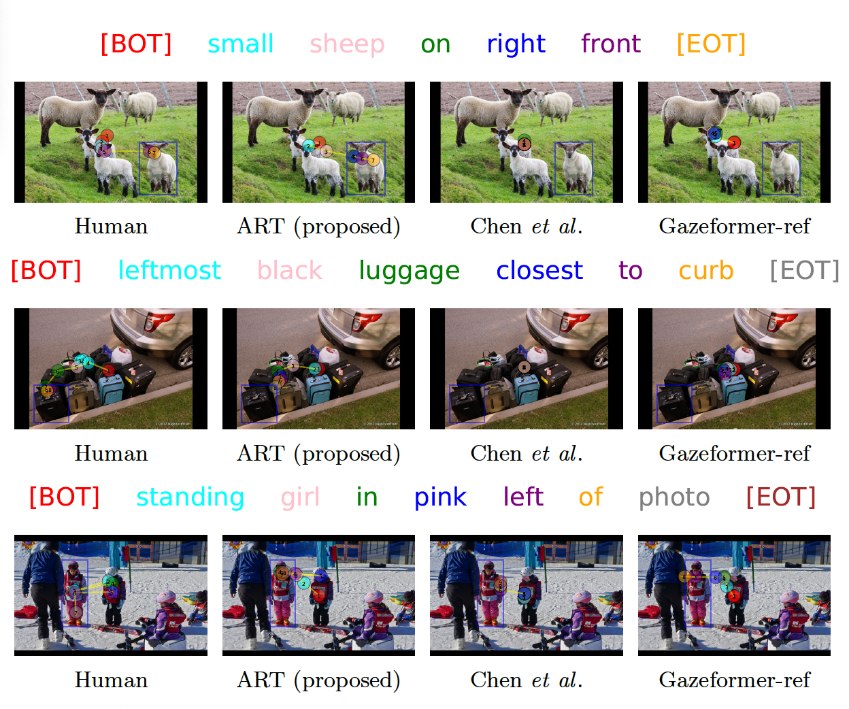
Experimental Results: Qualitative
ART generates the most human-like scanpaths for incremental object referral
Notes:
Here, we show some qualitative results. We find the ART generates the most human-like scanpaths for this task – displaying waiting, scanning and verification strategies akin to human participants.

Slide 14

Conclusion and Future Work
We introduced the incremental object referral task for gaze prediction
We collected RefCOCO-Gaze dataset for gaze behavior during incremental object referral
We developed a novel multimodal scanpath model, ART, specifically designed for our incremental multimodal task
ART outperforms previous scanpath prediction methods on RefCOCO-Gaze
We believe ART and RefCOCO-Gaze will benefit researchers studying human integration of vision and language, and HCI researchers alike
Code and dataset are available at https://sites.google.com/view/refcoco-gaze
Notes:
To sum it up, we introduced the incremental object referral task for scanpath prediction
and collected a large scale dataset called RefCOCO-Gaze for this task.
We also developed a novel architecture ART, carefully designed for our incremental multimodal task
and it outperforms several baselines on RefCOCOGaze
We hope ART and RefCOCO-Gaze will benefit researchers studying human integration of vision and language along with HCI researchers.
Code and dataset are available.
Thank you for your attention.

