Slide 1


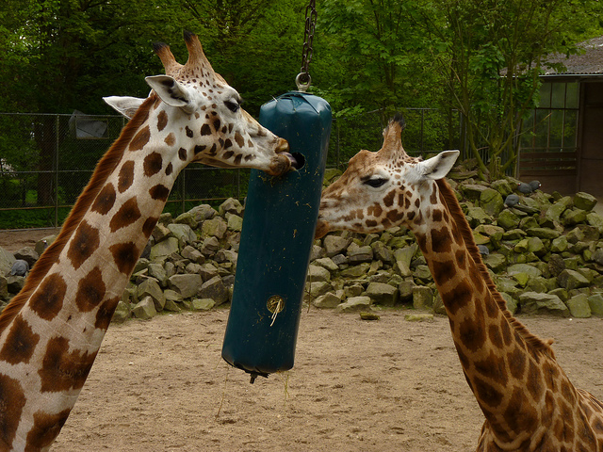
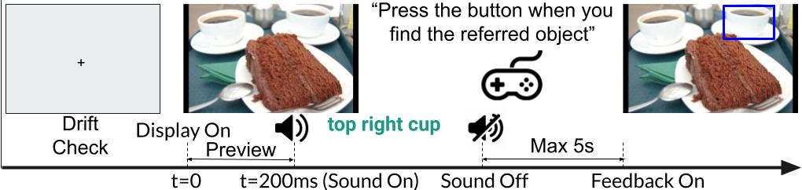
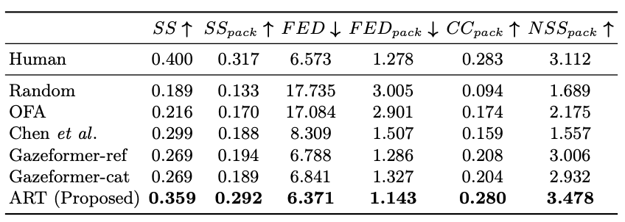
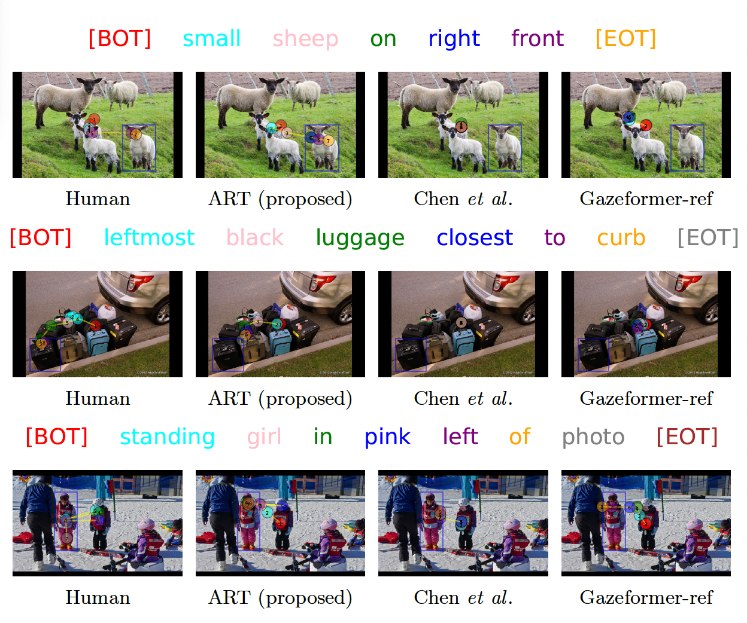
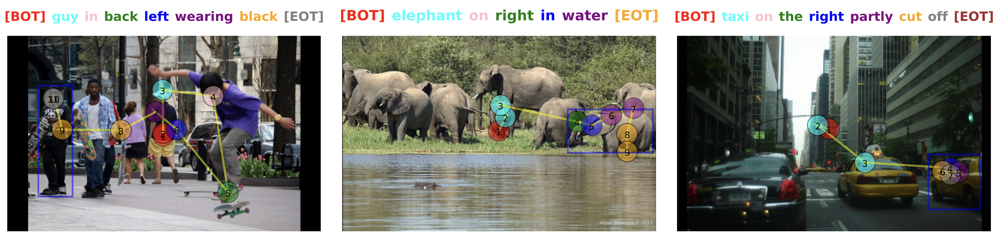
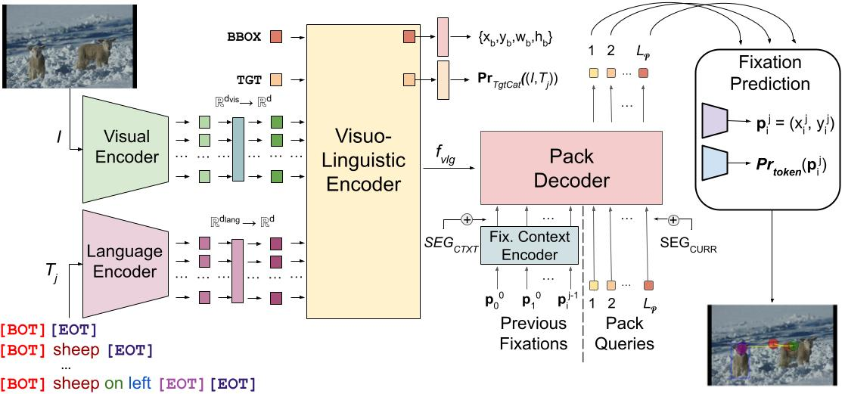
Look Hear: Gaze Prediction for
Speech-directed Human Attention
Sounak Mondal¹, Seoyoung Ahn², Zhibo Yang³, Niranjan Balasubramanian¹, Dimitris Samaras¹, Gregory Zelinsky¹, Minh Hoai⁴
¹Stony Brook University ²UC Berkeley ³Waymo LLC ⁴University of Adelaide
Motivation
First large-scale dataset of human gaze for incremental object referral task
Eye movements were lab collected using an eyetracker
Based on 2,094 RefCOCO images and their associated referring expressions
Consists of 19,738 scanpaths
Recorded for 220 participants who listened to the referring expressions while searching for the referred object
Humans use referring expressions to incrementally direct each others’ attention to objects in a scene with each word
Predicting gaze movements will enable seamless human-computer interactions for voice-assisted HCI applications
Generate testable hypotheses about how humans integrate language and vision
RefCOCO-Gaze
Experimental Results
giraffe
on
the
right
Quantitative Results: ART outperforms previous methods on RefCOCO-Gaze
Incremental Object Referral
Multimodal transformer encoder jointly learns gaze prediction and object grounding
Autoregressive transformer decoder leverages fixation history to generate per-word “pack” of fixations – containing zero, one or several fixations
Standard object referral involves localizing an object referred to by a referring expression
Our task involves predicting gaze of humans searching for the referred target while they are hearing a referring expression describing it
Prediction of gaze fixations on a word-by-word basis - word may trigger zero, one or several fixations
Attention in Referral Transformer (ART)
Qualitative Results: ART generates the most human-like scanpaths for incremental object referral.
Acknowledgements: Supported by US NSF Awards IIS-1763981, IIS-2123920, DUE-2055406, the SUNY2020 Infrastructure Transportation Security Center, and a gift from Adobe.

