Slide 1

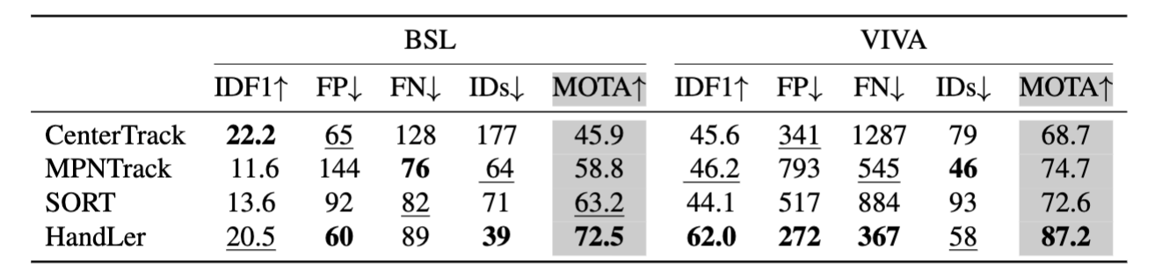
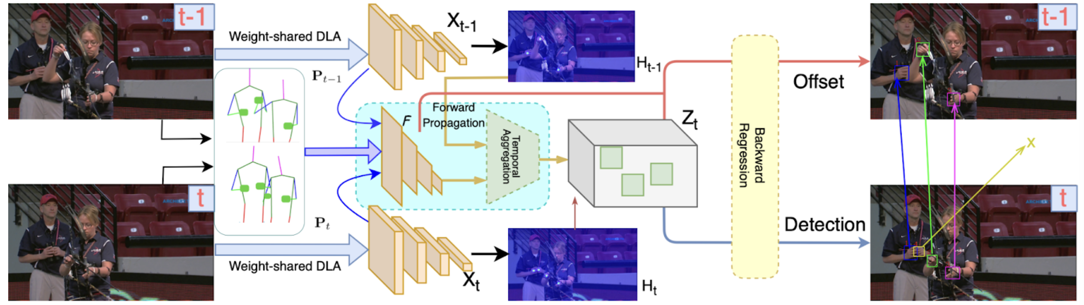
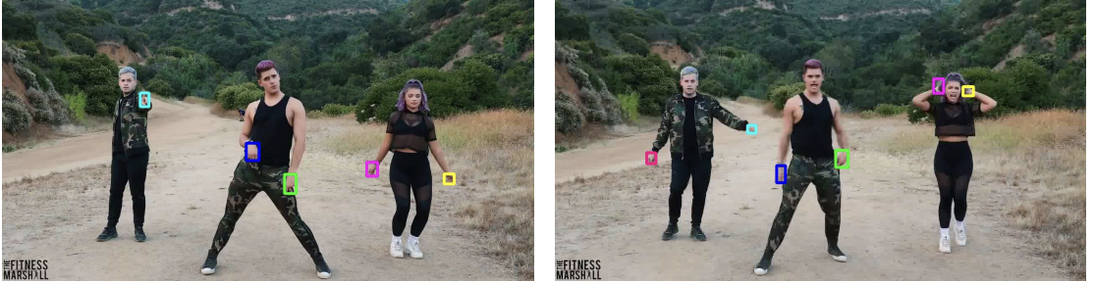
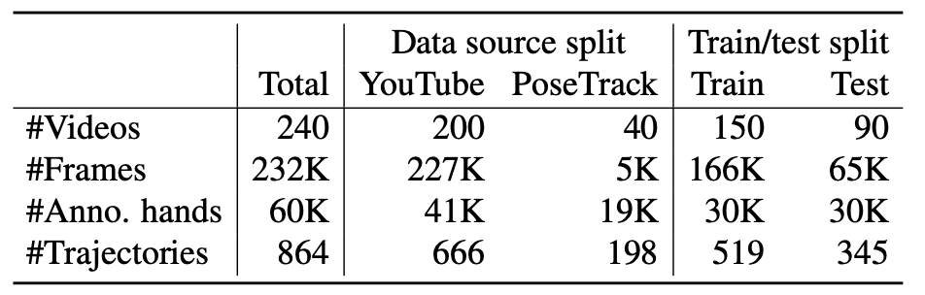
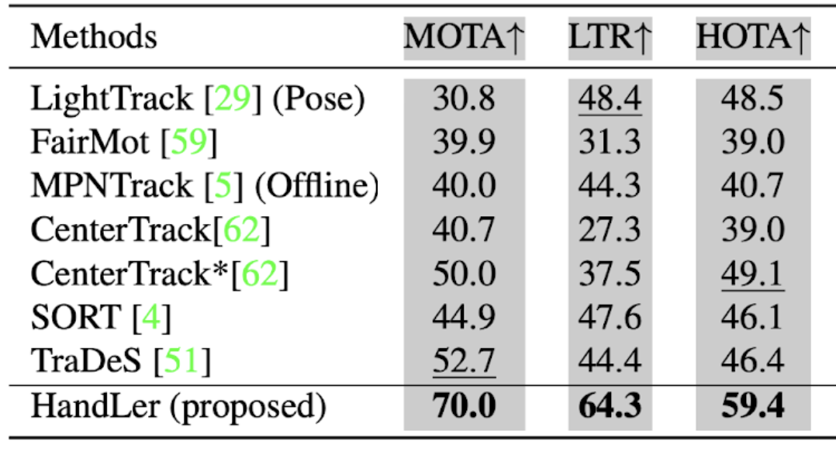
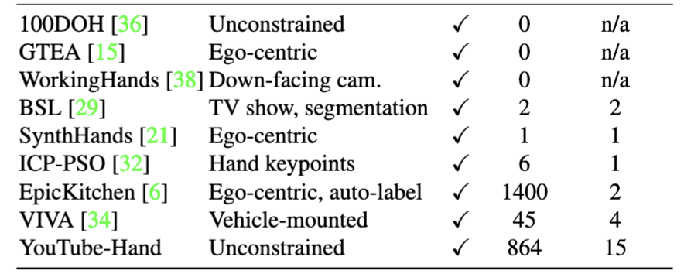
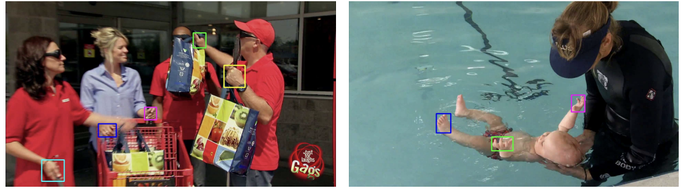
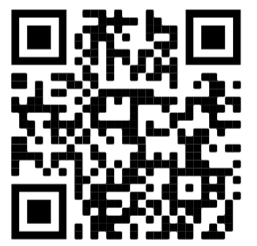
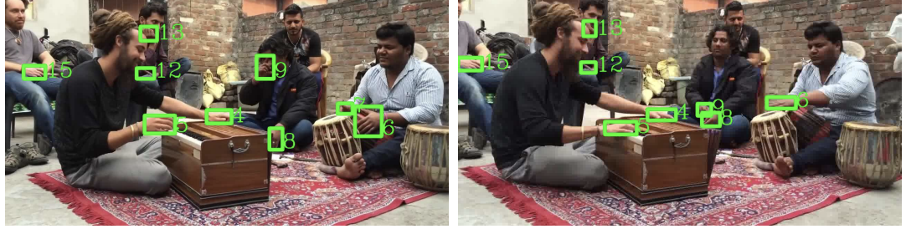
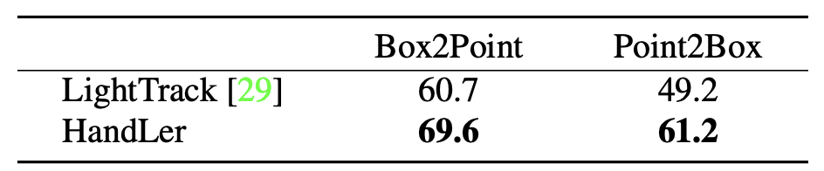
Forward Propagation, Backward Regression, and Pose Association for Hand Tracking in the Wild
Mingzhen Huang[1,2], Supreeth Narasimhaswamy[1], Saif Vazir[3], Haibin Ling[2], Minh Hoai[2,4]
Stony Brook University [1], University at Buffalo [2], Tulip Interfaces [3], VinAI Research [4]
Introduction:
  Goal: Tracking multiple hands in unconstrained environment
  Approach:
    An end-to-end trainable model based on Cascade-RCNN with additional two novel stages forward propagation, backward regression
    A high level association method for long term tracking
  Outperform SOTA MOT methods on several benchmarks
Methods
  Forward propagation: estimating motion and gathering features in two adjacent frames
  Backward regression: detecting the hands and their corresponding offset in prior frame to associate hands
  Pose association: using pose tracking to achieve long-term hand tracking
Challenges:
  Hands move fast, brings motion blur
  Hands’ appearances are different depend on the rotation
  Hands from different person have similar appearance
Compare with SOTAs on BSL and VIVA dataset
Qualitative Results:
Youtube-Hands Dataset
Experimental Results:
Failure Case:
Summary
  A novel method for hand tracking and a large-scale hand tracking dataset
  We outperform state-of-the-art MOT method on proposed dataset
Project Page
Compare with pose tracking method

