Slide 1


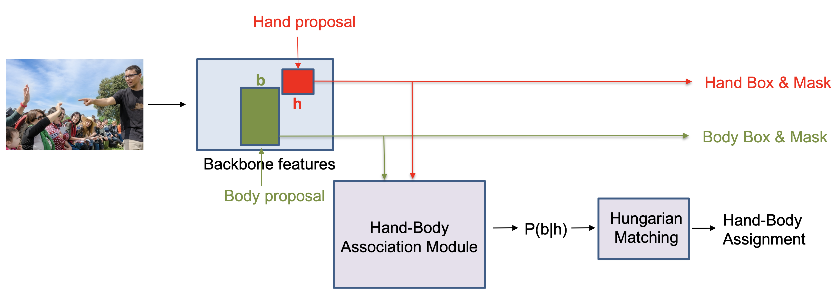
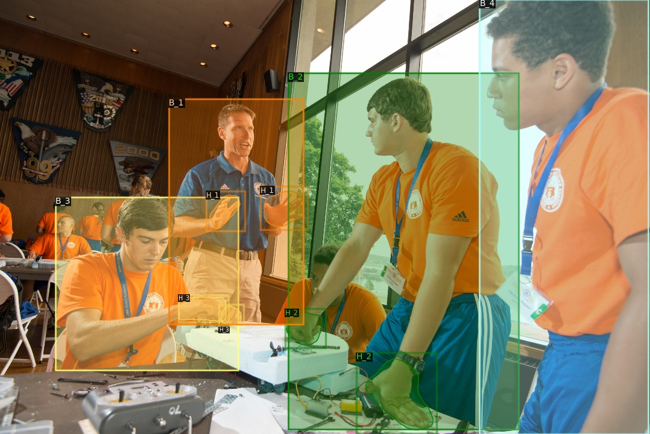
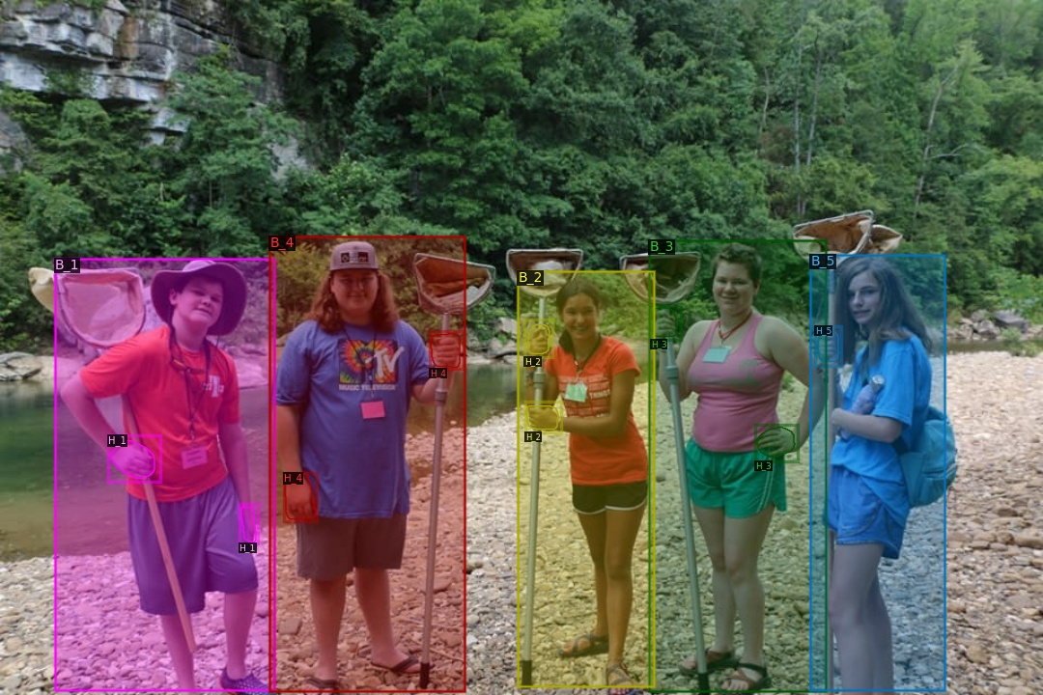
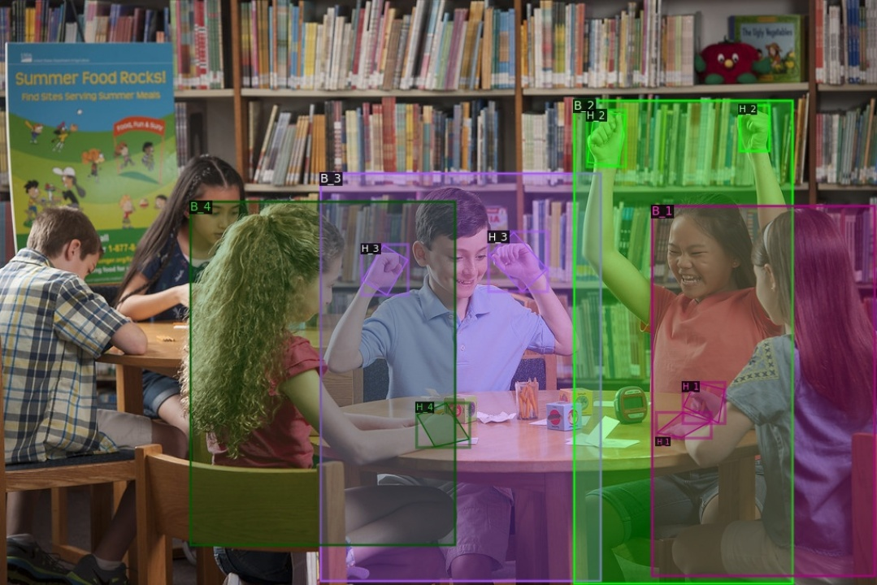
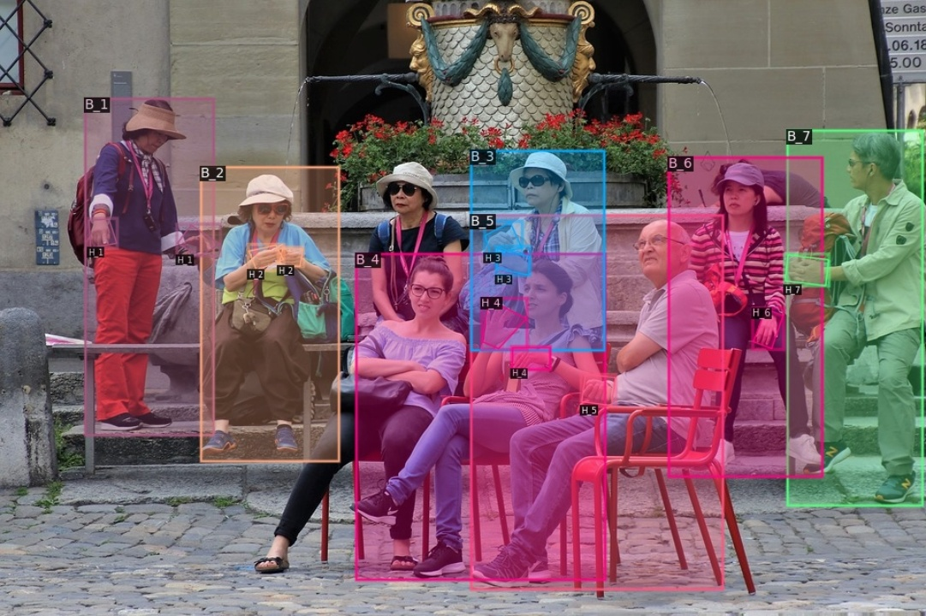
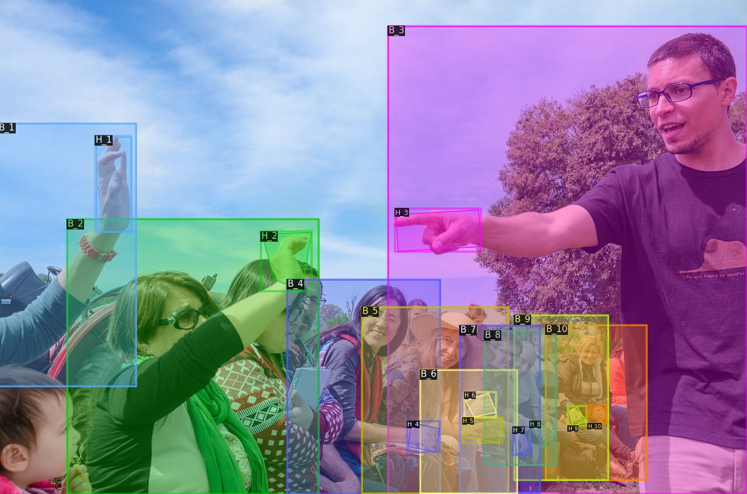
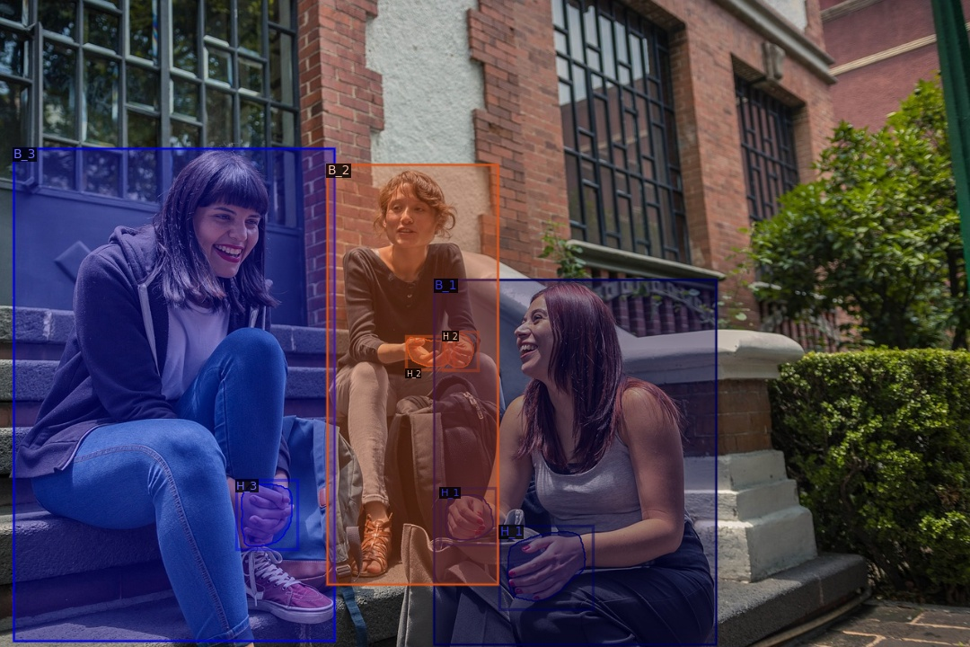
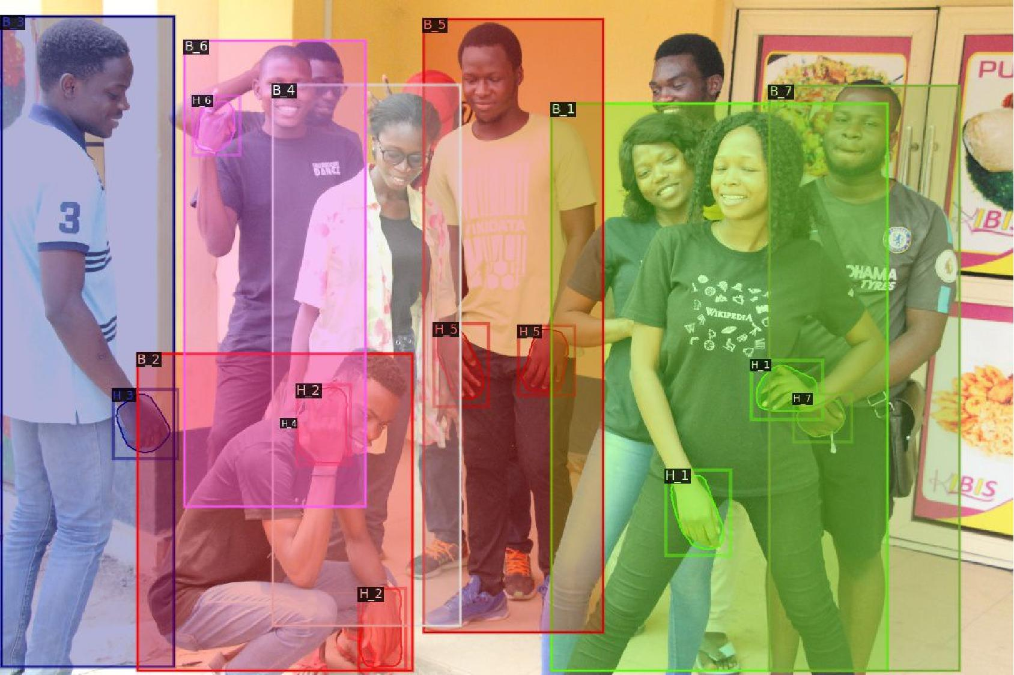
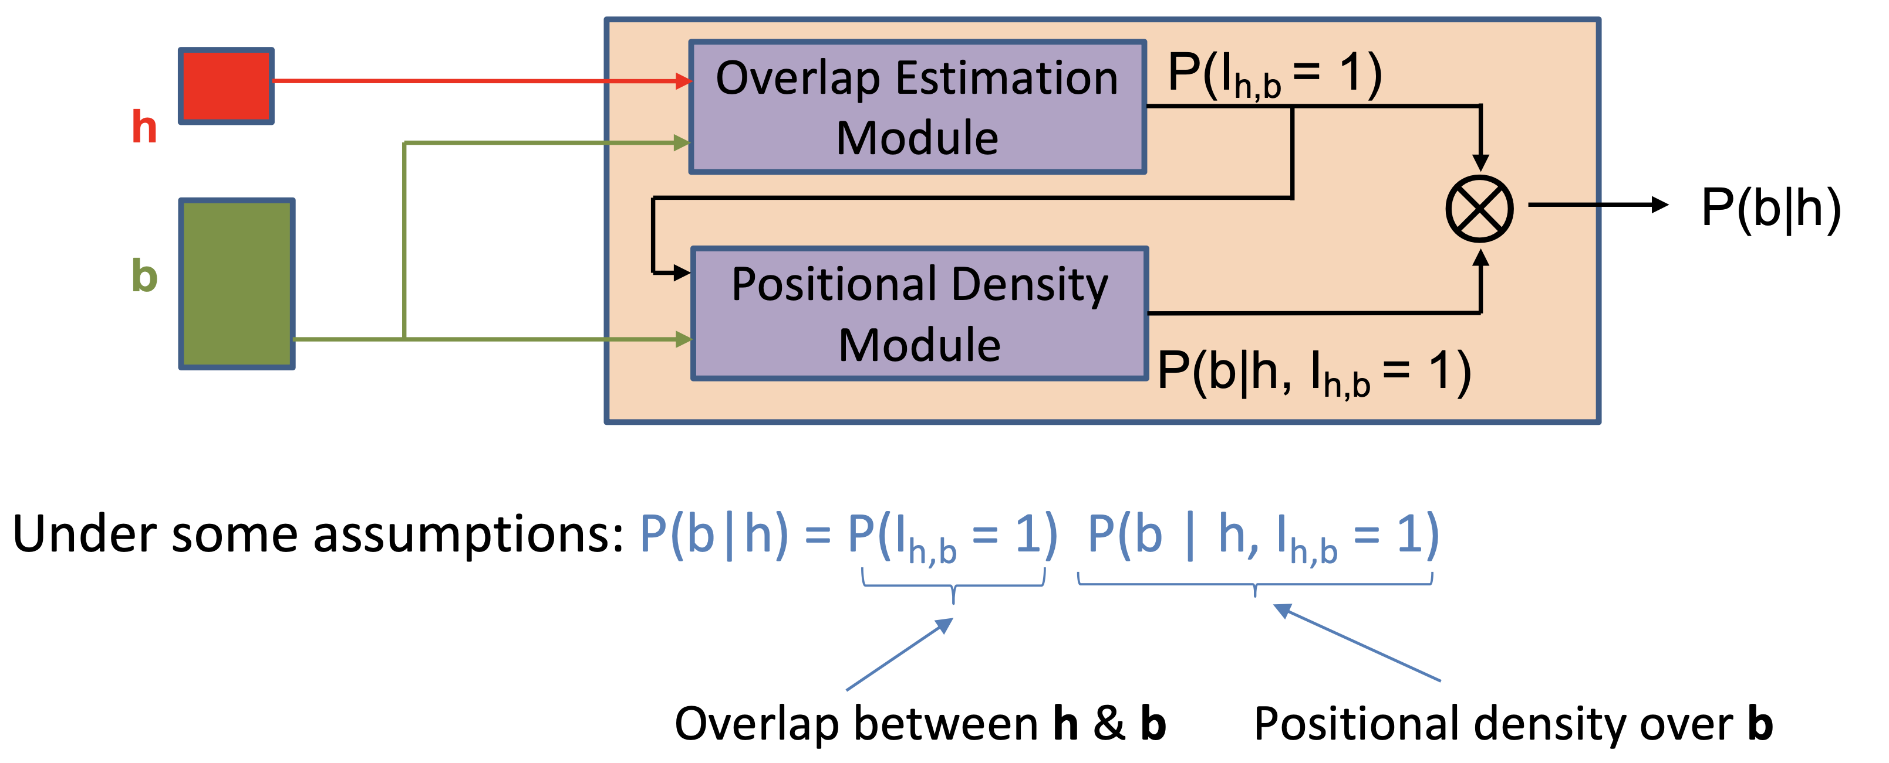
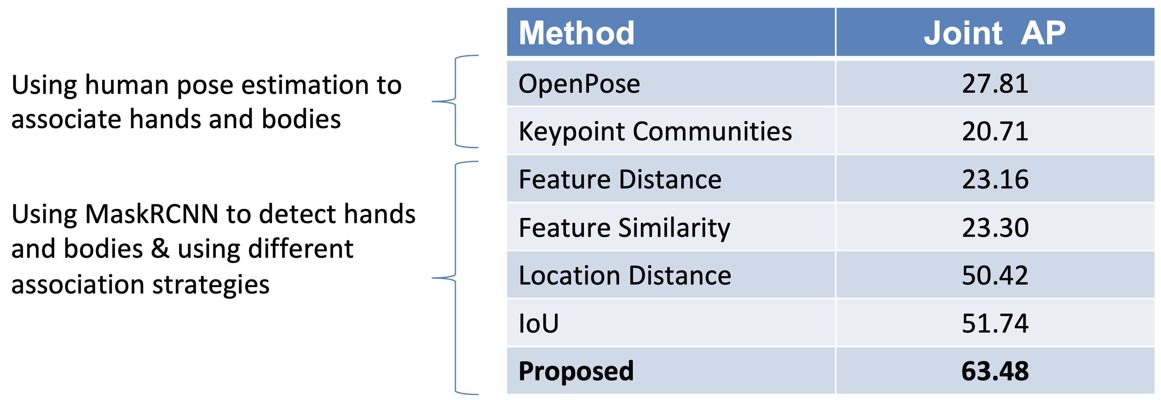

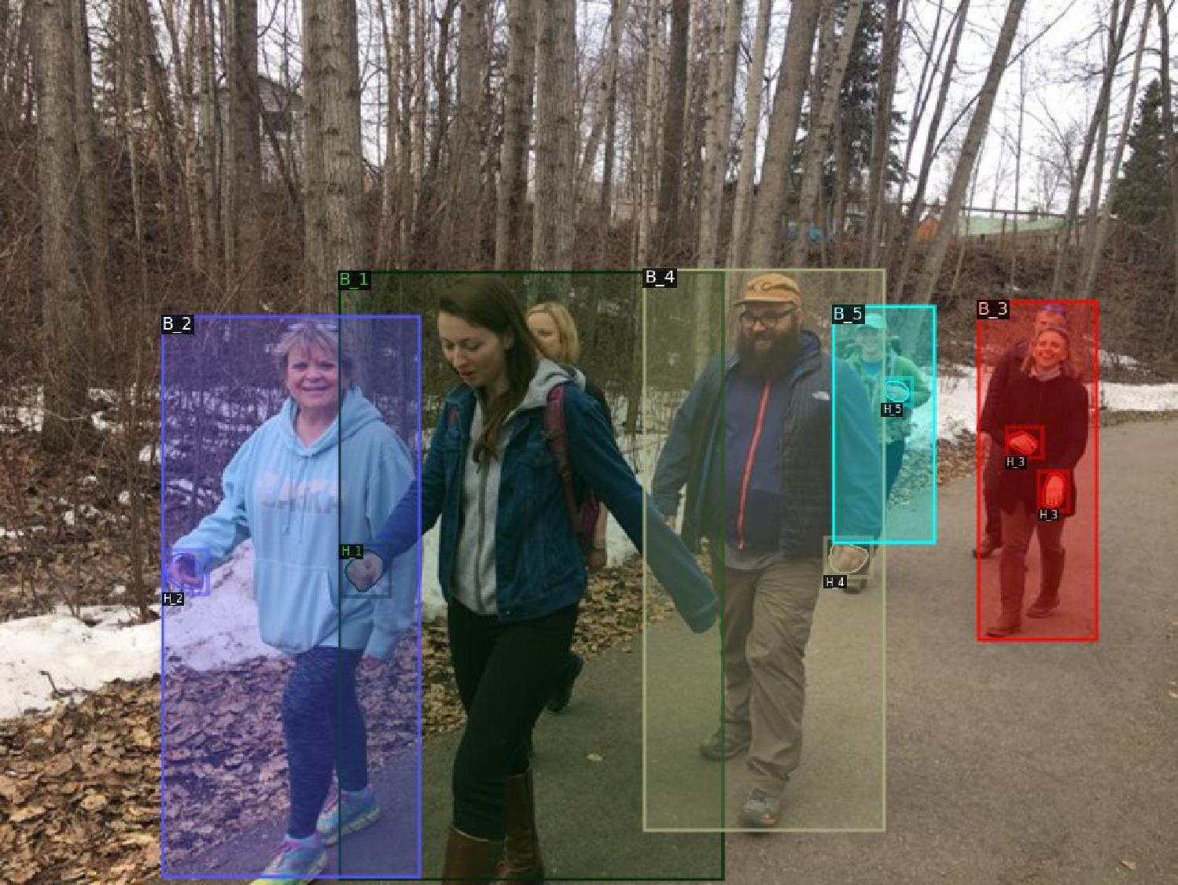
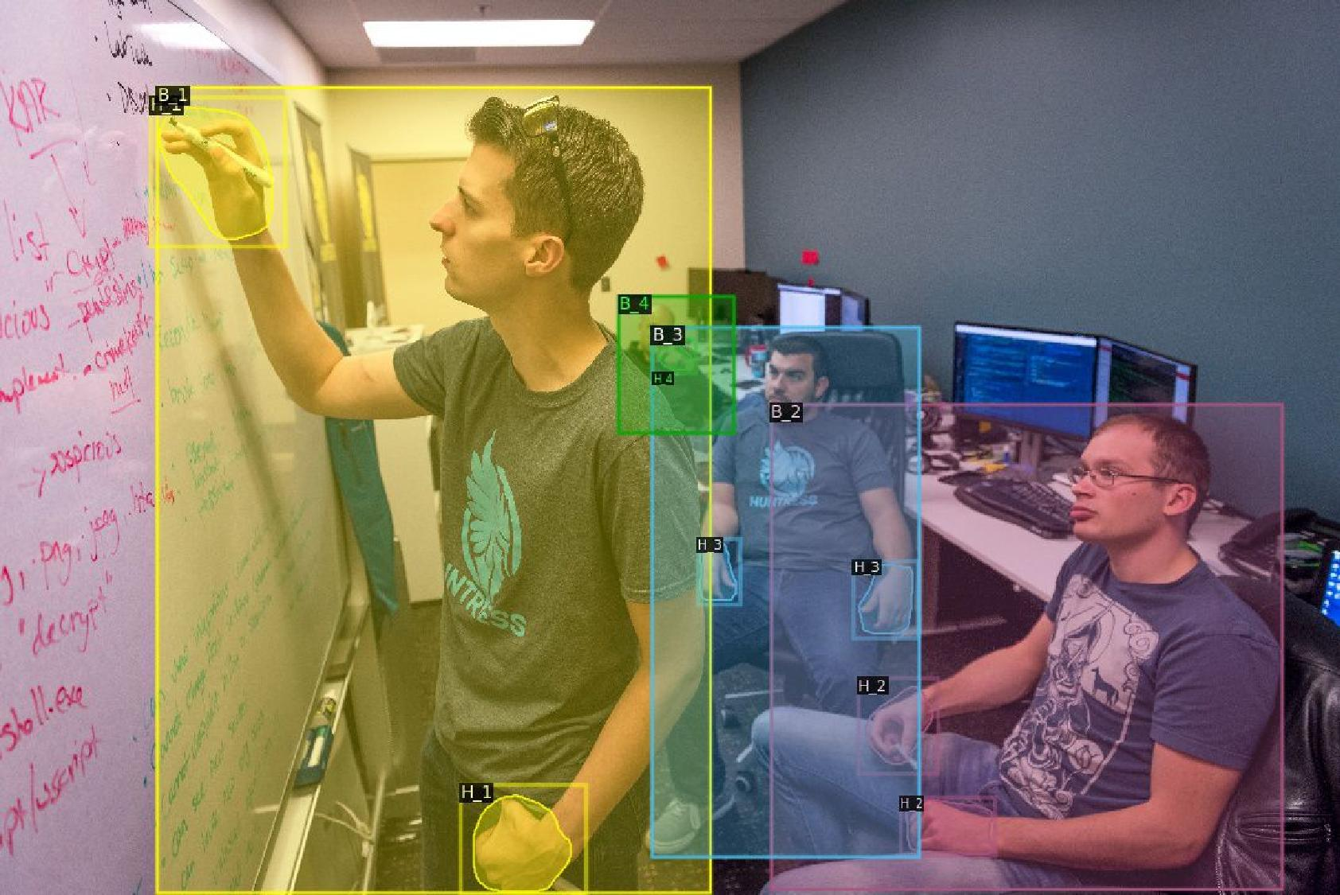

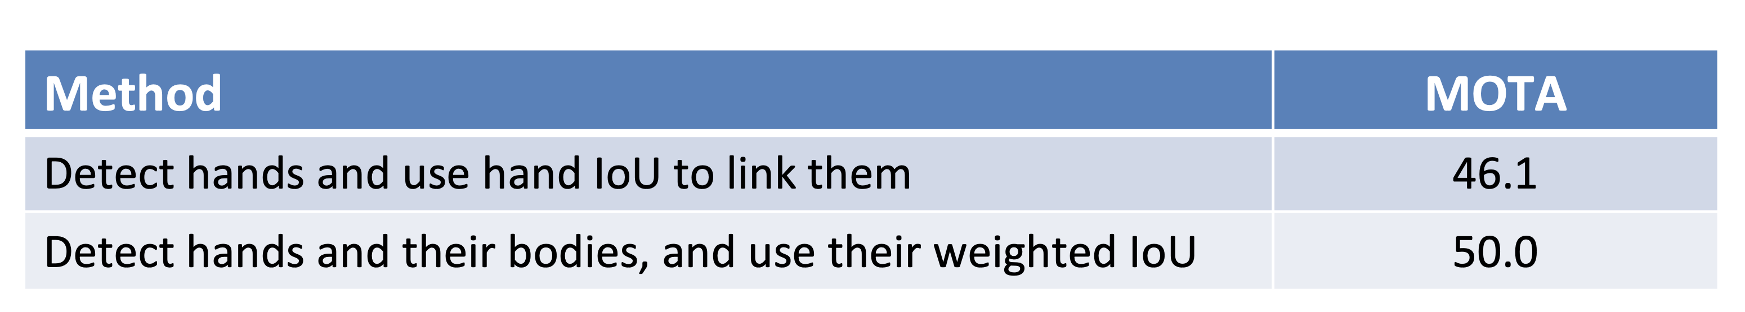
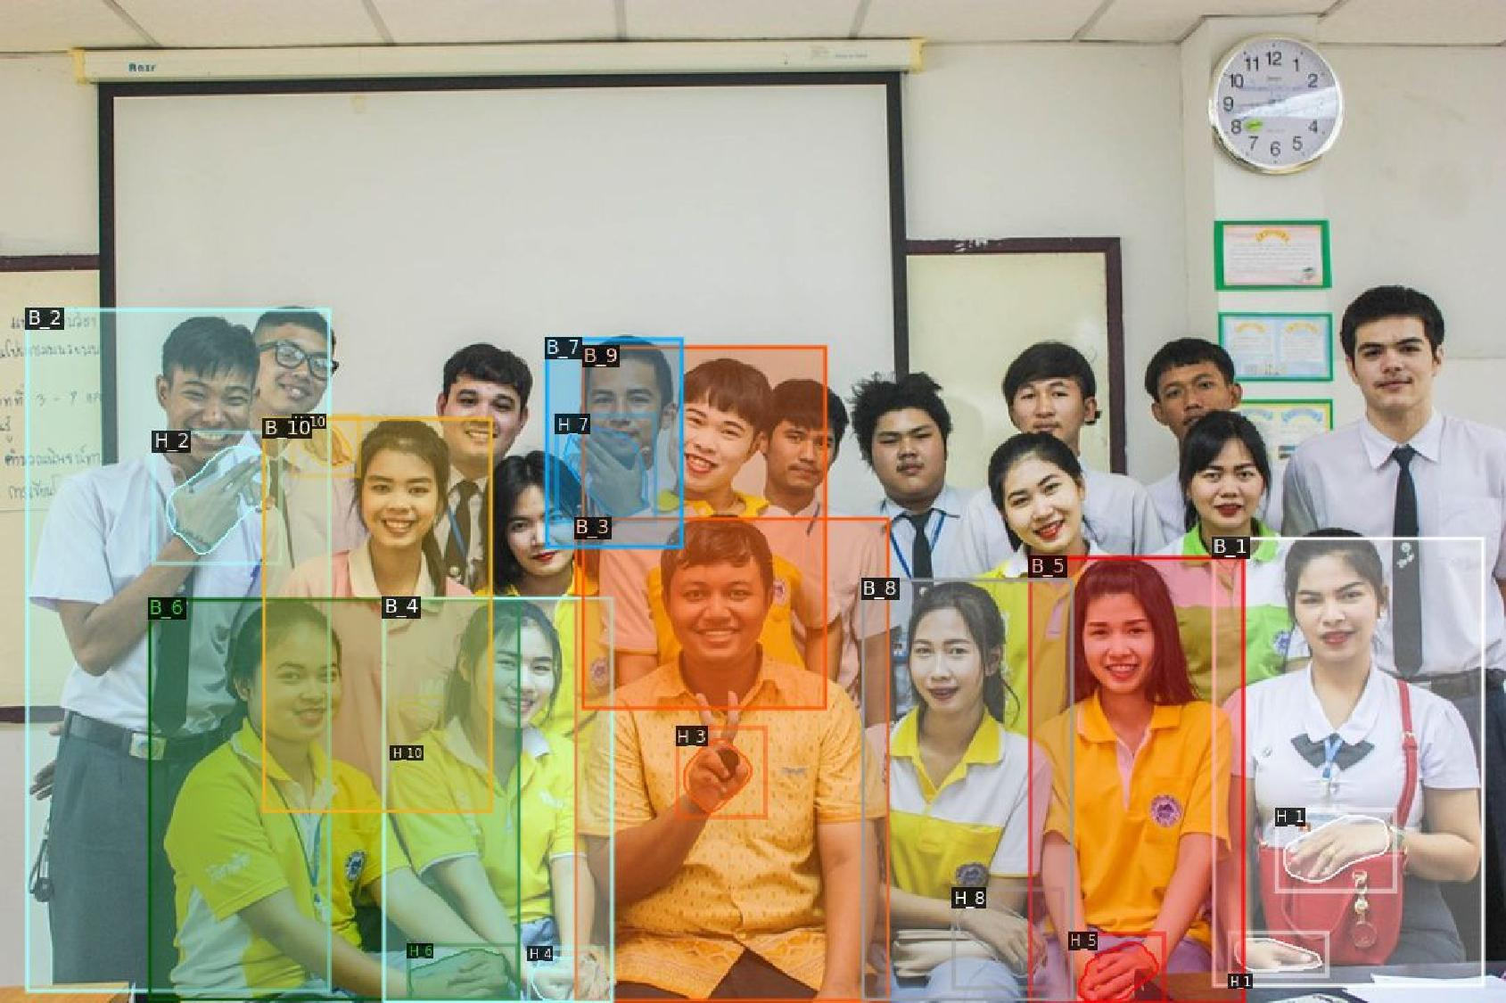
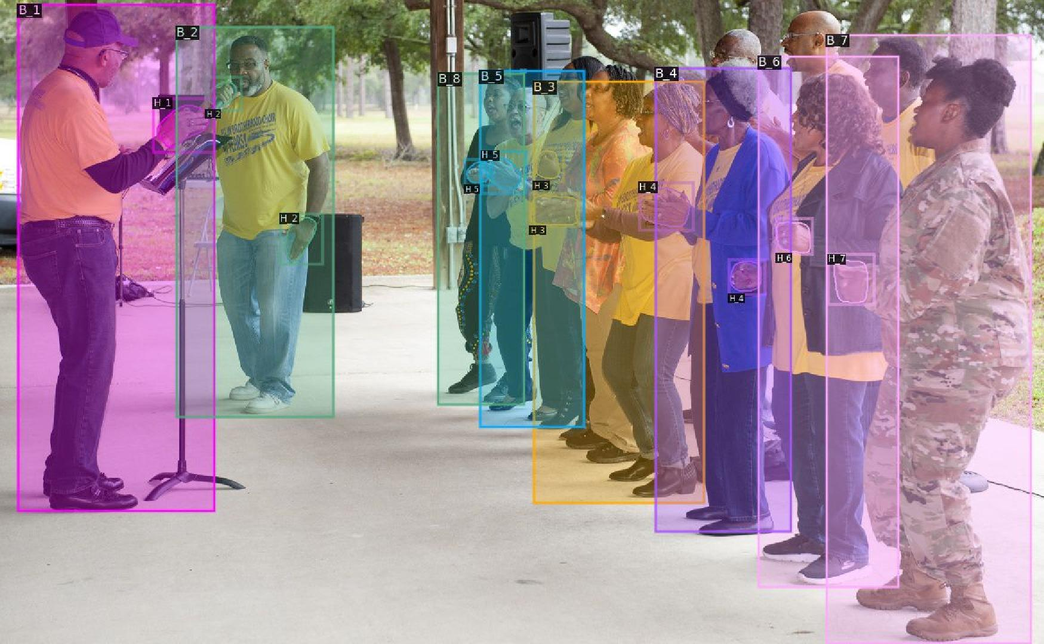
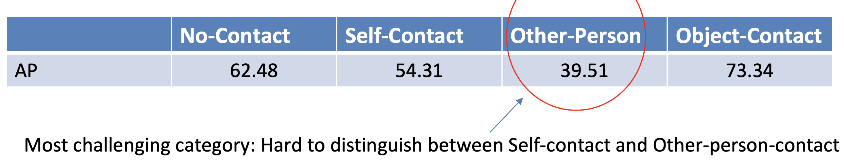
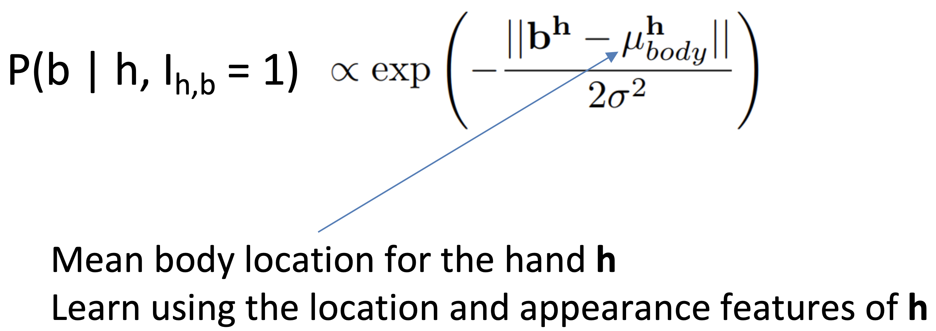
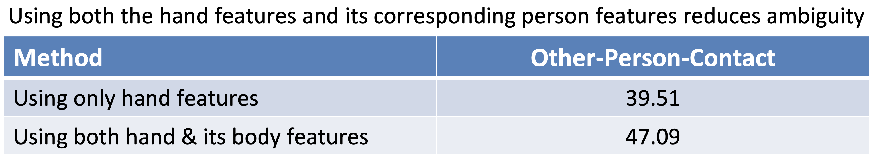
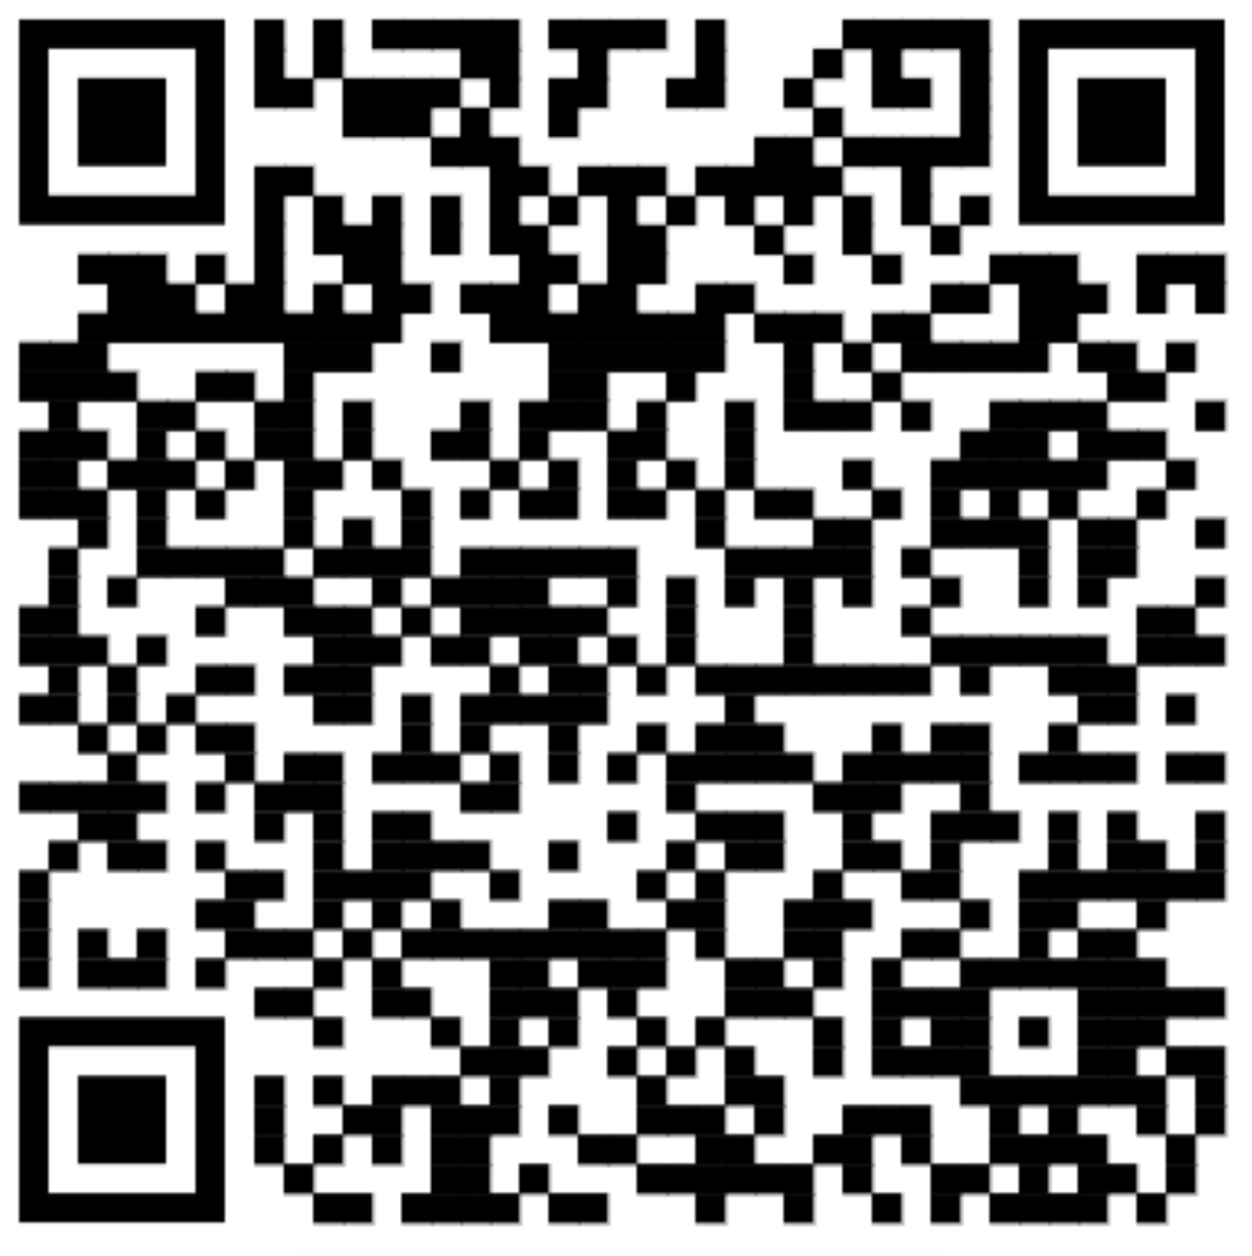
￼
Whose Hands Are These? Hand Detection and Hand-Body Association in the Wild
Supreeth Narasimhaswamy , Thanh Nguyen, Mingzhen Huang, and Minh Hoai
Stony Brook University, VinAI Research, University at Buffalo
Goal
Detect hands
For each detected hand, localize the body of the corresponding person
Challenges
Heuristics based on sizes, distances, overlaps does not work well
Pose-based approaches are not robust
Contributions
An end-to-end trainable CNN architecture to jointly detect hands and their corresponding people
BodyHands dataset: A large-scale dataset containing in-the-wild images with annotations for hand and corresponding person locations
Method
BodyHands Dataset
20K in-the-wild images
Annotations for hand and corresponding person locations
Qualitative Results
Hands and bodies belonging to the same person are visualized in the same color and identification numbers
Association score for hand h and body b
Quantitative Results
Evaluation metric: Joint AP
True positive: both hand and associated body have IoU > 0.5 with ground truth
Hand-Body Association Module
Hand box of one person completely overlaps with body box of another person
Large variation in relative hand-body scales between different people
Benefits of Hand-Body Assoc. : Hand Tracking
Results on YoutubeHands-20 dataset
Overlap Estimation Module
For each hand h and body b, estimate the probability that they overlap: P(I_{h,b} = 1)
Learn using the appearance features of h and b
Poses are not detected for occluded people
Detected skeletons are mixed up between people
Benefits of Hand-Body Assoc. : Hand Contact
Using hand-features to classify contact states:
Positional Density Module
For each detected hand h, estimate the density P(b | h, I_{h,b} = 1) over all bodies b
Hands and bodies belonging to the same person are visualized in the same color and identification numbers
Acknowledgements. This work was partially supported by DARPA PTG HR00112220001 award. The content of the information does not necessarily reflect the position or the policy of the Government, and no official endorsement should be inferred.
Code,
Data

