Slide 1



From Within to Between: Knowledge Distillation for Cross Modality Retrieval
Vinh Tran, Niranjan Balasubramanian, and Minh Hoai
Stony Brook University
Notes:
I am Vinh Tran from Stony Brook University
Our paper is: From within to between: knowledge distillation for cross modality retrieval

Slide 2
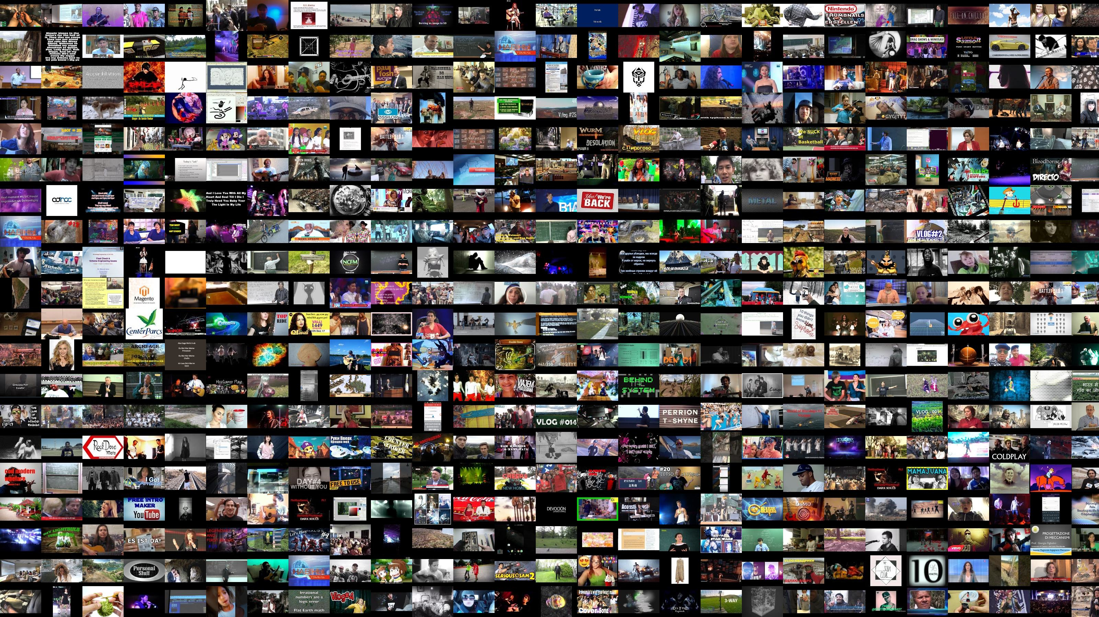
Introduction
Notes:
Videos have become a big part of our lives with hundred of thousands of video hours.
A problem of growing importance is to index and search for videos, based on their content.
This has been a long standing problem in computer vision with many useful applications.

Slide 3
Text Video Retrieval
Notes:
This paper investigates the problem of text-video retrieval two smaller sub problems: text-to-video and video-to-text.

Slide 4
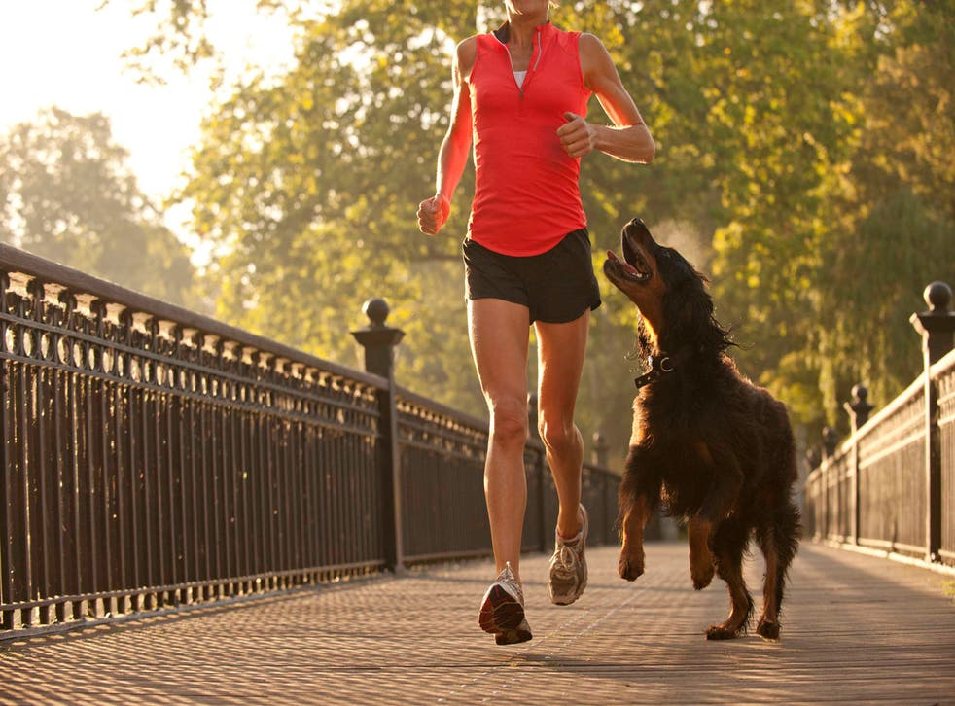
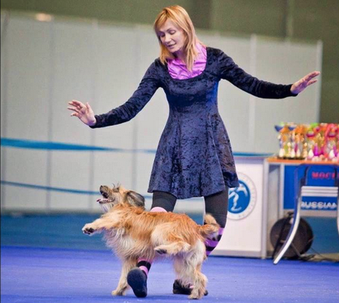
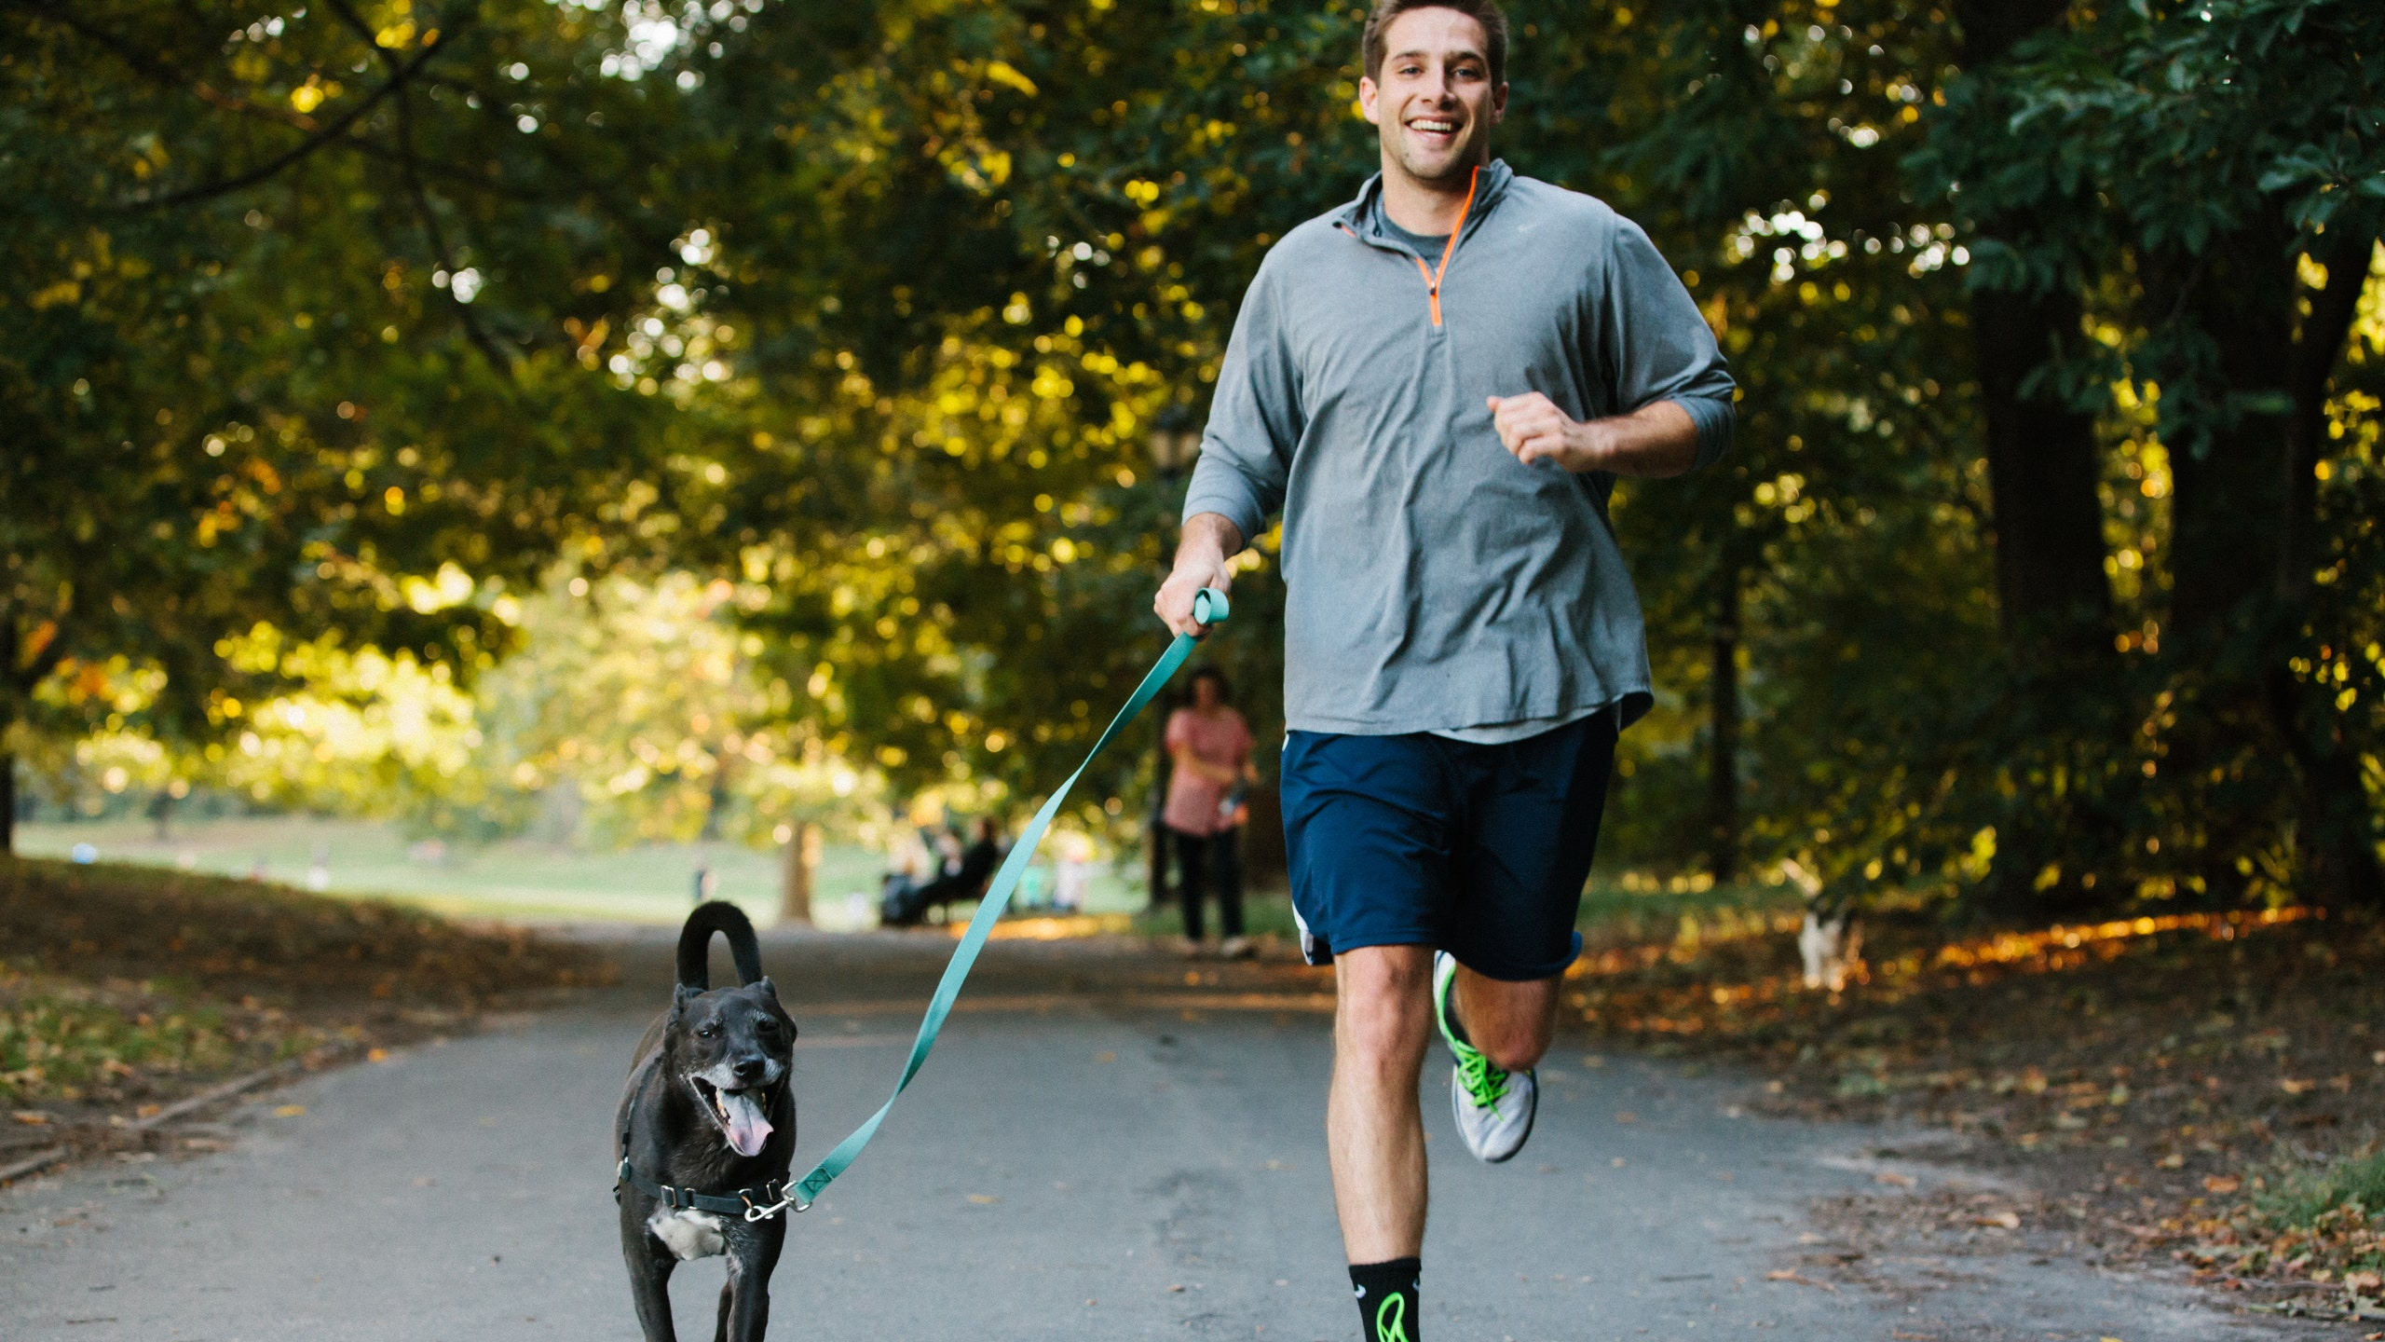
Text Video Retrieval
Text-to-video retrieval
Query:
“A woman is dancing with her dog”
Top retrieved videos:
✗
✓
✗
Notes:
In the former problem, the input is a text query, and the system has to retrieve a list of videos with relevant content

Slide 5

Text Video Retrieval
Text-to-video retrieval
Query:
“A woman is dancing with her dog”
Video-to-text retrieval
Query:
Top retrieved videos:
Top retrieved captions:
✗ A blue sky with an ocean view
✗ Ocean waves hitting the shore
✓ A bird is flying over the open sea
✗ Big wave hit the rocks
✗
✓
✗
Notes:
In the latter, the input is a video, and the system has to rank a list of captions based on how likely it is for the captions to be used to describe the content of the video

Slide 6

Previous Works
Use contrastive learning to learn the compability function s
Video
$${s(c}_{i},v_{j})$$
Caption
Notes:
Text video retrieval can be tackled by projecting text and video into a joint embedding space,
and learning a similarity scoring function for text and video embedding vectors.

Slide 7
Previous Works
Use contrastive learning to learn the compability function s
Video
$${s(c}_{i},v_{j})$$
Caption
Notes:
At test time, the retrieved candidates, either text or video, are ranked based on their similarity with respect to the input query

Slide 8
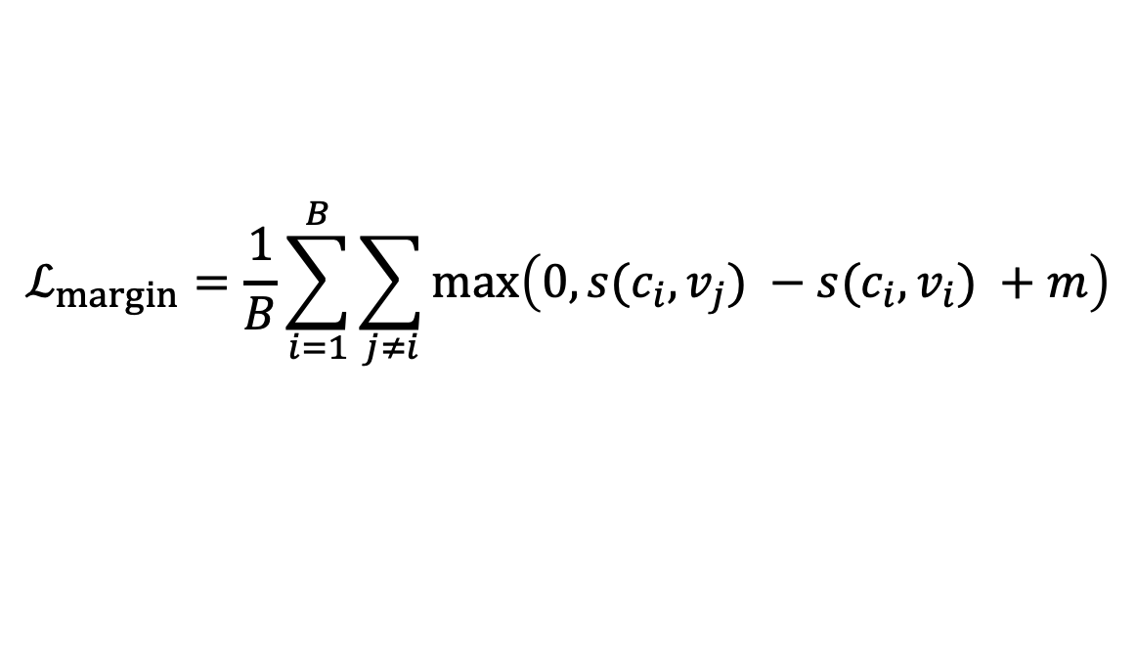
Previous Works
Use contrastive learning to learn the compability function s
Max margin loss (CE, MMT, TeachText):
Video
$${s(c}_{i},v_{j})$$
Caption
$$ℒ_{margin}=\frac{1}{B}\sum_{i=1}^{B}{\sum_{j≠i}{\max\left(0,s(c_{i},v_{j}) −s(c_{i},v_{i}) +m\right)}}$$
Notes:
Existing methods use max-margin loss to separate matching caption-video pairs (called positive pairs) from the non-matching ones (called negative pairs)

Slide 9
Previous Works
Use contrastive learning to learn the compability function s
Max margin loss (CE, MMT, TeachText):
Video
$${s(c}_{i},v_{j})$$
Caption
$$ℒ_{margin}=\frac{1}{B}\sum_{i=1}^{B}{\sum_{j≠i}{\max\left(0,s(c_{i},v_{j}) −s(c_{i},v_{i}) +m\right)}}$$
Negative pair
Positive pair
Notes:
A positive pair is the one where the caption and the video come from the same training data instance. Whereas, a negative caption- video pair consists of a caption and a video from different training instances.

Slide 10
Previous Works
Use contrastive learning to learn the compability function s
Max margin loss (CE, MMT, TeachText):
Video
$${s(c}_{i},v_{j})$$
Caption
Fixed margin
$$ℒ_{margin}=\frac{1}{B}\sum_{i=1}^{B}{\sum_{j≠i}{\max\left(0,s(c_{i},v_{j}) −s(c_{i},v_{i}) +m\right)}}$$
Negative pair
Positive pair
Notes:
One major problem of this approach is that it treats all non-matching pairs the same, demanding a fixed separating margin for all of them.
However, not all non-matching pairs are alike. Two videos with similar captions would become as noisy negative samples.
This severely affects the performance of the learned embedding space and scoring function

Slide 11
Motivation
Similarity in the same domain is more reliable than across domains
Notes:
To address this problem, we propose a complementary loss function that exploits the relationship between data instances in the same domain and distill this knowledge across domains.

Slide 12
Motivation
Similarity in the same domain is more reliable than across domains
Idea 💡 : Knowledge distillation from within domain to between domains
Notes:
This is to use the similarity between captions from different training samples as a guidance for training the compatibility function between captions and videos

Slide 13
Framework
Notes:
Our idea is plugged into any standard text-video retrieval framework with a video encoder and a text encoder.
Each training batch consists of text and video pair, and the caption-to-video similarity is computed between every text and video instances

Slide 14
Framework
Notes:
In the next step, we compute the caption similarity of a given caption to the other captions in an input training batch.
Then, the knowledge from caption-to-caption similarity is distlled to the similarity between the caption-to-video.

Slide 15
Framework
Notes:
likewise, the similarity between videos features can be used as another training signal.

Slide 16
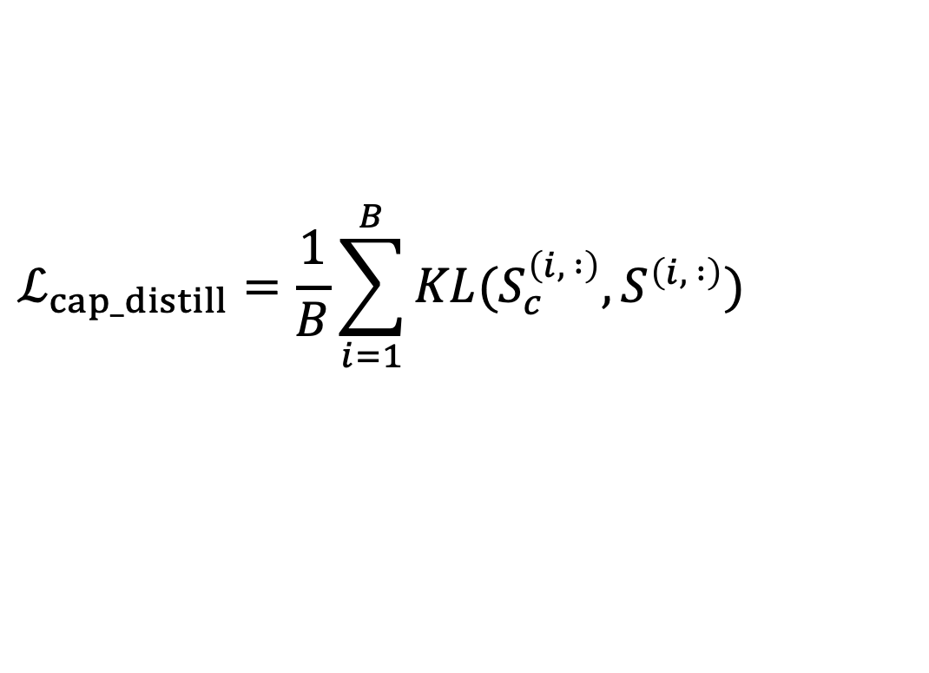
Distillation Loss
Text Distillation
$$ℒ_{cap_distill}=\frac{1}{B}\sum_{i=1}^{B}{KL(S_{c}^{\left(i, :\right)},S^{\left(i, :\right)})}$$
Notes:
Each row of the two similarity matrix is normalized to probability distribution using softmax, and we use the knowledge distillation loss to measure the dissimilarity between the two distributions using Kullback–Leibler divergence

Slide 17
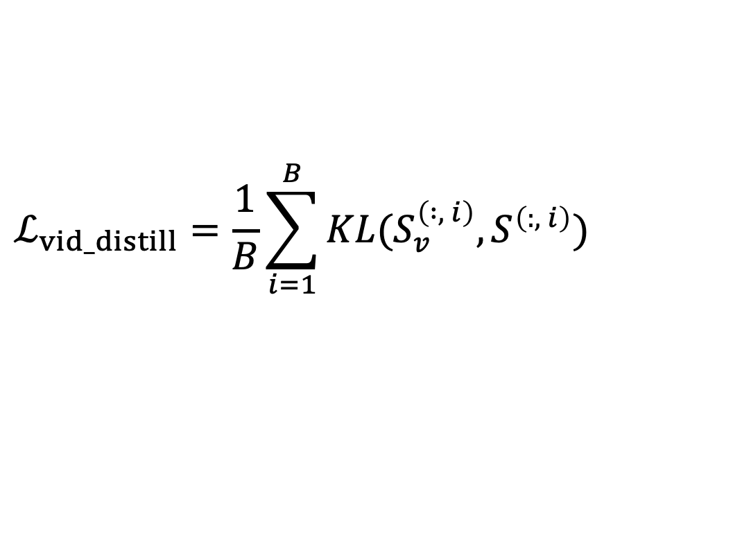
Distillation Loss
Text Distillation
$$ℒ_{cap_distill}=\frac{1}{B}\sum_{i=1}^{B}{KL(S_{c}^{\left(i, :\right)},S^{\left(i, :\right)})}$$
Video Distillation
$$ℒ_{vid_distill}=\frac{1}{B}\sum_{i=1}^{B}{KL(S_{v}^{\left( :, i\right)},S^{\left(:, i\right)})}$$
Notes:
The same operation can be applied on columns for video-to-video distillation

Slide 18
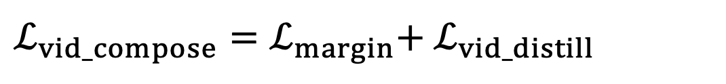
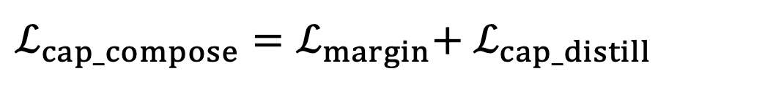
Combined Training Loss
Text Distillation
$ℒ_{cap_compose}=ℒ_{margin}$+ $ℒ_{cap_distill}$
Video Distillation
$ℒ_{vid_compose}=ℒ_{margin}$+ $ℒ_{vid_distill}$
Notes:
We add the two new distillation loss functions to the standard bidirectional max-margin ranking loss for training the compatibility function between a caption and a video.

Slide 19
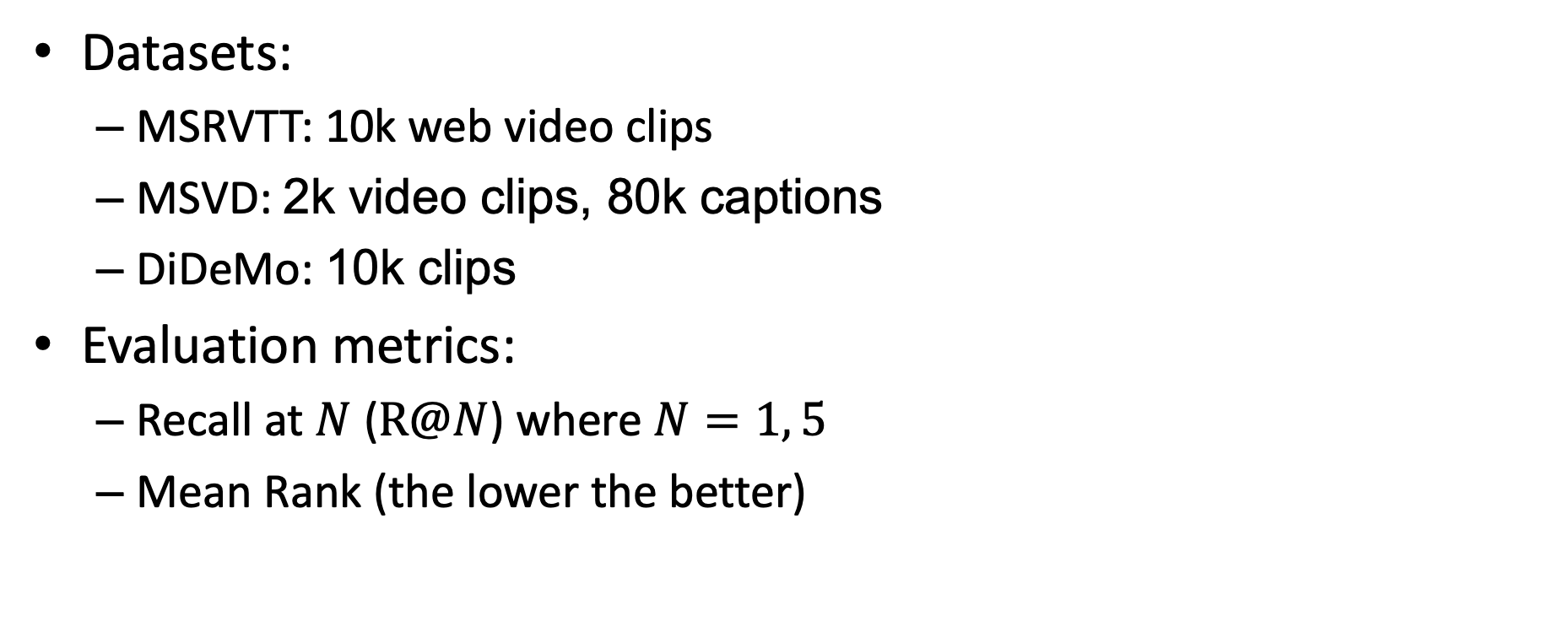
Experimental Results
Datasets:
MSRVTT: 10k web video clips
MSVD: 2k video clips, 80k captions
DiDeMo: 10k clips
Evaluation metrics:
Recall at $N$ ($R@N$) where $N=1, 5$
Mean Rank (the lower the better)
Notes:
We perform experiments on different challenging benchmarks for cross modal text-video retrieval
We report performances on both text-to-video and video-to-text retrieval tasks.
The performance of all models are evaluated with recall at rank N (R@N), a standard retrieval metric.
This metric 1 if the relevant video is within top N of the retrieval results.
Better models should achieve higher recall.
We also report the mean rank of the relevant video. For this metric, the lower the better

Slide 20
Experimental Results
MSRVTT 1k-A
Methods | Rec@1 | Rec@5 | MnR↓
TT-CE+ (2021) | 29.6 | 61.6 | -
Frozen (2021) | 31.0 | 59.5 | -
MDMMT (2021) | 38.9 | 69.0 | 16.5
Clip4clip (2021) | 44.5 | 71.4 | 15.3
Ours | 46.2 | 73.1 | 13.2
Notes:
Using the new loss functions, we significantly improve the retrieval performance on MSRVTT dataset. We are better in both recall and mean rank metrics.

Slide 21
Experimental Results
MSVD
Methods | Rec@1 | Rec@5 | MnR↓
CE+ (2019) | 25.1 | 56.5 | 17.8
TT-CE+ (2021) | 25.1 | 56.8 | 16.8
Frozen (2021) | 33.7 | 64.7 | -
Clip4clip (2021) | 46.2 | 76.1 | 10.0
Ours | 48.8 | 79.2 | 8.7
Notes:
On MSVD dataset the, improvement is similar, where our method beats previous works by a large margin.

Slide 22
Experimental Results
DiDeMo
Methods | Rec@1 | Rec@5 | MnR↓
CE+ (2019) | 18.2 | 43.9 | -
TT-CE+ (2021) | 21.6 | 48.6 | -
Frozen (2021) | 34.6 | 65.0 | -
Clip4clip (2021) | 43.4 | 70.2 | 17.5
Ours* | 43.2 | 69.2 | 17.5
(*We train our model with frozen layers and smaller batch size)
Notes:
For DiDeMo dataset, our method is not better than the current state-of-the-art due to the lack of computational resources to follow the recommended experimental settings.
As explained in the paper, for this dataset, we has to freeze some network layers and use much smaller batch size.
However, the mean rank is comparable to the state-of-the-art

Slide 23
Summary
Notes:
In summary, this paper proposes a novel knowledge distillation framework for cross modality retrieval
The knowledge distillation is either from text or video, and can be easily computed within each training batch.
The method is applicable to any standard text-video retrieval frameworks.
Thank you for listening

