Slide 1


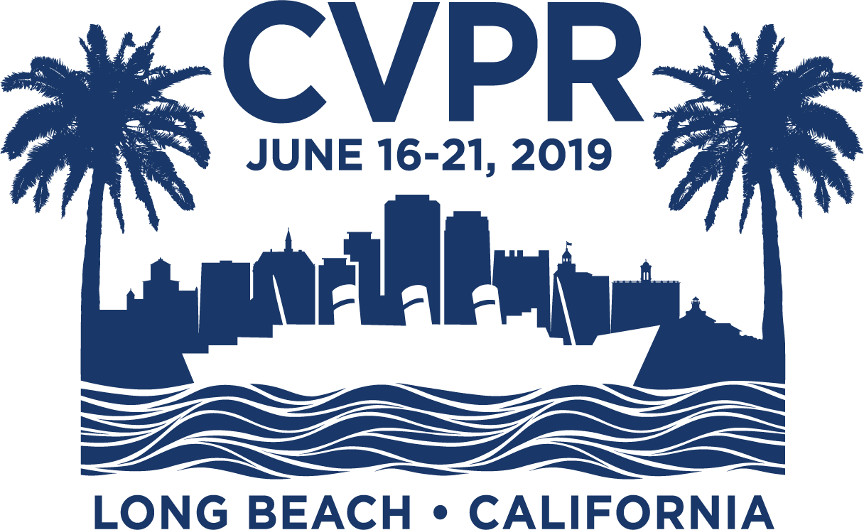


GIF2Video: Color Dequantization and Temporal Interpolation of GIF images
Yang Wang, Haibin Huang, Chuan Wang, Tong He, Jue Wang, Minh Hoai.
Stony Brook University, Megvii Research USA, UCLA.
Motivation
GIF (Graphics Interchange Format) is a highly portable graphics format that is ubiquitous on the Internet
GIFs often have much worse visual quality than their original source videos, due to heavy quantization in the creation process
We propose GIF2Video, the first learning-based method for enhancing the visual quality of GIFs in the wild
GIF Creation & Artifacts
Datasets
GIF-Faces: human face centric;
GIF-Moments: generic & diverse.
Color Dequantization
Quantization ${ G=f}_{𝒞}\left(\hat{I}\right)$ Dequantization ${I=f}_{𝒞}^{−1}\left(G\right)$
  ill-posed problem, as $f_{𝒞}$ is many-to-one mapping, $𝒞$ is the color palette
We seek image $I$: ${\min_{I}{ \left\|I − \hat{I} \right\|}}_{2}^{2}+λ{\left\|f_{𝒞}\left(I\right)−G\right\|}_{2}^{2}$
② is not applicable, because is 0 almost everywhere
We propose CCDNet to iteratively optimize for ②
CCDNet: Compositional Color Dequantization Network
Architecture
Loss
GIF2Video
SuperSlomo [H. Jiang, et al. 2018]
Conclusions
Our method can dramatically enhance the visual quality of input GIFs
and significantly reduce the quantization artifacts
It is beneficial to separately process dithered & non-dithered GIFs
U-Net is an effective building block for CCDNet
It is critical to include the loss defined on the gradient values
Using adversarial loss yields more realistic images
It is beneficial to unfold CCDNet by multiple steps
It is beneficial to embed the quantization process into the CCDNet
Qualitative Results
①
②

