Slide 1




Few-shot Counting and Detection
Thanh Nguyen*, Chau Pham*, Khoi Nguyen, Hoai Nguyen
ECCV 2022
* equal contribution
Notes:
Hello everyone, today, I would like to present our latest work about Few-shot Counting and Detection

Slide 2
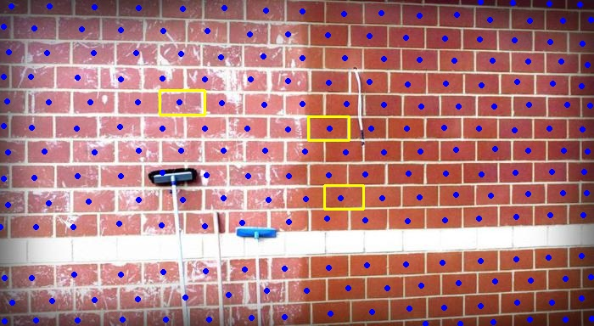
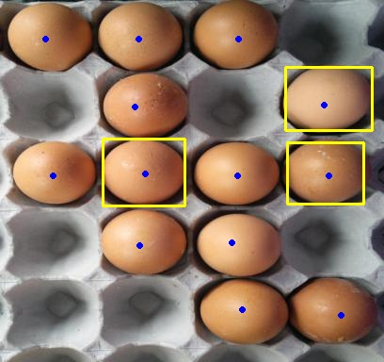
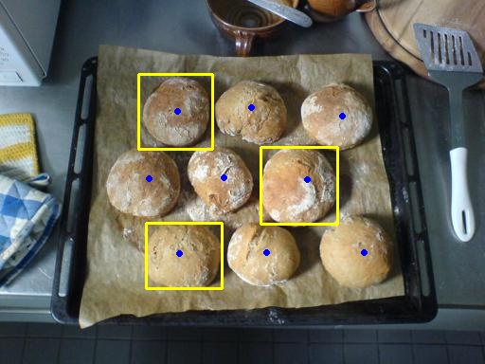
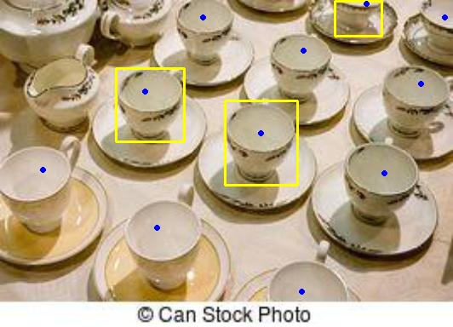
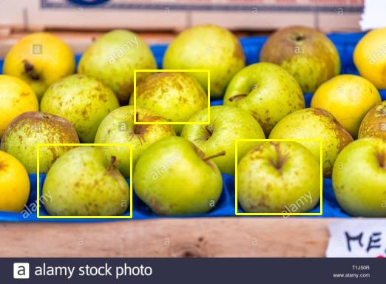
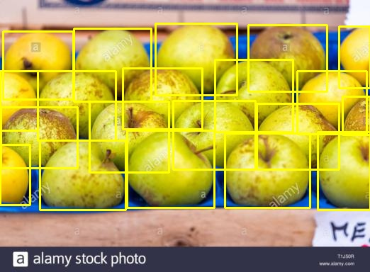
Problem Statement
Training: Images with all dots and few bounding boxes are given
Testing: Given an input image with few box exemplars
==> count and locate all object with the same class with these exemplars
Count: 20
Notes:
First of all, let's talk about the problem statement and the setting we use in this paper. Our work consists of two tasks, we simultaneously detect and count all objects of interest. More specifically, during the training phase, we are given 3 bounding boxes annotations, which we call exemplars, and all dot annotations for remaining objects.
During the testing phase, we are given 3 exemplars. Our task is we need to detect and count all the objects with similar categories as the exemplars.

Slide 3
Applications
Save annotators’ time and effort to annotate object bounding boxes by a few exemplar boxes
Serve as an interpretable tool for validating the counting results by locating all objects counted
Few-shot learning from very few exemplars easily gets overfitted.
Training object detector with the supervision of dot annotation is also very challenging.
Challenges
Notes:
There are two main applications of our work:
- Saving time and effort annotation.
- Serve as an interpretable tool for validating the counting results.
There are several challenges in our setting.
- Few shot learning from few exemplars easily gets overfitted.
- Training object detector with the supervision of dot annotation is also challenging.

Slide 4
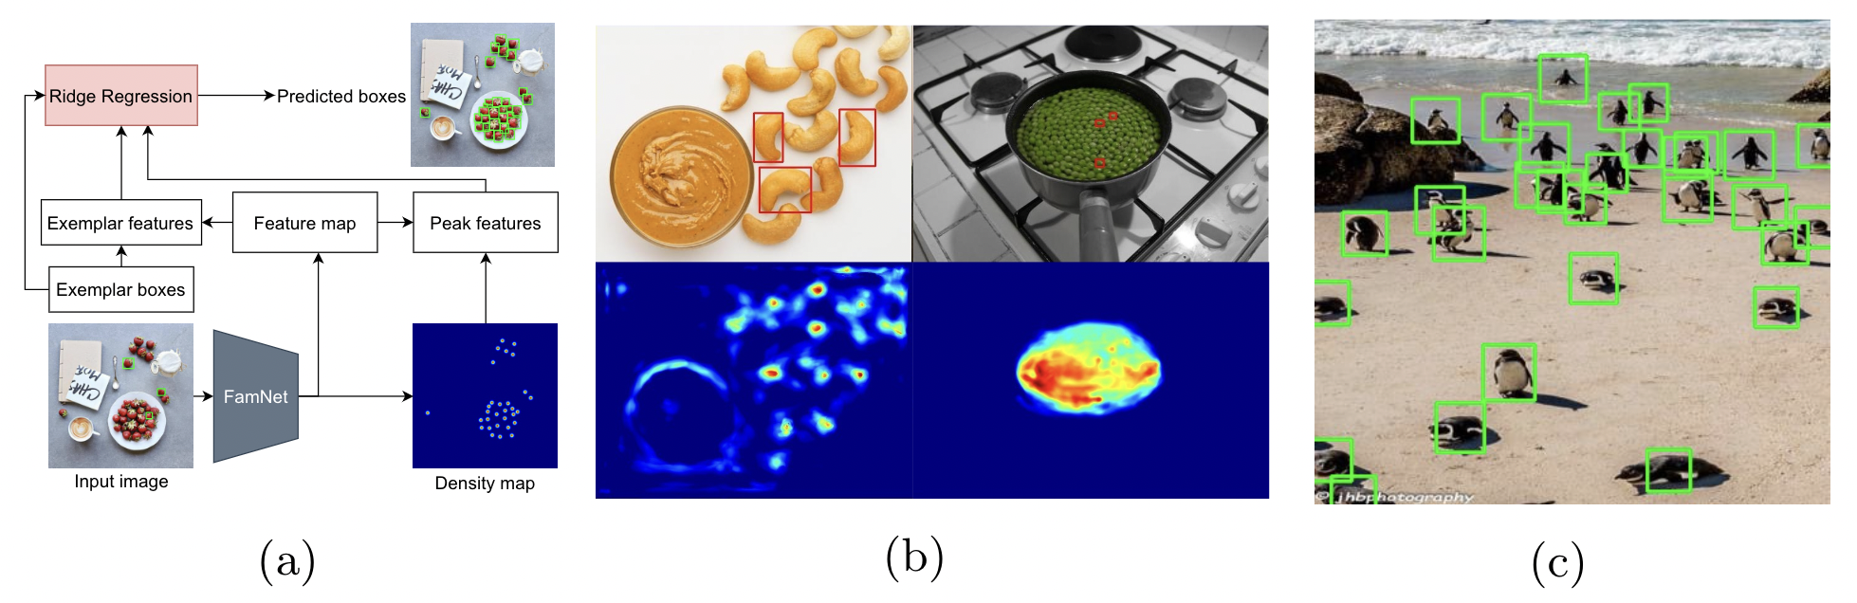
A Baseline based on FamNet [1]
[1] Learning To Count Everything, Viresh Ranjan, Udbhav Sharma, Thu Nguyen and Minh Hoai, CVPR 2021.
Notes:
There are two main applications of our work:
- Saving time and effort annotation.
- Serve as an interpretable tool for validating the counting results.
There are several challenges in our setting.
- Few shot learning from few exemplars easily gets overfitted.
- Training object detector with the supervision of dot annotation is also challenging.

Slide 5
Our Contributions
Introduce a new problem of few-shot object counting and detection (FSCD) and two benchmark datasets:
FSCD-147: manually annotate the bounding boxes for all images of the validation and test sets in the FSC-147 dataset (for few-shot object counting).
FSCD-LVIS: adapted from the LVIS dataset
Propose a new point-based approach, named Counting-DETR, to address the FSCD problem.
Two-stage training strategy: convert to few-shot object detection by generating pseudo bounding boxes from dot annotations
Uncertainty-aware few-shot object detector trained with the pseudo boxes
Notes:
There are two main contributions of our work. The first contribution is introducing a new problem of Few-shot Object Counting and Detection and two benchmark datasets, which are FSCD-147 and FSCD-LVIS. The second contribution is to propose a new point-based approach, which we named Counting-DETR, to address the FSCD problem: We use a two stage-training strategy and an uncertainty-aware loss.

Slide 6
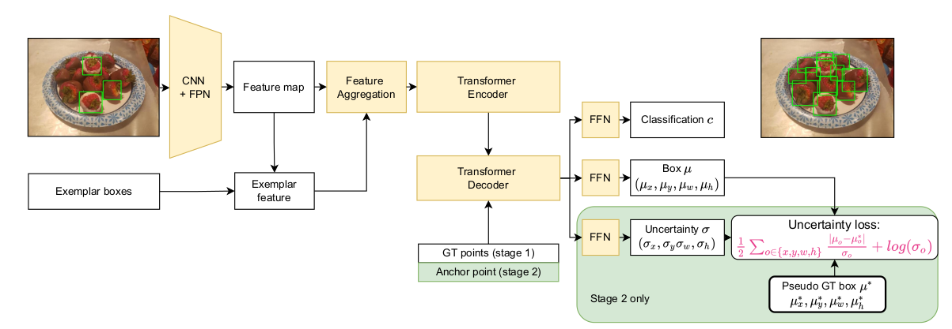
The Architecture of Counting-DETR
Notes:
The overview of our two-step training approach:
Counting-DETR is first trained on a few pairs of dot and bounding boxes and then used to predict pseudo GT boxes for the annotated dots;
Counting-DETR is trained to predict the object bounding boxes, with the prediction target being the pseudo GT boxes from the first stage. Specifically, the input image is first forwarded through a CNN+FPN backbone to extract its feature map. The exemplar features are extracted from their boxes to integrate with the feature map producing the exemplars-integrated feature map. This feature map is then taken as input to the encoder-decoder transformer along with either the annotated dots in the first stage or the anchor points in the second stage for foreground/background classification and bounding box regression. In the second stage, the estimated uncertainty is used to regularize the training with a new uncertainty loss to account for the imperfection of the pseudo GT bounding boxes.

Slide 7





Proposed approach: Uncertainty Loss
Assume predicted size (w, h) follow Laplace distribution:
Ground truth bounding box follow delta Dirac distribution:
Minimize KL divergence between predicted and ground truth distribution:
: estimated size
: standard deviation
: ground truth size

Slide 8
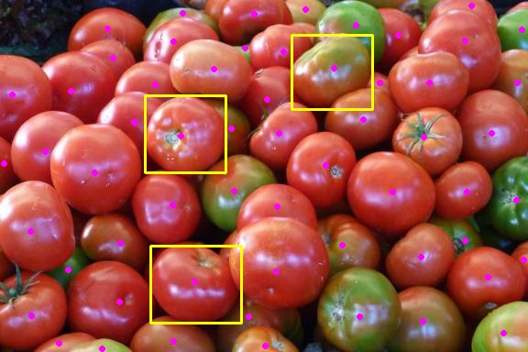
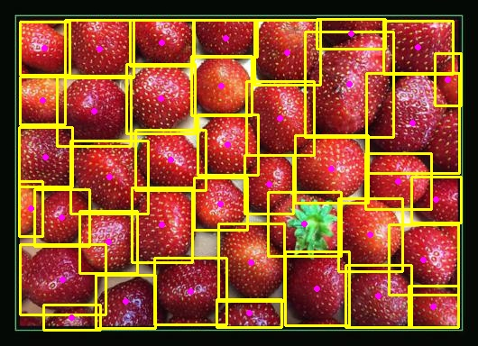
Benchmark - The FSCD-147 Dataset
Split | Number of images | Annotations
Train | 3659 | All dots + a few boxes (already existed)
Val | 1286 | All dots + all boxes (newly annotated)
Test | 1190 | All dots + all boxes (newly annotated)
Train Set
Val + Test Set
Notes:
Here, we show the statistics of FSCD-147 dataset.

Slide 9
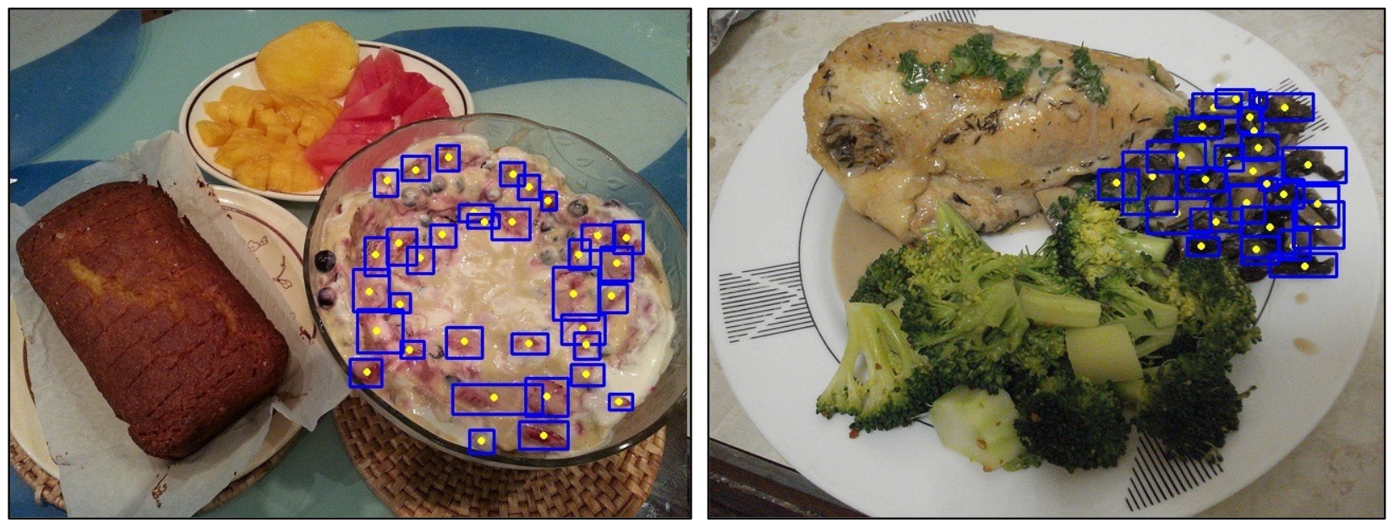
Benchmark: The FSCD-LVIS Dataset
Split | Number of images | Annotations
Train | 4000 | All dots + a few boxes
Validation | 1081 | All dots + all boxes
Test | 1015 | All dots + all boxes
More object classes,
higher variance of object size and shape,
more cluttered scene than those of FSCD-147
Notes:
Example of FSCD-LVIS dataset.
More object classes, higher variance of object size and shape, and more cluttered scene than those of FSCD-147

Slide 10



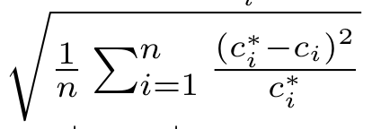
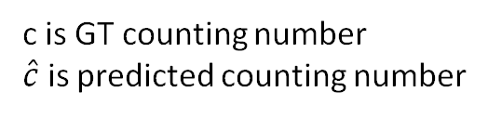
Metrics
For object counting:
Mean Absolute Error (MAE) =
Root Mean Squared Error (RMSE) =
Normalized Absolute Error (NAE) =
Square Relative Error (SRE) =
For object detection:
Average Precision (AP) IoU from 0.5 to 0.95
AP50 with IoU = 0.5
c is GT counting number
$\hat{c}$ is predicted counting number
Notes:
Here is the metric for evaluating the results.

Slide 11
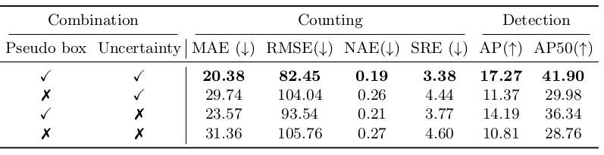
Contribution of each components

Slide 12
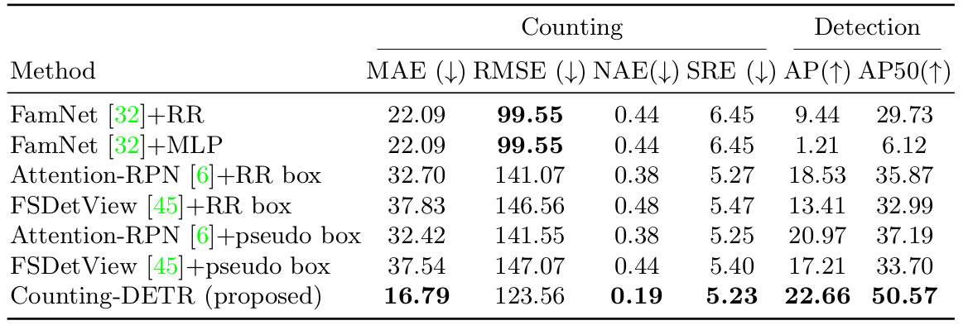
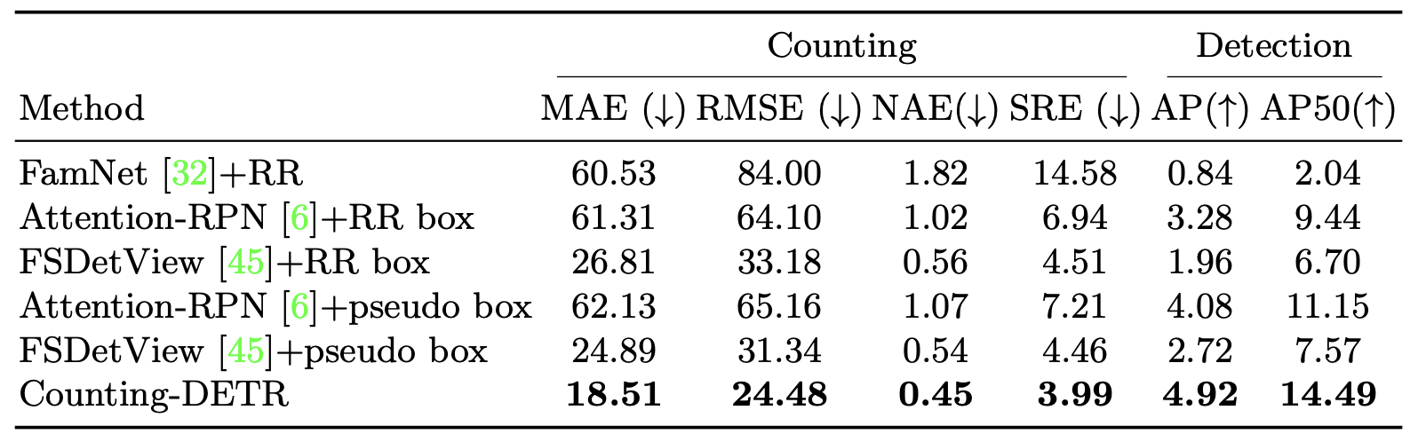
Results on FSCD-147 & FSCD-LVIS test sets
FSCD-147
Our methods outperform other methods in almost every metric
Our methods outperform other methods in all metrics
FSCD-LVIS

Slide 13
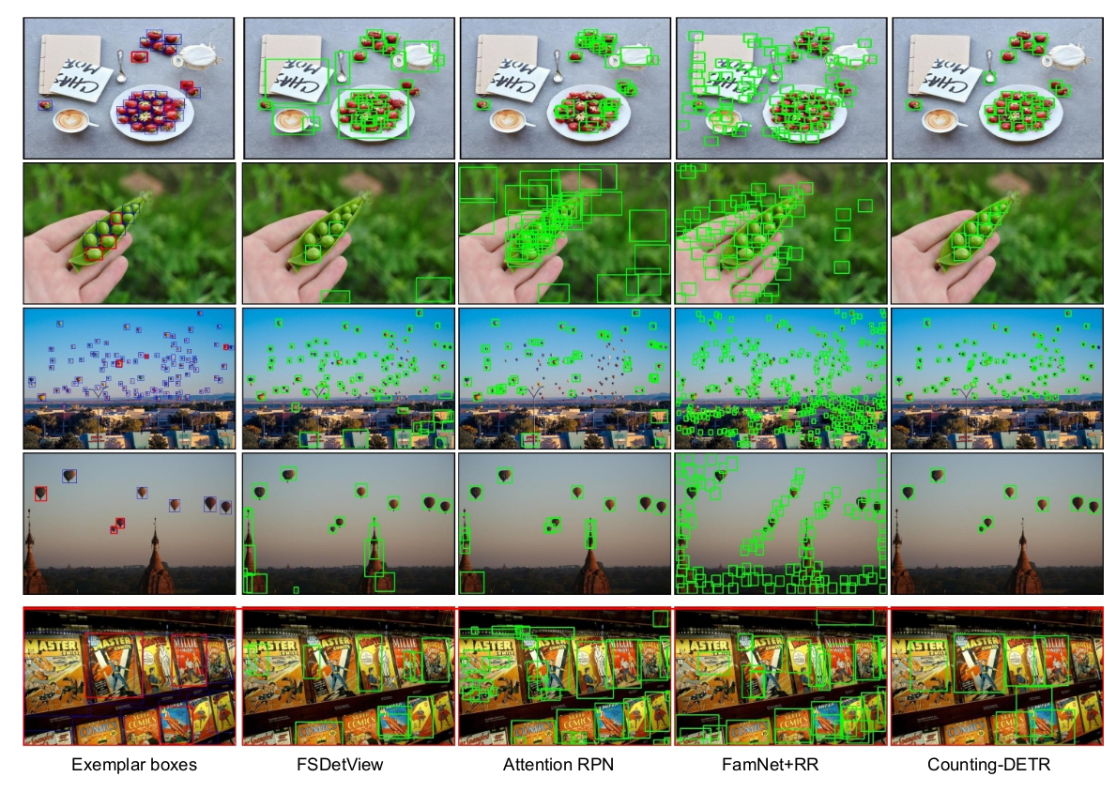
Qualitative Results on FSCD-147
Notes:
Here, we show the qualitative results of FSCD-147 dataset. The first four rows show our superior performance over other methods. In the first row, our method can distinguish the target class and other foreground classes. In the next three rows, exemplar objects either share similar color with the environment or contain many background pixels lead to wrong detection

Slide 14
Thank you!

Slide 15
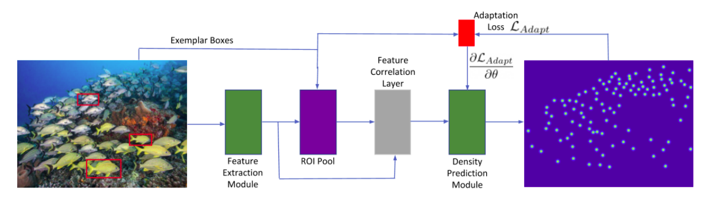
FamNet: a Density-based Approach for Few-shot Counting
FamNet converts dot annotation to a density map (using a Gaussian filter) to train a visual counting network
[1] Viresh Ranjan, Udbhav Sharma, Thu Nguyen, and Minh Hoai. Learning to count everything, CVPR 2021

Slide 16
Results on FSCD-LVIS test set
Our methods outperform other method in all metrics

Slide 17
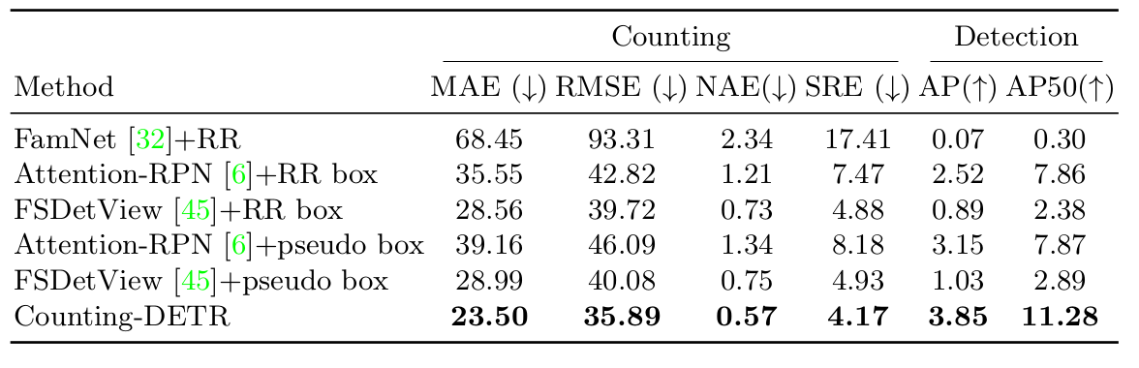
Results on FSCD-147 unseen test set

Slide 18
Introduction
Given an image containing many objects of multiple classes, we seek to count and detect all objects of a target class of interest specified by a few exemplar bounding boxes in the image.
To facilitate few-shot learning, in training, we are only given the supervision of few-shot object counting, i.e., dot annotations for the approximate centers of all objects and a few exemplar bounding boxes for object instances from the target class.
It is worth noting that the test classes may or may not be present in training classes.

Slide 19
Challenges
Few-shot learning from very few exemplars easily gets overfitted.
Training object detector with the supervision of dot annotation is also very challenging.

Slide 20
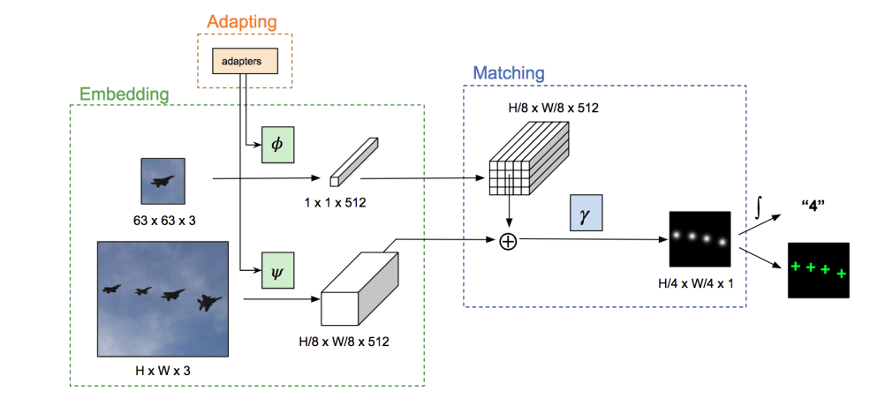
GMN: agnostic counting based on similarity
Generic Matching Network convolutes adapted embedding vector to image feature to count
[2] Erika Lu, Weidi Xie, and Andrew Zisserman. Class-Agnostic Counting, ACCV 2018

Slide 21
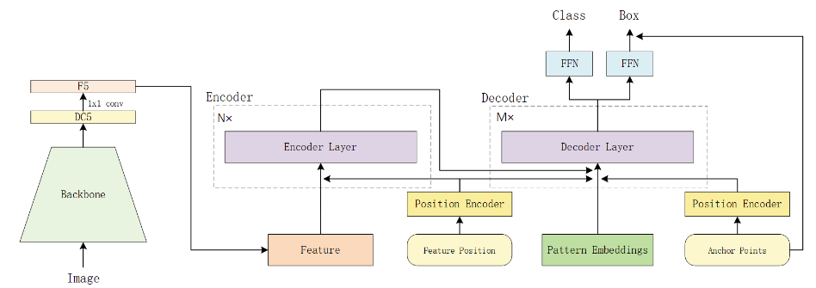
AnchorDETR: anchor-utilized for object detection
AnchorDETR use anchor points to guide where model should focus on, use multiple pattern to detect many object at one position.
[3]Yingming Wang, Xiangyu Zhang, Tong Yang, Jian Sun. Anchor DETR: Query Design for Transformer-Based Object Detection, AAAI 2022

Slide 22
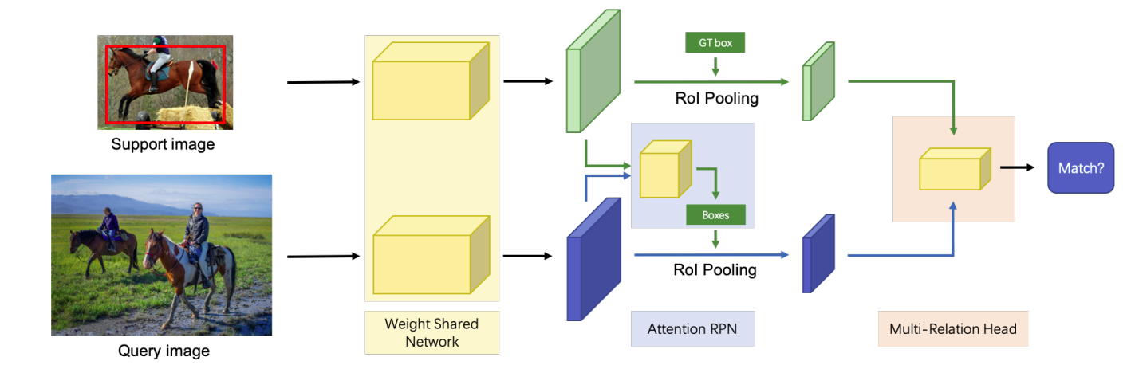
Few-Shot Object Detection with Attention-RPN and Multi-Relation Detector
Attention-RPN use multi relation detector to match support object with query proposals
[4] QiFan, Wei Zhou, Chi Keung Tang, Yu Wing Tai. Few-Shot Object Detection with Attention-RPN and Multi-Relation Detector, CVPR 2020

