Slide 1


Exemplar Free Class Agnostic Counting
  Viresh Ranjan, Minh Hoai
  Stony Brook University
  ACCV 2022

Slide 2
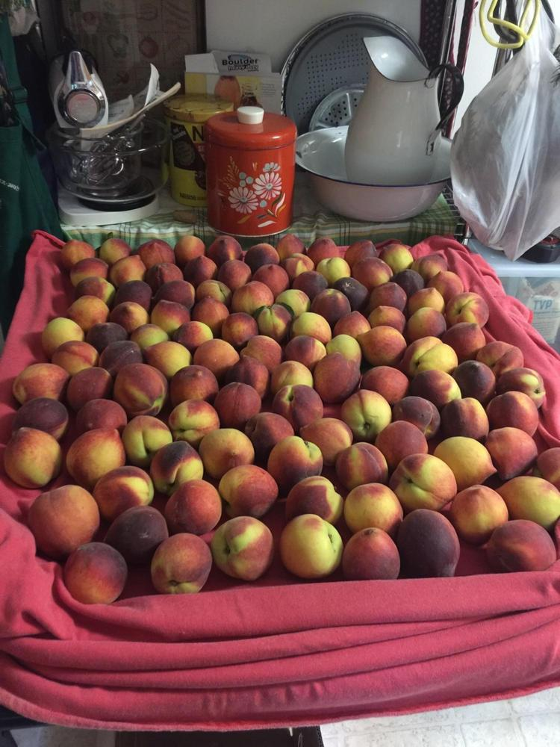

Motivation
Human
Notes:
Here's what the pipeline for any few-shot counter looks like. A human identifies few exemplars from the object category they want to count.

Slide 3
Motivation
Human
Few-Shot Counter
Feature Extraction
Module
Feature Correlation
Module
Density Prediction Module
Exemplar Boxes
Notes:
And the few-shot counter predicts the density map corresponding to the chosen exemplar’s object category.

Slide 4
Motivation
Human
Few-Shot Counter
Cannot work in an automated setting !
Feature Extraction
Module
Feature Correlation
Module
Density Prediction Module
Exemplar Boxes
Notes:
Such a few-shot counter cannot be used in any automated system. Also, such a counter cannot be used for any video applications because it isn’t feasible to annotate exemplars in large number of video frames.

Slide 5
Motivation
Replace the human with a Neural Network
Feature Extraction
Module
Feature Correlation
Module
Density Prediction Module
Exemplar Boxes
Notes:
To address these limitations, We aim to replace the human with a neural network.

Slide 6
Proposed Approach
Exemplar Proposal
Few-Shot Counter
Feature Extraction
Module
Feature Correlation
Module
Density Prediction Module
Exemplar Boxes
Notes:
So our proposed approach will consist of two neural networks: one for proposing the exemplar, and the few shot counter for counting the instances corresponding to the chosen exemplar.

Slide 7
Motivation
Which object to count ?
Feature Extraction
Module
Feature Correlation
Module
Density Prediction Module
Notes:
Now, there could be several object classes in an image, which can create confusion about which category should be picked as the exemplar.

Slide 8
Motivation
Count repetitive objects
Feature Extraction
Module
Feature Correlation
Module
Density Prediction Module
Notes:
In this work, we focus on counting the repetitive objects. We make this choice because humans can count non repetitive objects within a few seconds, and humans usually require the help of a visual counter for the repetitive objects.

Slide 9
Motivation
Count repetitive objects
Feature Extraction
Module
Feature Correlation
Module
Density Prediction Module
Notes:
So We want the chosen exemplar to come from the repetitive object classes in the image.

Slide 10
Motivation
Count repetitive objects
Feature Extraction
Module
Feature Correlation
Module
Density Prediction Module
Notes:
For this image, apple is the only repetitive class. So the chosen exemplar should be an apple, and not bottle or jug present at the top of the image.

Slide 11
Motivation
Count repetitive objects
Feature Extraction
Module
Feature Correlation
Module
Density Prediction Module
Exemplar Boxes
Notes:
Once the exemplar is chosen, the density map can be predicted by the class agnostic counter.

Slide 12
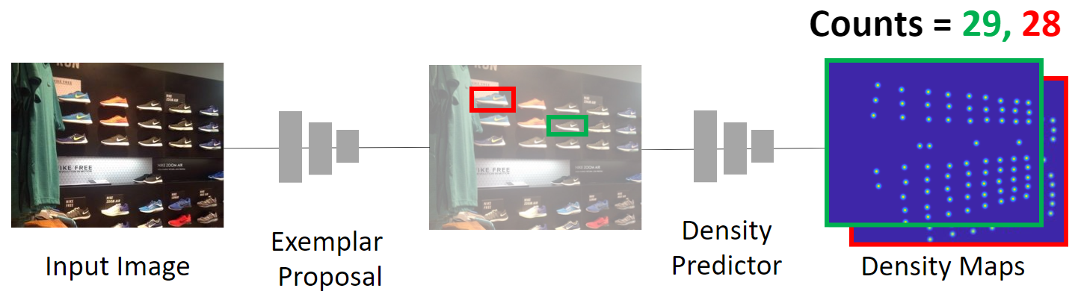
RepRPN-Counter
RepRPN
Class Agnostic Counter

Slide 13
Proposed Approach
Repetitive Region Proposal Network (RepRPN)
Bounding Box
Objectness Score
Repetition Score

Slide 14
Proposed Approach
Repetitive Region Proposal Network (RepRPN)
Sorted Proposals
Proposal₁
Proposal₂
Proposal₃
Class Agnostic Counter
Proposal₁₀₀₀

Slide 15
Experiments
Dataset: FSC147
Top-k version Mean Absolute Error (MAE) and Root Mean Square Error (RMSE)
Notes:
We conduct the experiments on our FSC147 dataset, and use the Top-k version of MAE and RMSE metrics for evaluation. I will briefly describe our topk metric.

Slide 16
Experiments
Dataset: FSC147
Top-k version Mean Absolute Error (MAE) and Root Mean Square Error (RMSE)
Notes:
Each image in the dataset comes with annotations for only one class, and using our Top-K metrics ensures that we use the predictions corresponding to the correct class for computing the MAE and RMSE metrics.

Slide 17
Experiments
Dataset: FSC147
Top-k version Mean Absolute Error (MAE) and Root Mean Square Error (RMSE)
Proposal Method | Method | MAE
 |  | Top-1 | Top-3 | Top-5
RPN [1] | GMN [2] | 43.35 | 39.72 | 37.86
RPN [1] | MAML [3] | 37.88 | 33.27 | 31.47
RPN [1] | FamNet | 35.81 | 33.32 | 32.27
[1]Ren et al, Faster r-cnn: Towards real-time object detection with region proposal networks, NeurIPS, 2015
[2] Lu et al, Class Agnostic Counting, ACCV 2018
[3]Finn et al, Model agnostic meta-learning for fast adaptation of deep networks, ICML, 2017

Slide 18
Experiments
Dataset: FSC147
Top-k version Mean Absolute Error (MAE) and Root Mean Square Error (RMSE)
Proposal Method | Method | MAE
 |  | Top-1 | Top-3 | Top-5
RPN [1] | GMN [2] | 43.35 | 39.72 | 37.86
RPN [1] | MAML [3] | 37.88 | 33.27 | 31.47
RPN [1] | FamNet | 35.81 | 33.32 | 32.27
RepRPN (Proposed) | RepRPN-Counter (Proposed) | 28.32 | 27.45 | 26.66
[1]Ren et al, Faster r-cnn: Towards real-time object detection with region proposal networks, NeurIPS, 2015
[2] Lu et al, Class Agnostic Counting, ACCV 2018
[3]Finn et al, Model agnostic meta-learning for fast adaptation of deep networks, ICML, 2017

Slide 19
Experiments
Dataset: FSC147
Top-k version Mean Absolute Error (MAE) and Root Mean Square Error (RMSE)
Proposal Method | Method | MAE |  |  | RMSE
 |  | Top-1 | Top-3 | Top-5 | Top-1 | Top-3 | Top-5
RPN [1] | GMN [2] | 43.35 | 39.72 | 37.86 | 145.34 | 142.81 | 141.39
RPN [1] | MAML [3] | 37.88 | 33.27 | 31.47 | 133.89 | 131.00 | 129.31
RPN [1] | FamNet | 35.81 | 33.32 | 32.27 | 133.57 | 132.52 | 131.46
RepRPN (Proposed) | RepRPN-Counter (Proposed) | 28.32 | 27.45 | 26.66 | 128.76 | 129.69 | 129.11
[1]Ren et al, Faster r-cnn: Towards real-time object detection with region proposal networks, NeurIPS, 2015
[2] Lu et al, Class Agnostic Counting, ACCV 2018
[3]Finn et al, Model agnostic meta-learning for fast adaptation of deep networks, ICML, 2017

Slide 20
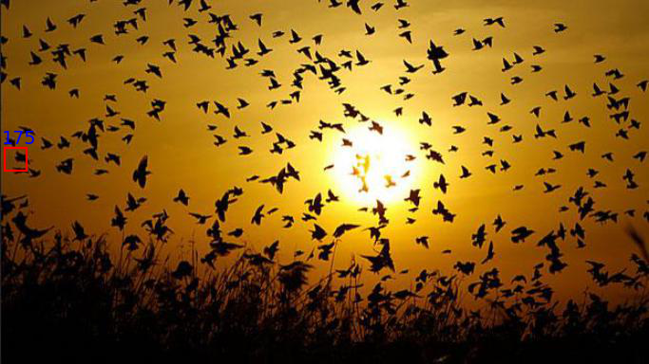
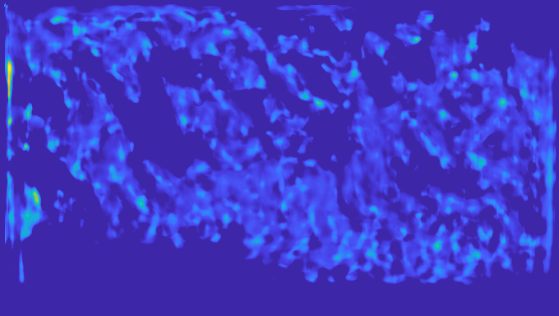
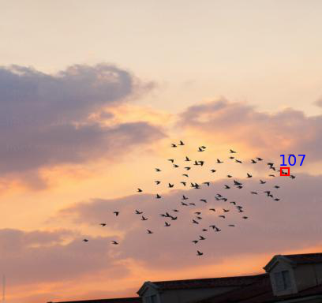
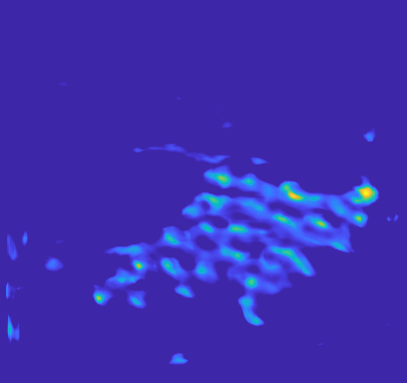
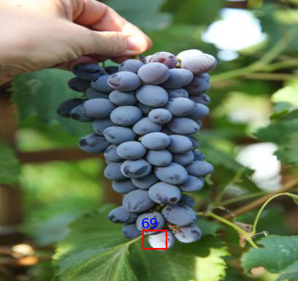
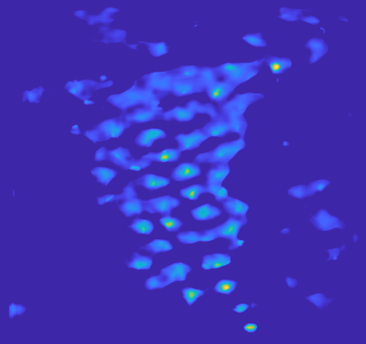


Experiments
GT Count: 298
Rep: 175, Pred: 331
GT Count: 83
Rep: 107, Pred: 83
GT Count: 55
Rep: 69, Pred: 61
GT Count: 206
Rep: 31, Pred: 10

Slide 21
Thank you !

