Slide 1


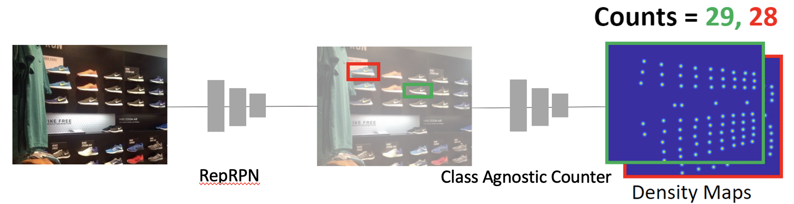
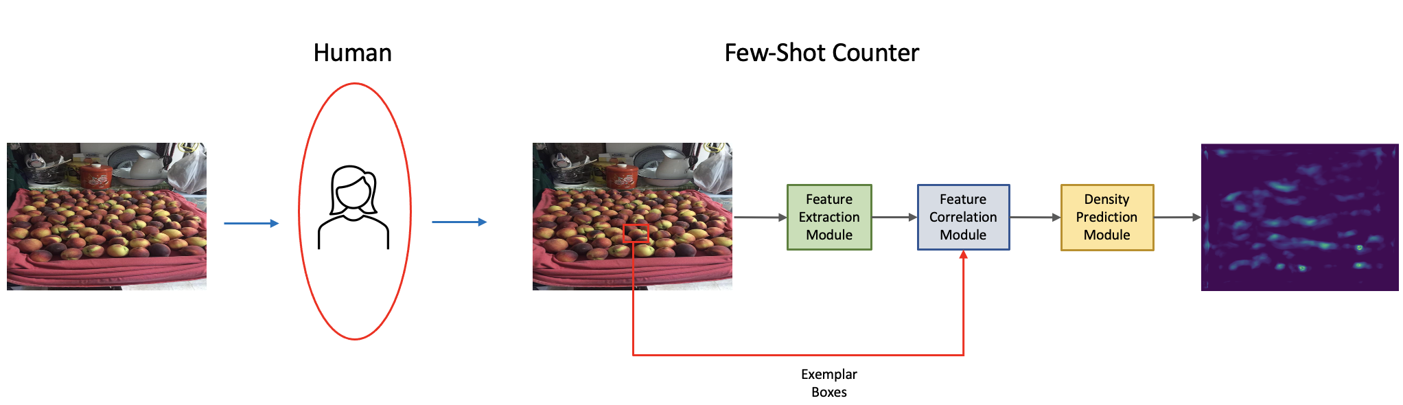

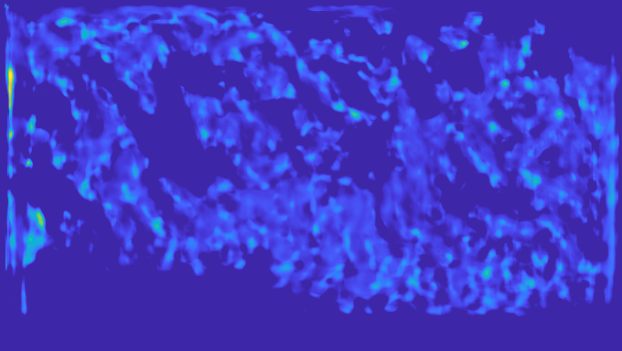
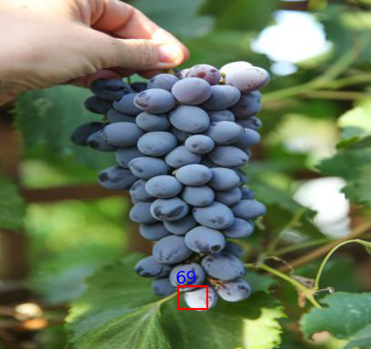
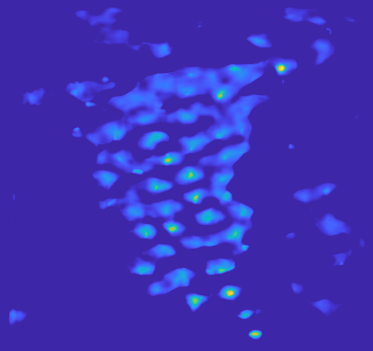
Exemplar Free Class Agnostic Counting
Viresh Ranjan¹, Minh Hoai^{1,2}
¹Department of Computer Science, Stony Brook University
²VinAI Research, Vietnam
Introduction
Proposed Approach
Results
Typical Few Shot Counting approach [1]
  Input: image with novel objects, goal is to count the novel object.
  Human user selects few exemplars depicting the object of interest to be counted.
  Output: density map for the object of interest.
  Count is obtained by integrating across the density map.
We report results on Val set of FSC-147 dataset[1]. Please see paper for more results and details.
Evaluation metrics
  Top-k version of Mean Absolute Error (MAE) and Root Mean Squared Error (RMSE).
Proposal Method | Method | MAE |  |  | RMSE
 |  | Top-1 | Top-3 | Top-5 | Top-1 | Top-3 | Top-5
RPN [4] | GMN [2] | 43.35 | 39.72 | 37.86 | 145.34 | 142.81 | 141.39
RPN [4] | MAML [3] | 37.88 | 33.27 | 31.47 | 133.89 | 131.00 | 129.31
RPN [4] | FamNet [1] | 35.81 | 33.32 | 32.27 | 133.57 | 132.52 | 131.46
RepRPN (Proposed) | RepRPN-Counter (Proposed) | 28.32 | 27.45 | 26.66 | 128.76 | 129.69 | 129.11
Our proposed RepRPN-Counter consists of two key components: 1) a novel region proposal network called Repetitive Region Proposal Network (RepRPN), 2) a Class Agnostic Counter.
RepRPN
  RepRPN automatically identifies exemplars from the repetitive categories in the image.
  Predicts a repetitiveness score for each of the object proposals, and picks proposals with high repetitiveness scores as exemplars.
Class Agnostic Counter
  Predicts a separate density map for each of the exemplars chosen by RepRPN.
RepRPN-Counter is trained in two stage. We first train RepRPN to identify exemplars, and then train the Class Agnostic Counter to predict the density map for the exemplars.
Below we show few images, exemplar identified by RepRPN, and the predicted density map
Limitations of existing few-shot counters
  Require a human to provide exemplars corresponding to the object of interest.
  Cannot work in fully automated settings.
To address this limitation, we propose Repetitive Region Proposal Network based Counter (RepRPN-Counter), an exemplar free class agnostic counter which does not require a human to provide exemplars from the novel categories.
GT Count: 298
Pred: 331
GT Count: 55
Pred: 61
References
[1] V. Ranjan, Udbhav, Thu Nguyen, Minh Hoai, Learning to Count Everything, CVPR 2021
[2] Erika Lu, Weidi Xie, and Andrew Zisserman. Class-agnostic counting, ACCV 2018
[3] Chelsea Finn, Pieter Abbeel, and Sergey Levine. Model-agnostic meta-learning for fast adaptation of deep networks, ICML 2017
[4] Ren et al, Faster r-cnn: Towards real-time object detection with region proposal networks, NeurIPS, 2015

