Slide 1


Characterizing Learners’ Complex Attentional States During Online Multimedia Learning
Using Eye-tracking, Egocentric Camera, Webcam, and Retrospective recalls
Prasanth Chandran¹, Yifeng Huang², Jeremy Munsell³, Brian Howatt¹, Brayden Wallace¹, Lindsey Wilson¹, Sidney D’Mello, Minh Hoai², N. Sanjay Rebello³
Lester C Loschky¹
1 Kansas State University, 2 SUNY Stonybrook, 3 Purdue University
Supported by:
National Science Foundation under grant numbers 2100071, 2055406 & 2100218
The Cognitive and Neurobiological Approaches to Plasticity (CNAP)
Center of Biomedical Research Excellence (COBRE) of the National Institutes of Health
under grant number P20GM113109.

Slide 2


Slide 3

Notes:
However, there is a big problem with online learning
Unlike in face-to-face learning, teachers have no idea of their students’ attentional state
You cannot easily tell who is paying attention, and who is not. In the classroom, this is easier to do.

Slide 4

Notes:
However, there is a big problem with online learning
Unlike in face-to-face learning, teachers have no idea of their students’ attentional state
You cannot easily tell who is paying attention, and who is not. In the classroom, this is easier to do.

Slide 5
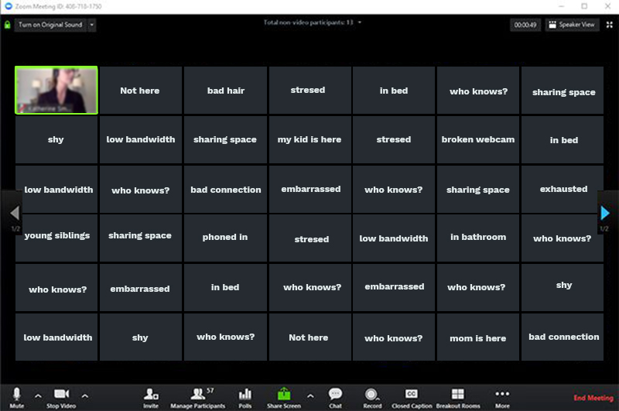
https://phspawprint.org/587/news/black-muted-boxes-create-disconnect-within-virtual-learning-classrooms/
Notes:
However, there is a big problem with online learning
Unlike in face-to-face learning, teachers have no idea of their students’ attentional state
You cannot easily tell who is paying attention, and who is not. In the classroom, this is easier to do.

Slide 6
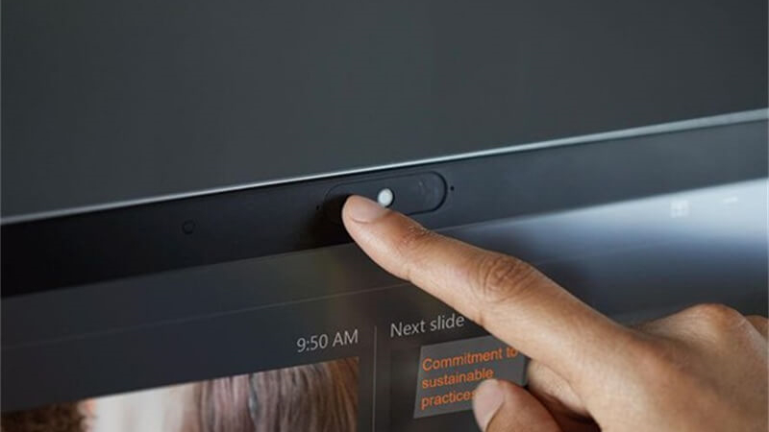

Slide 7

Notes:
Conversely, online learning can provide far more information about students’ attentional states than could ever be possible in the classroom.
Laptops have webcams that can capture facial expressions, and even track users’ eyes.
Use of a mouse also provides useful information (what was clicked, etc.)
…and mice
All of that information:
produces recordable data
And:
can be analyzed using machine learning
to try to infer the student’s attentional and cognitive states.

Slide 8
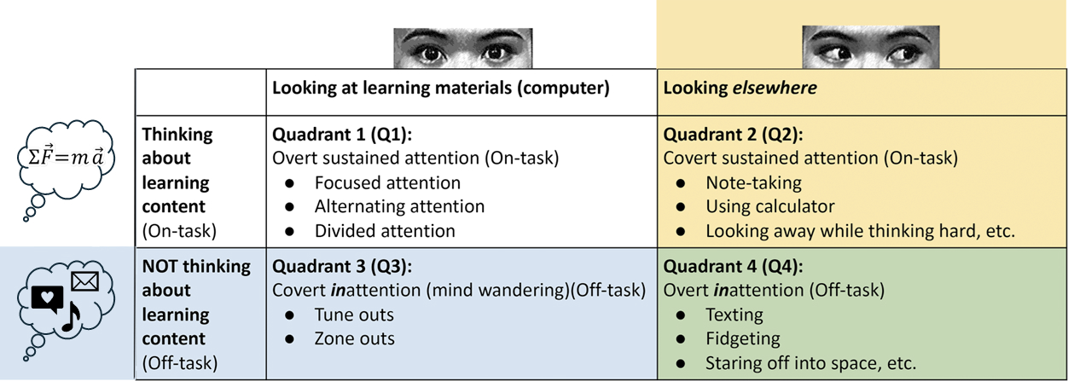
D’Mello (2016)

Slide 9
D’Mello (2016)

Slide 10
Research Questions
Can we categorize participants into each of D’Mello’s 4 quadrants, for an entire 20 min learning module, at 2-seconds level of precision?
  Looking at vs. away has been done before
  On-task vs. off-task has been done before
  But not all 4 quadrants simultaneously
    Tricky for the quadrants in which the learners are looking away from the screen
Can we determine the effects of spending time in each of the quadrants on their learning?

Slide 11
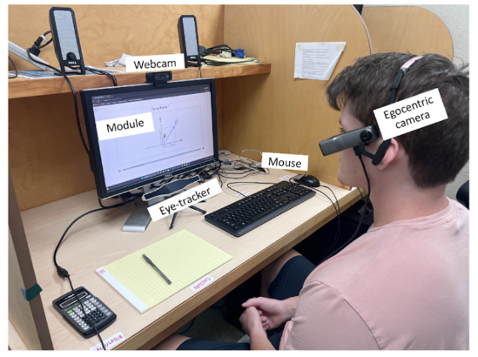
Method

Slide 12
101 Participant Lab Study
Laboratory (In-Person)
Online (Zoom-Proctored)
20-45 mins
15-20 mins
10 mins
15-20 mins
20-45 mins
20-45 mins
20-45 mins
PRE-TEST
(26 items)
MODULE
(Newton’s II Law)
QUESTION-
NAIRES
-Cognitive load
-Engagement
-User Experience
RETROSPECTIVE RECALL INTERVIEW
(Participant views each clip & RA labels Quadrant)
POST-TEST
(26 same
items)
SPAN TESTS
(O-Span,
L-Span)
1-Week RETENTION
TEST
(26 same
items)
MIND-WANDERING PROBES
(every 2.0-2.5 mins)

Slide 13
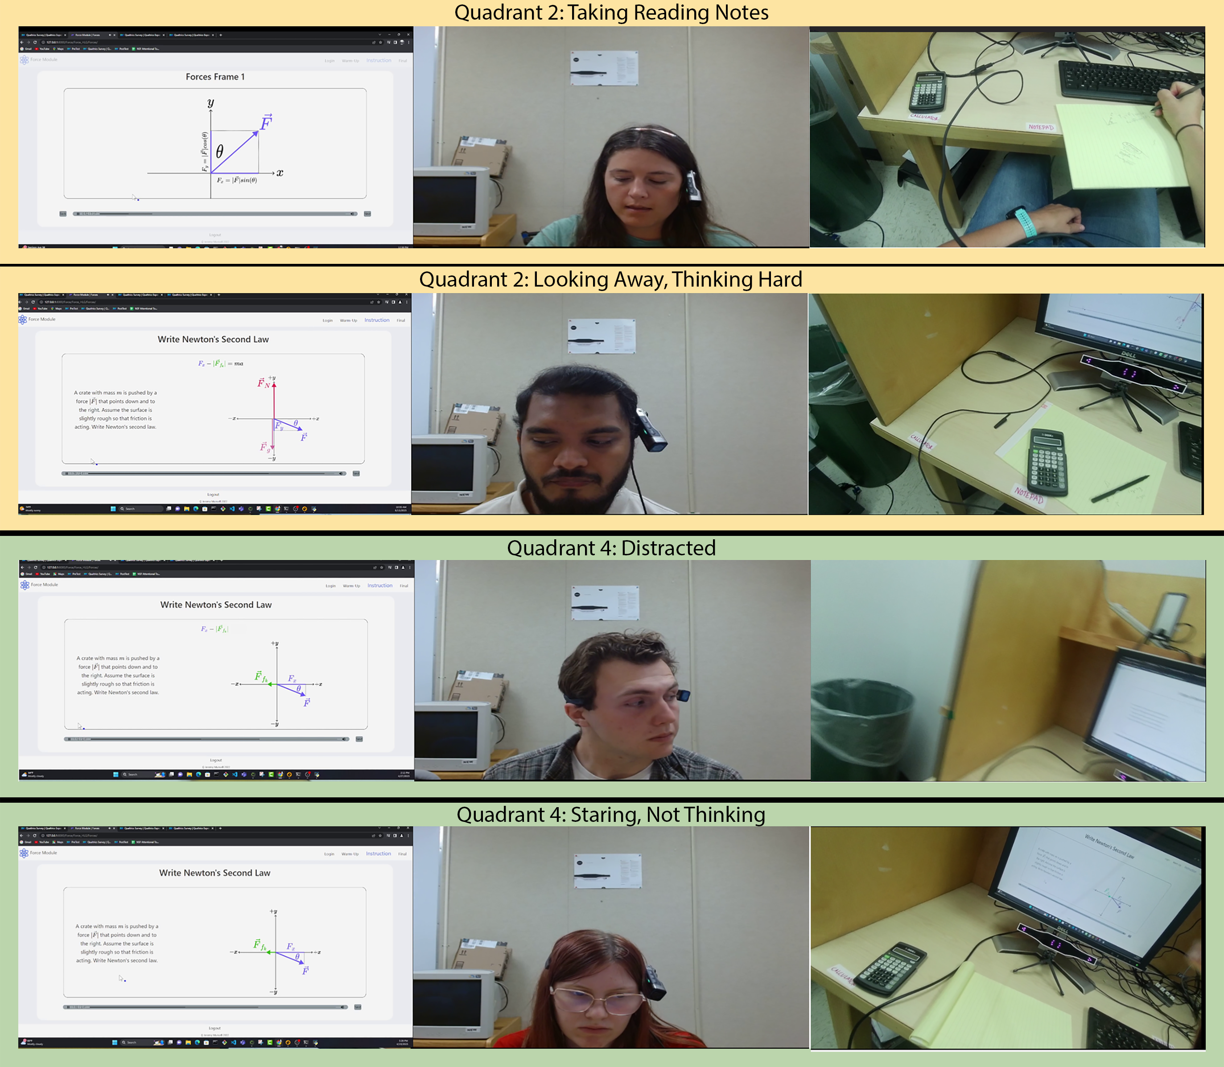
Multi-modal data used in the retrospective recall interview for categorizing on- vs. off-task while looking away from the learning materials

Slide 14
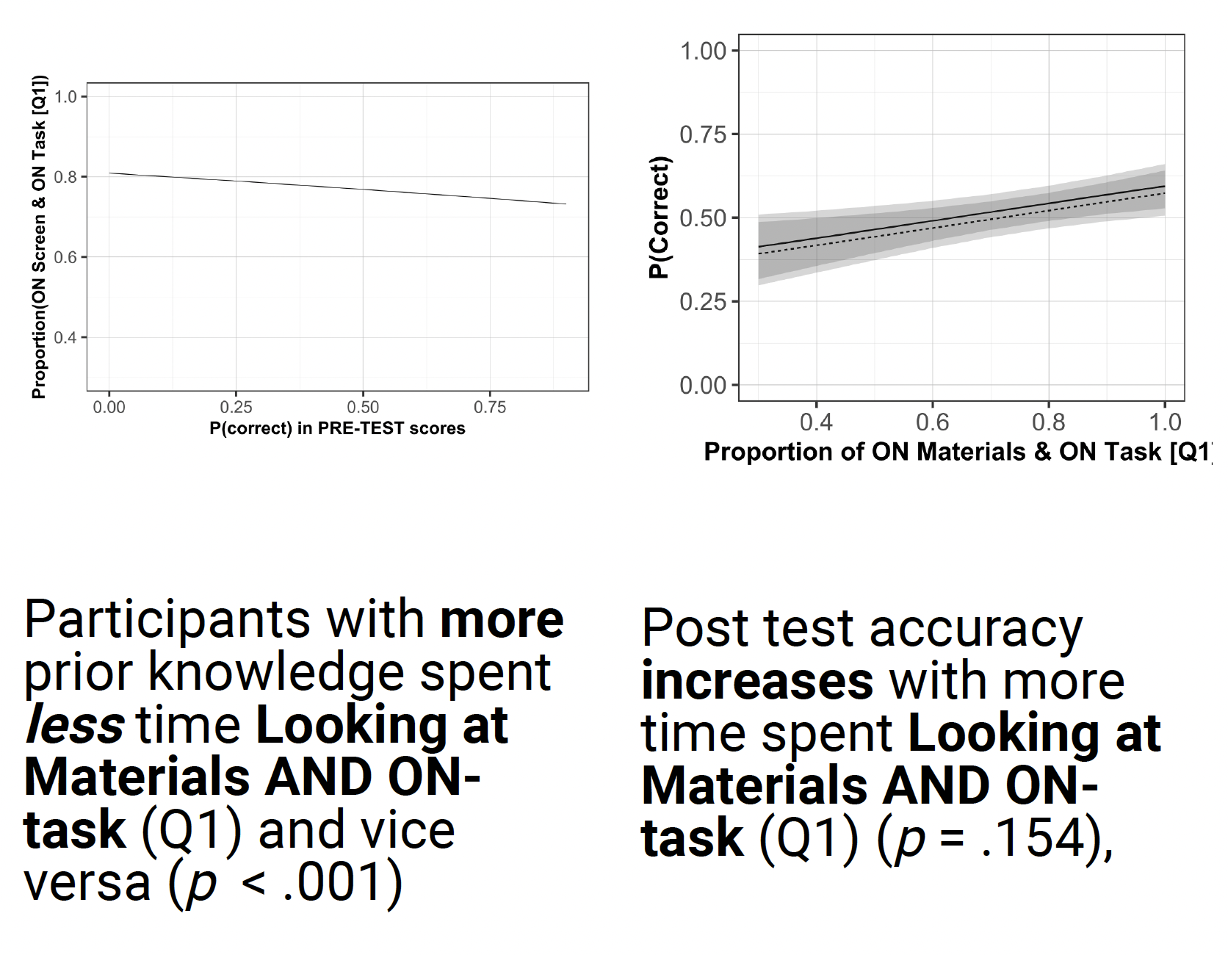
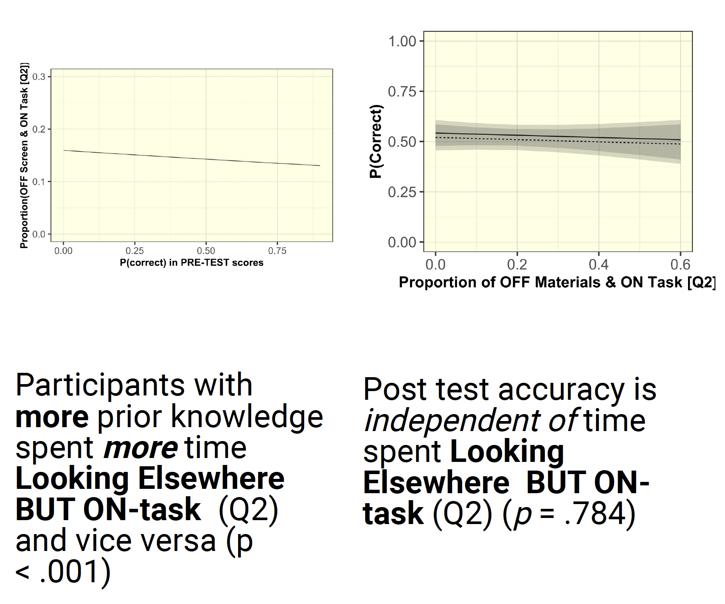
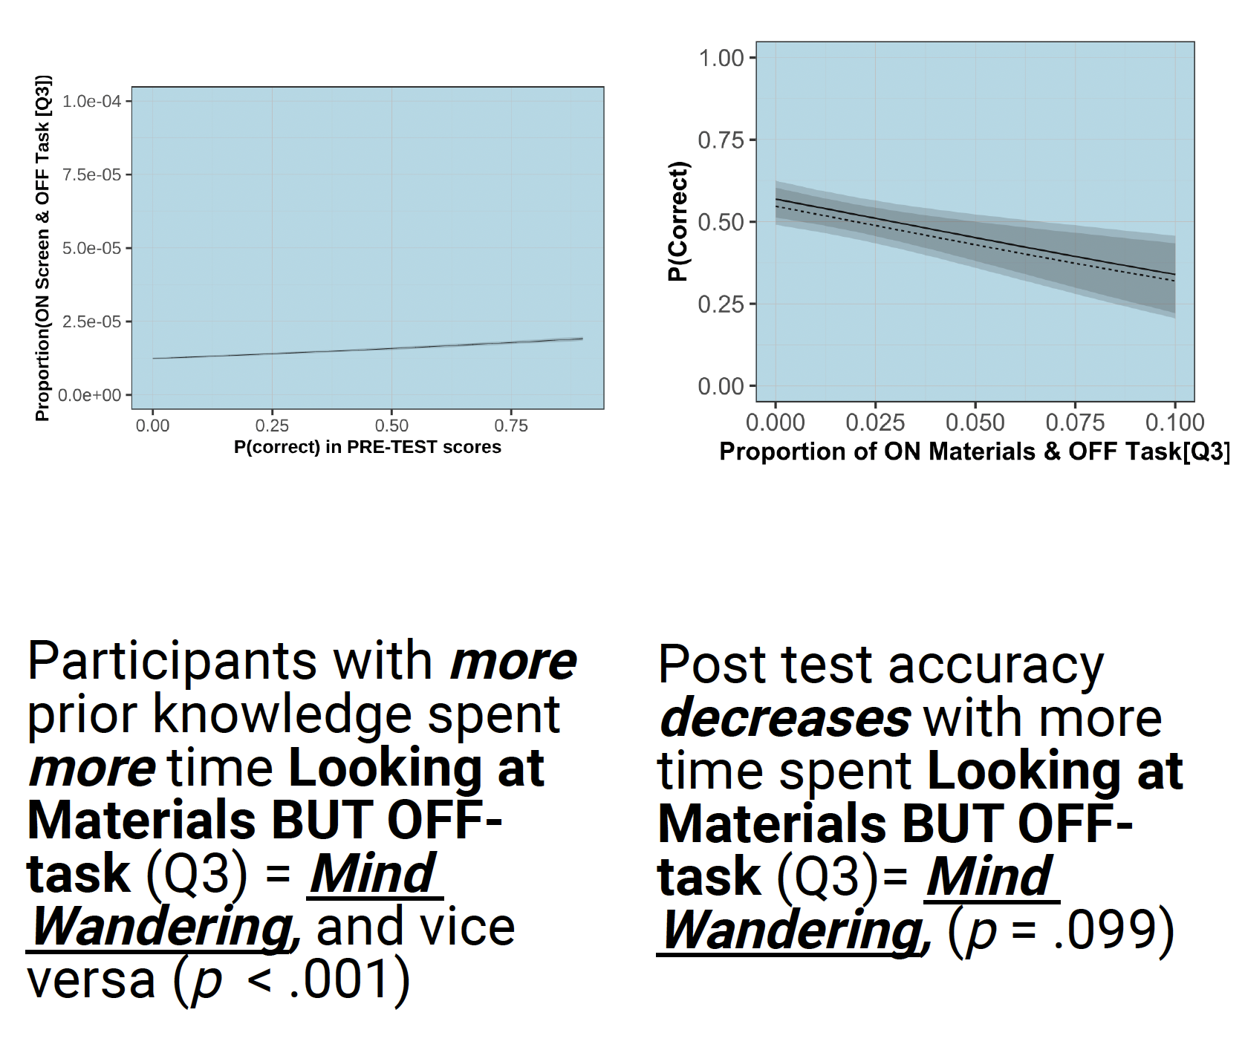
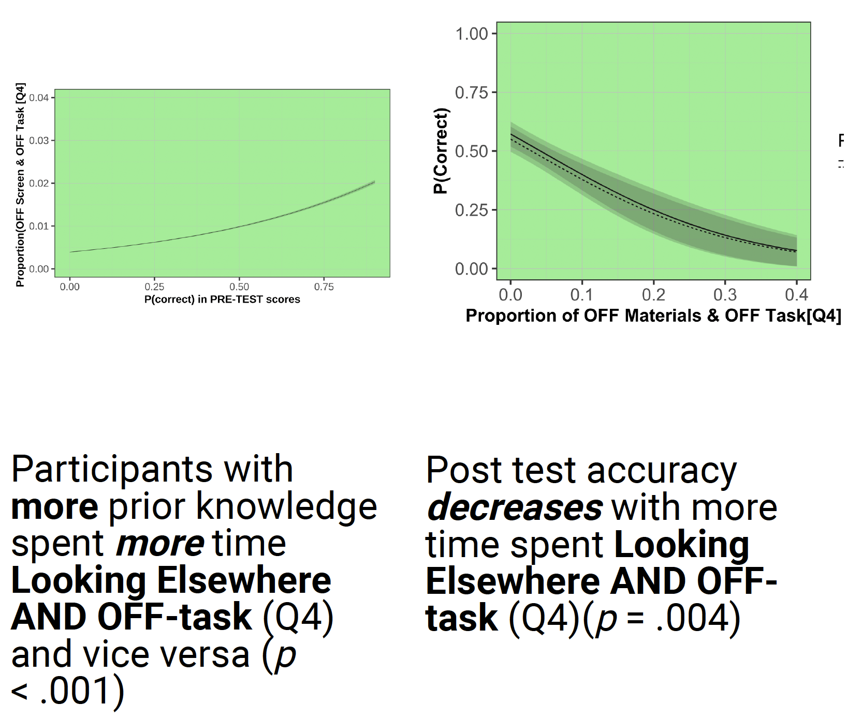
Results
Learning
Learning
Time in Quadrant
p = .154
p = .784
p = .004
Time in Quadrant
p = .099

Slide 15
Discussion
Can account for BOTH looking at vs. away from materials, AND on- vs. off-task behavior, with 2 seconds precision for entire learning module
This produced a very rich ground truth data
  Many more detailed analyses to come
    Mediated relations between attention and learning (e.g., WM, engagement)
    Characterizing learners’ attention spans over time
    Effects of Sweller’s 3 types of cognitive load on learning
  Training machine learning using ground truth
Limitation: very little off-task behavior
  Awareness of being highly monitored (eye tracking, webcam, egocentric cam)
  Fewer distractions than outside of the lab
    Another study “in the wild” with ~900 participants, but no eye tracking, egocentric camera
    Try to leverage ML from lab study, then fine-tune on “in the wild” data

Slide 16
Results
Time in Quadrant
Time in Quadrant
Prior Knowledge
p < .001
p < .001
Prior Knowledge
p < .001
p < .001

Slide 17
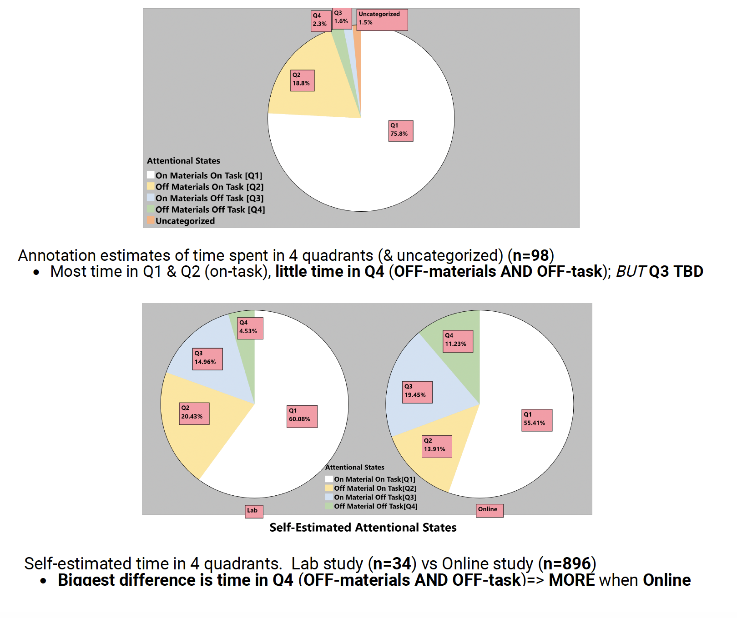
Results

