Slide 1










HyperCUT: Video Sequence From a Single Blurry Image
Using Unsupervised Ordering
Bang-Dang Pham¹
Phong Tran^{1,2}
Anh Tran¹
Cuong Pham^{1,3}
Rang Nguyen¹
Minh Hoai^{1,4}
¹VinAI Research, Vietnam ²MBZUAI, UAE ³Posts & Telecommunications Inst. of Tech., Vietnam ⁴Stony Brook University, USA
Poster: WED-AM-155

Slide 2
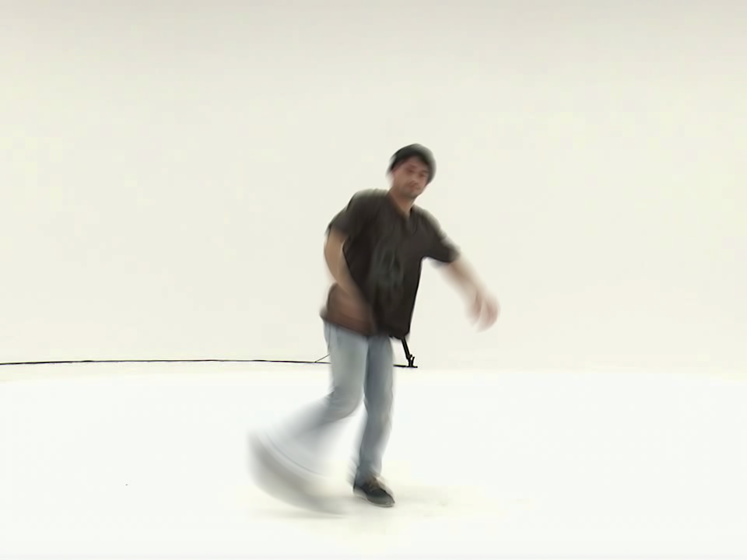
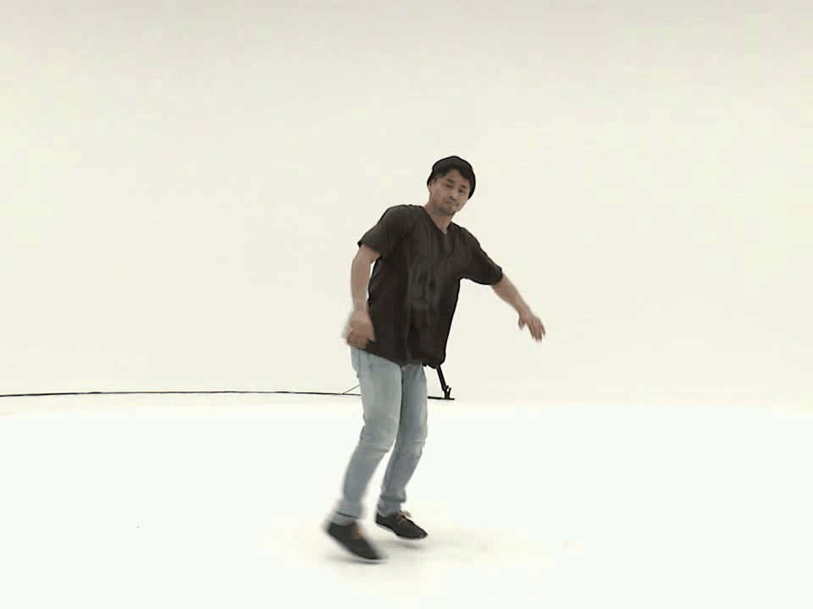
Quick Preview
Image-to-video deblurring (Blur2Vid)
Blur input
Seq. of sharp images

Slide 3
Quick Preview
Image-to-video deblurring (Blur2Vid)
Seq. of sharp images
Blur input

Slide 4
Quick Preview
Image-to-video deblurring (Blur2Vid)
Seq. of sharp images
Blur input

Slide 5
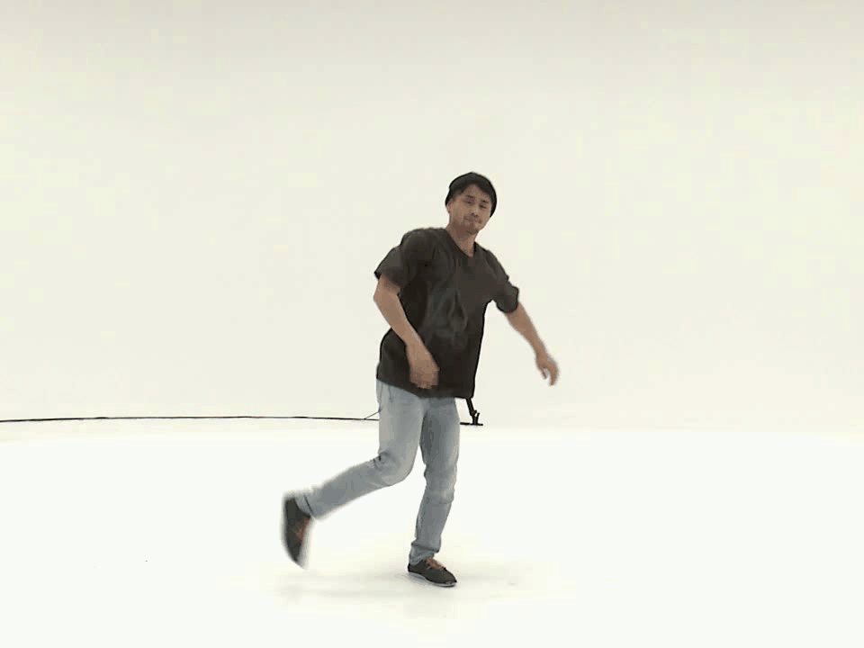
Quick Preview
Image-to-video deblurring (Blur2Vid)
Seq. of sharp images
Blur input
Another solution

Slide 6

Quick Preview
Image-to-video deblurring (Blur2Vid)
Seq. of sharp images
Blur input
Reverse Order
Another solution

Slide 7
Quick Preview
Order-Ambiguity Issue
Seq. of sharp images
Blur input
Reverse Order
Another solution

Slide 8
Quick Preview
Order-Ambiguity Issue
Seq. of sharp images
Blur input
Reverse Order
Another solution

Slide 9
Quick Preview
Order-Ambiguity Issue Fail Training Incorrect Motion
Blur input

Slide 10
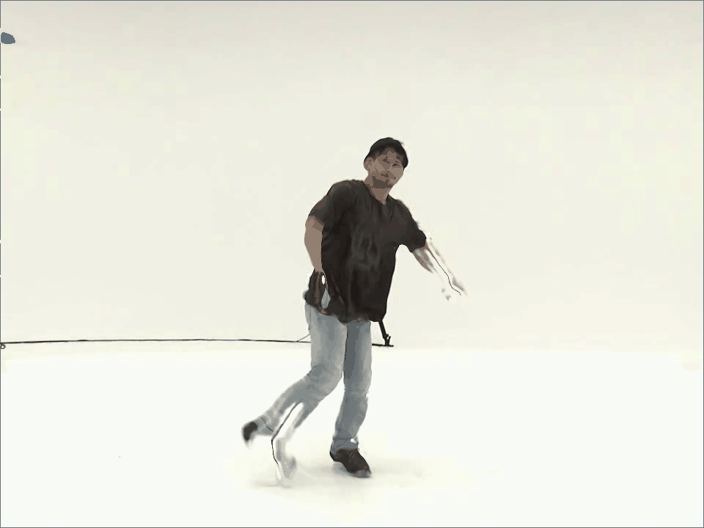
Quick Preview
Order-Ambiguity Issue Fail Training Incorrect Motion
Blur input
Failure Generated Frames

Slide 11
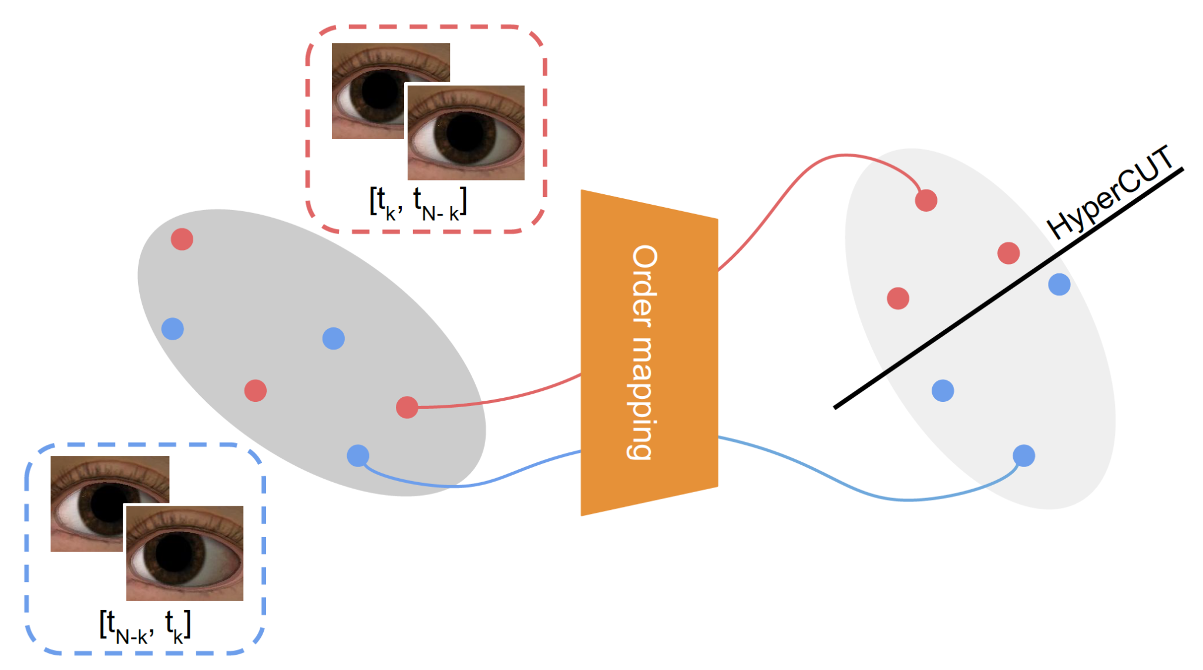
Quick Preview
We propose HyperCUT, an effective Self-supervised Ordering Scheme that assigns an explicit order for each video sequence, thus avoiding the order-ambiguity issue

Slide 12
Quick Preview
We propose HyperCUT, an effective Self-supervised Ordering Scheme that assigns an explicit order for each video sequence, thus avoiding the order-ambiguity issue

Slide 13
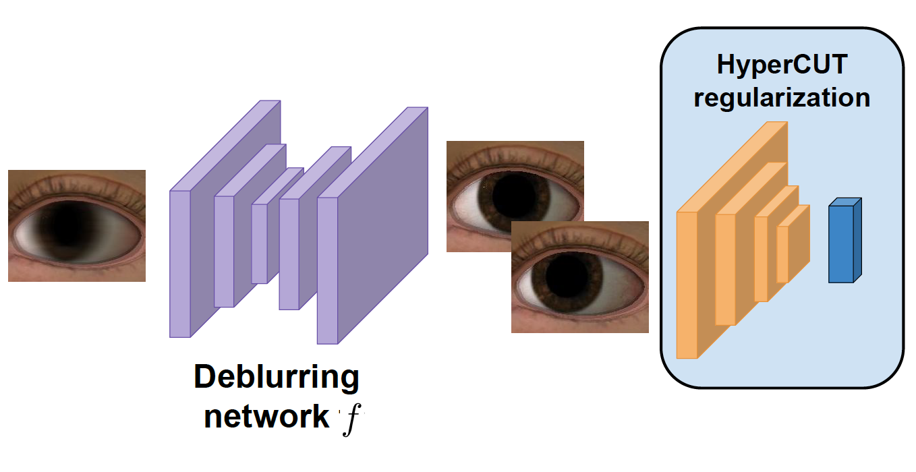
Quick Preview
We propose HyperCUT, an effective Self-supervised Ordering Scheme that assigns an explicit order for each video sequence, thus avoiding the order-ambiguity issue

Slide 14
Quick Preview
We propose HyperCUT, an effective Self-supervised Ordering Scheme that assigns an explicit order for each video sequence, thus avoiding the order-ambiguity issue
We provide the first real-world blur2vid dataset covers a variety of popular domains, including face, hand, and street

Slide 15
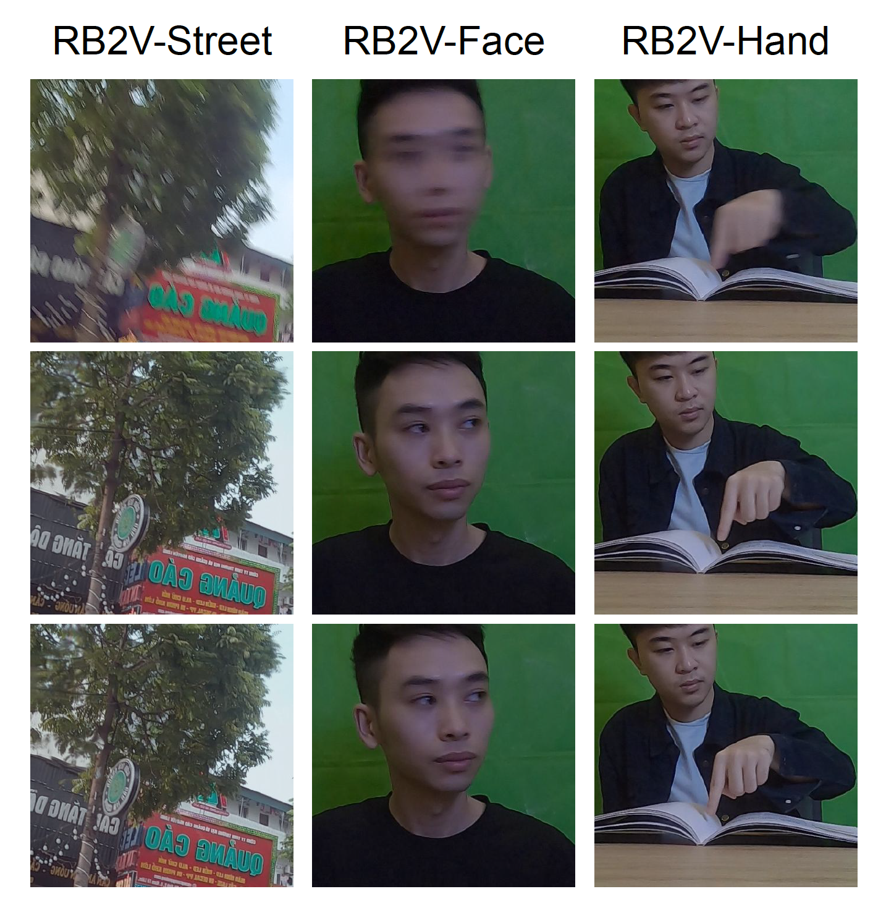
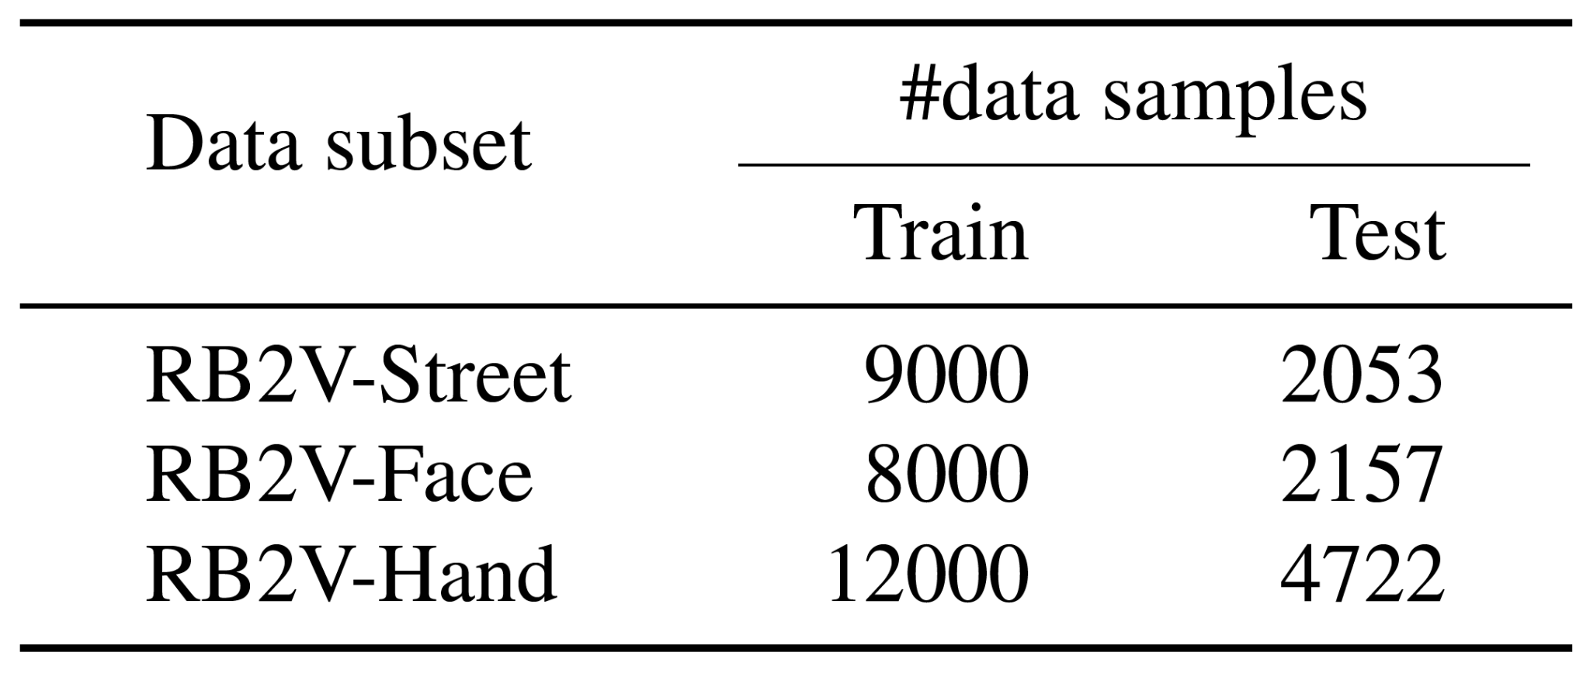
Quick Preview
We propose HyperCUT, an effective Self-supervised Ordering Scheme that assigns an explicit order for each video sequence, thus avoiding the order-ambiguity issue
We provide the first real-world blur2vid dataset covers a variety of popular domains, including face, hand, and street
Dataset Statistics

Slide 16
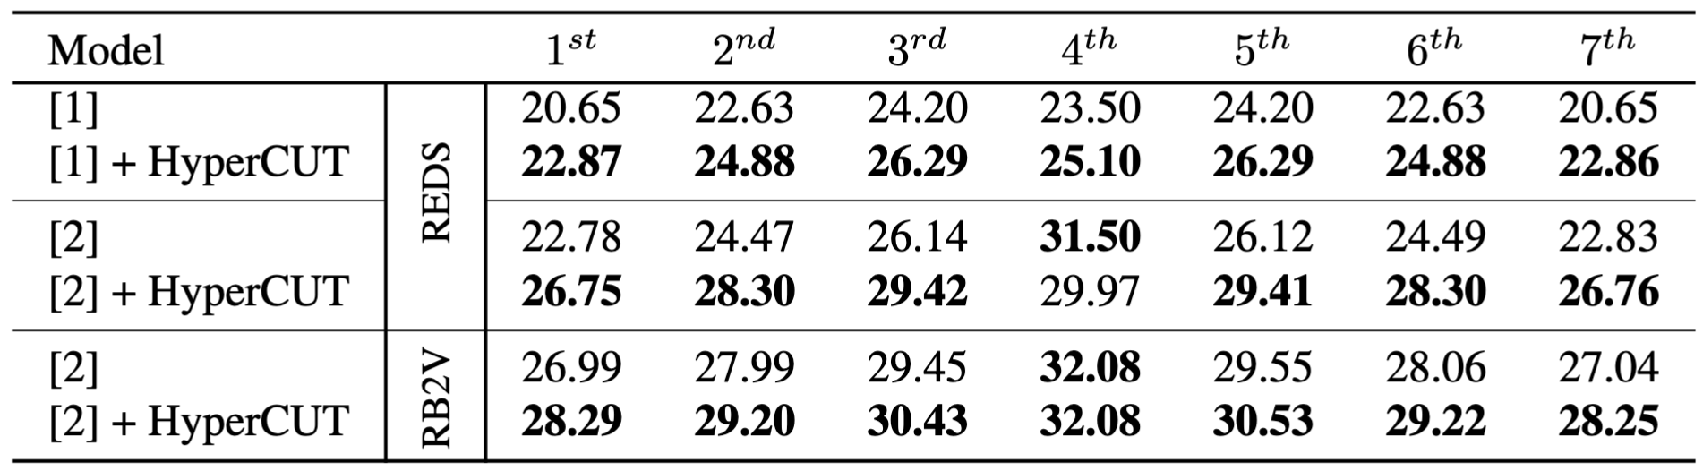
Quick Preview
We propose HyperCUT, an effective Self-supervised Ordering Scheme that assigns an explicit order for each video sequence, thus avoiding the order-ambiguity issue
We provide the first real-world blur2vid dataset covers a variety of popular domains, including face, hand, and street
Generated frames
Baselines
[1] Meiguang Jin, Givi Meishvili, and Paolo Favaro. Learning to extract a video sequence from a single motion-blurred image. CVPR, 2018
[2] Kuldeep Purohit, Anshul Shah, and AN Rajagopalan. Bringing alive blurred moments. CVPR, 2019

Slide 17
Quick Preview
We propose HyperCUT, an effective Self-supervised Ordering Scheme that assigns an explicit order for each video sequence, thus avoiding the order-ambiguity issue
We provide the first real-world blur2vid dataset covers a variety of popular domains, including face, hand, and street
Generated frames
Baselines
[1] Meiguang Jin, Givi Meishvili, and Paolo Favaro. Learning to extract a video sequence from a single motion-blurred image. CVPR, 2018
[2] Kuldeep Purohit, Anshul Shah, and AN Rajagopalan. Bringing alive blurred moments. CVPR, 2019
Notes:
Fix 1, 2

Slide 18
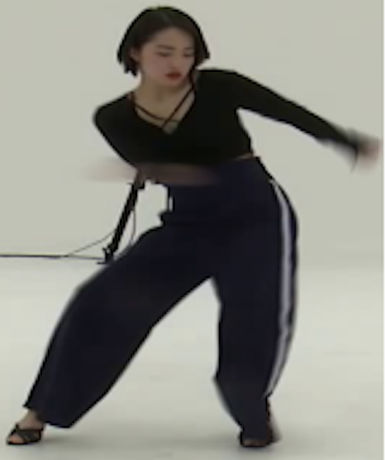
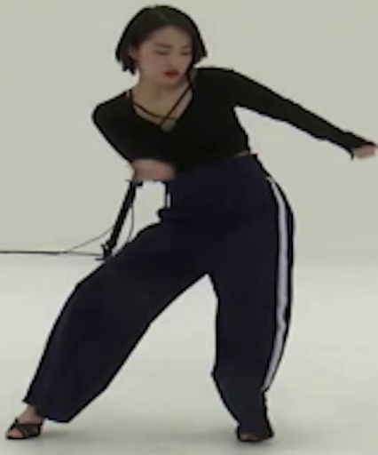
Motivation
Blur
Sharp
Deblur

Slide 19
Motivation
Blur
Sharp
Deblur

Slide 20

Motivation
Blur
Sharp images
Deblur

Slide 21
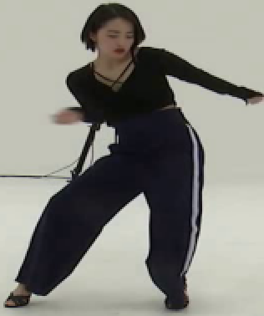
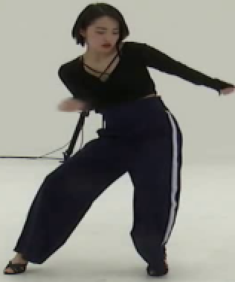




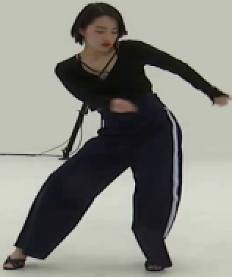
Motivation
Deblur

Slide 22
Motivation
Deblur
Better Motion Analysis

Slide 23
Previous Approaches

Slide 24
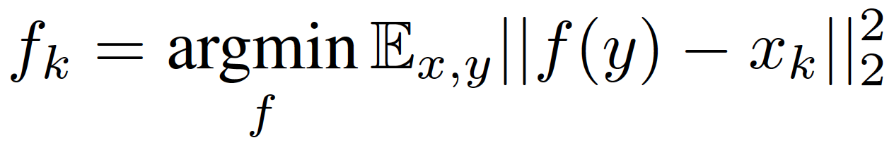

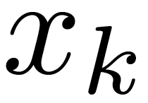
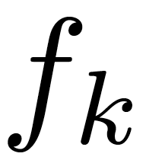
Previous Approaches
Naive Optimization approach:
with y : blur input
xk: ground-truth sharp images
fk : network predict each sharp frame

Slide 25
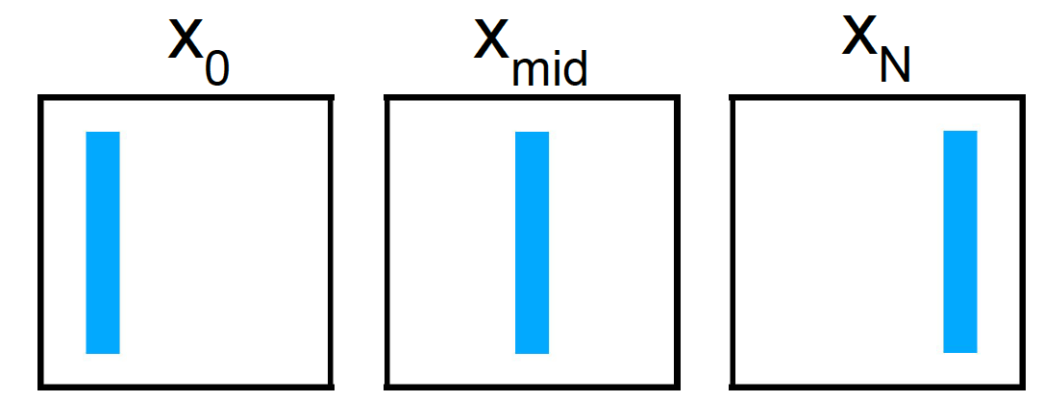

Previous Approaches
Naive Optimization approach:
with y : blur input
xk: ground-truth sharp images
fk : network predict each sharp frame
Blur input
Ground-truth

Slide 26
Previous Approaches
Naive Optimization approach:
with y : blur input
xk: ground-truth sharp images
fk : network predict each sharp frame
Blur input

Slide 27
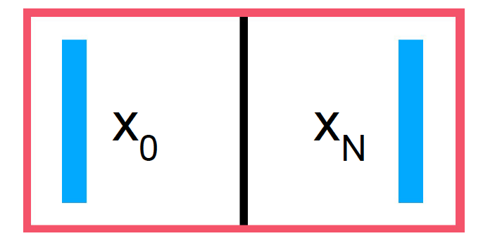
Previous Approaches
Naive Optimization approach:
with y : blur input
xk: ground-truth sharp images
fk : network predict each sharp frame
Blur input
Ground-truth

Slide 28
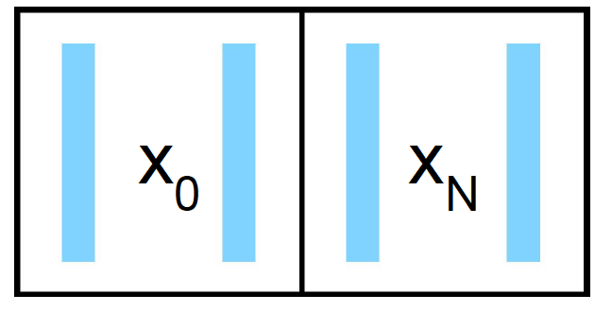
Previous Approaches
Naive Optimization approach:
with y : blur input
xk: ground-truth sharp images
fk : network predict each sharp frame
Blur input
Naive deblurring
Ground-truth

Slide 29
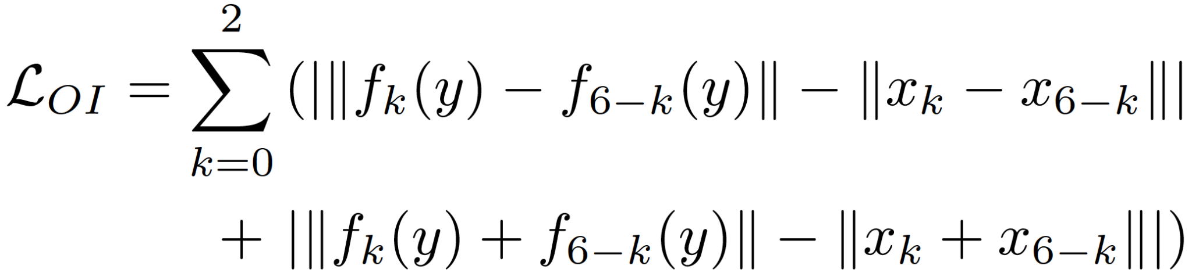
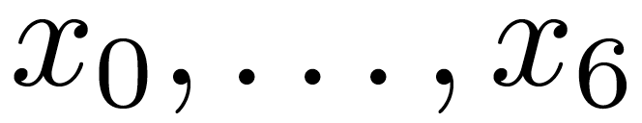
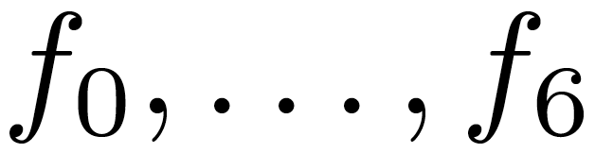
Previous Approaches
Order-Invariant loss:
with y : blur input
xk: ground-truth sharp images ( )
fk : network predict each sharp frame ( )

Slide 30
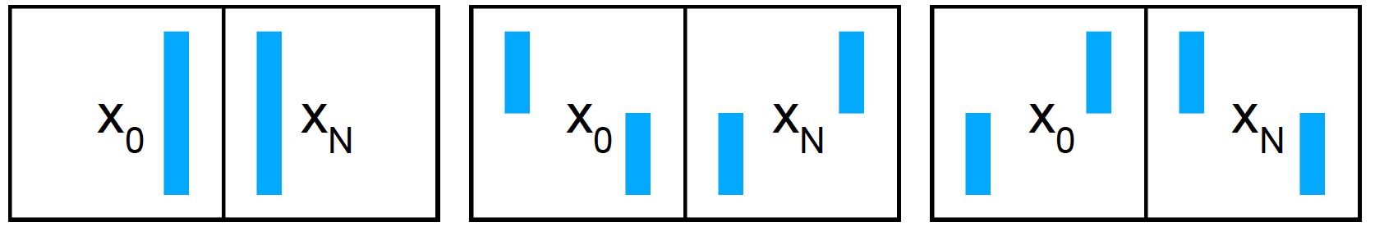
Previous Approaches
Order-Invariant loss:
with y : blur input
xk: ground-truth sharp images ( )
fk : network predict each sharp frame ( )
Blur input
Possible Solutions

Slide 31
Previous Approaches
Motion Guidance:
Figure from Zhong et al. “Animation from blur: Multimodal blur decomposition with motion guidance”. ECCV, 2022

Slide 32
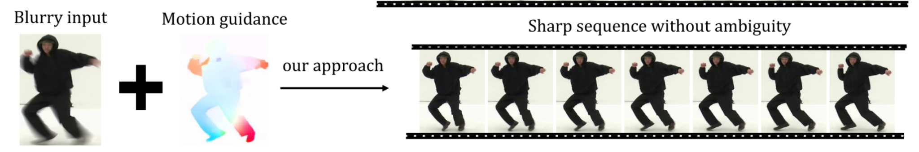
Previous Approaches
Motion Guidance:
✅ Multi-directional motion
✅ Refinement
Figure from Zhong et al. “Animation from blur: Multimodal blur decomposition with motion guidance”. ECCV, 2022

Slide 33
Previous Approaches
Motion Guidance:
✅ Multi-directional motion
✅ Refinement
❌ Accurate annotation requirement
❌ Handcrafted heuristics dependence
Figure from Zhong et al. “Animation from blur: Multimodal blur decomposition with motion guidance”. ECCV, 2022

Slide 34
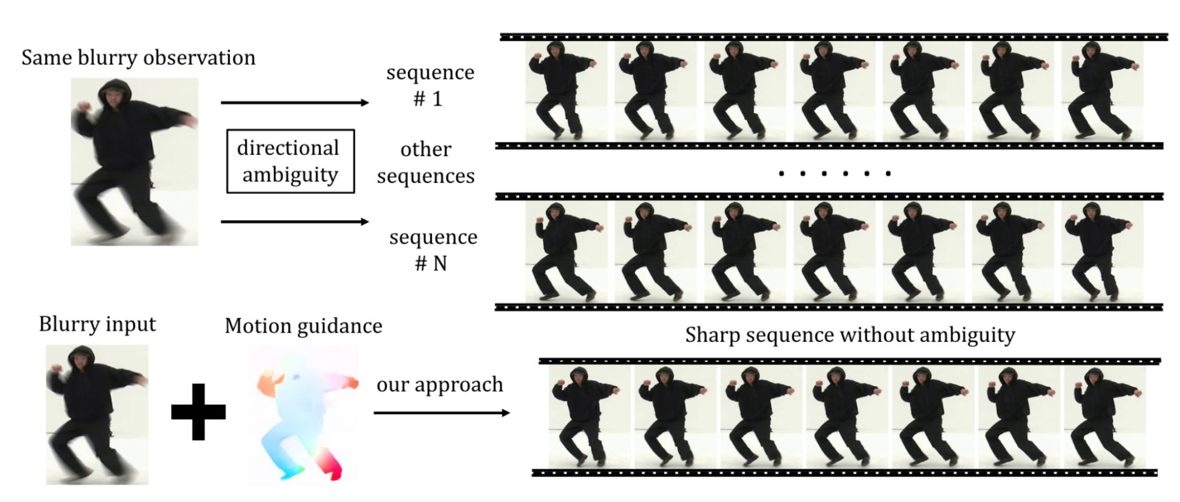
Previous Approaches
Motion Guidance:
Our goal
Separate the solution space
Consistent and efficient order alignment
No heuristic dependence
✅ Multi-directional motion
✅ Refinement
❌ Accurate annotation requirement
❌ Handcrafted heuristics dependence

Slide 35
Proposed Method
Our goal
Separate the solution space
Consistent and efficient order alignment
No heuristic dependence

Slide 36
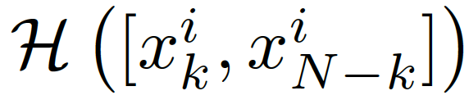
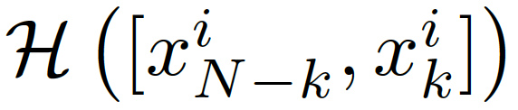
Proposed Method

Slide 37
Proposed Method

Slide 38
Proposed Method

Slide 39
Proposed Method

Slide 40


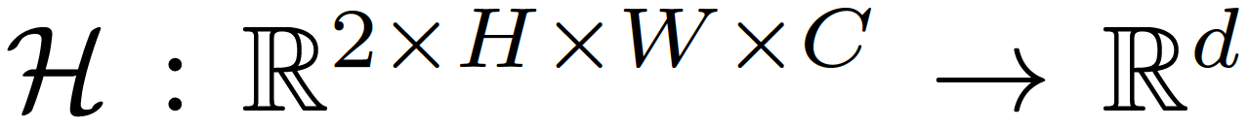
Proposed Method
: hyperplane,

Slide 41
Proposed Method
: hyperplane,

Slide 42
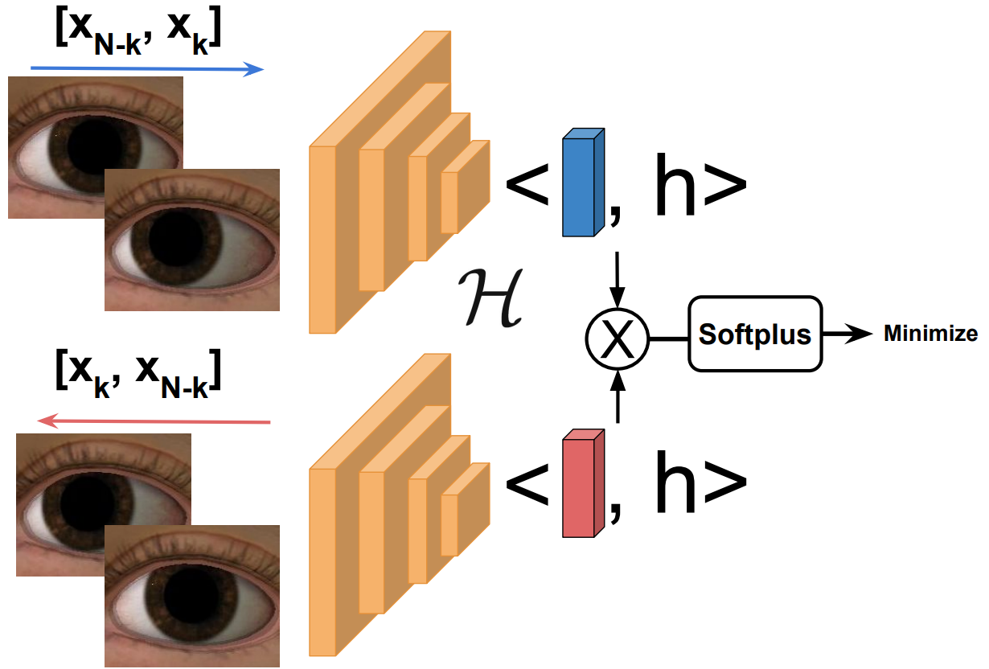
Proposed Method - HyperCUT Training
Notes:
fix script

Slide 43
Proposed Method - HyperCUT Training

Slide 44
Proposed Method - HyperCUT Training
For each sample , , our objective:

Slide 45

Proposed Method - HyperCUT Training
For each sample , , our objective:

Slide 46
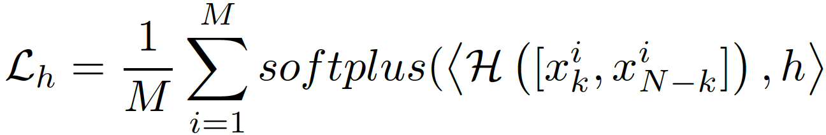
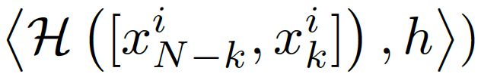

Proposed Method - HyperCUT Training
For each sample , , our objective:
Loss function:
With

Slide 47
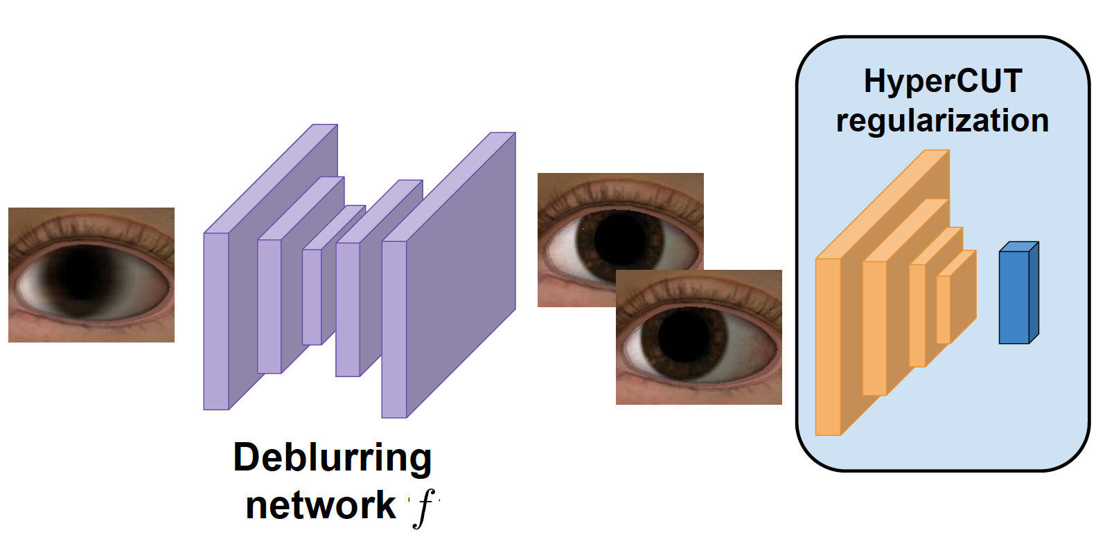
HyperCUT Regularization

Slide 48
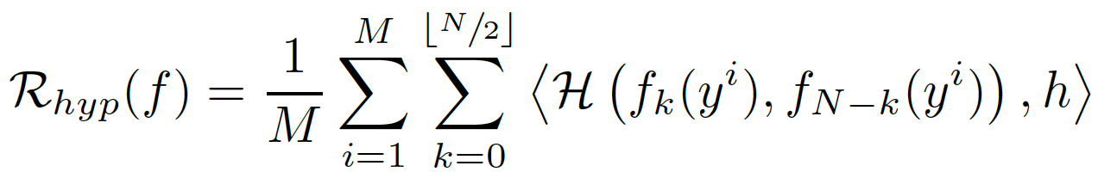
HyperCUT Regularization

Slide 49
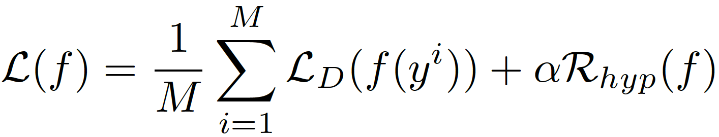
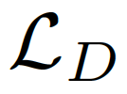
HyperCUT Regularization
Total Deblurring Loss:
where can be any deblurring loss

Slide 50
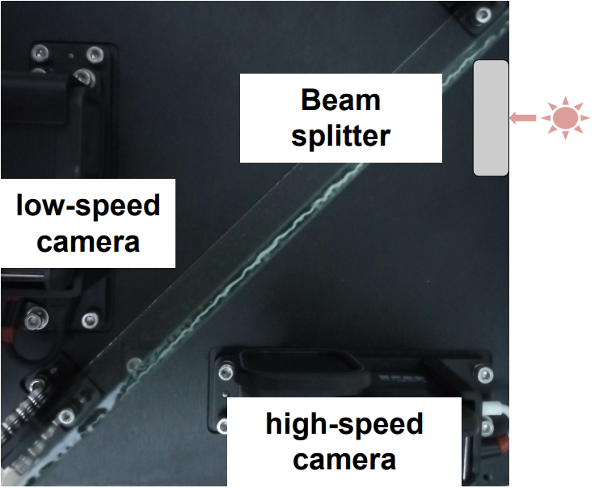
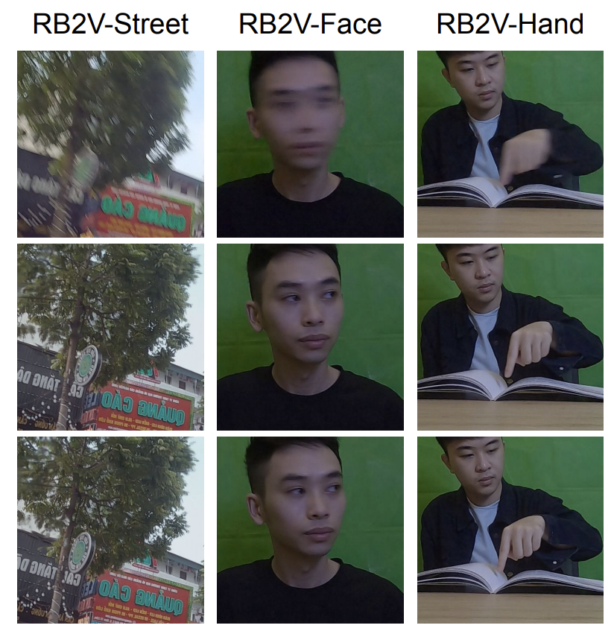
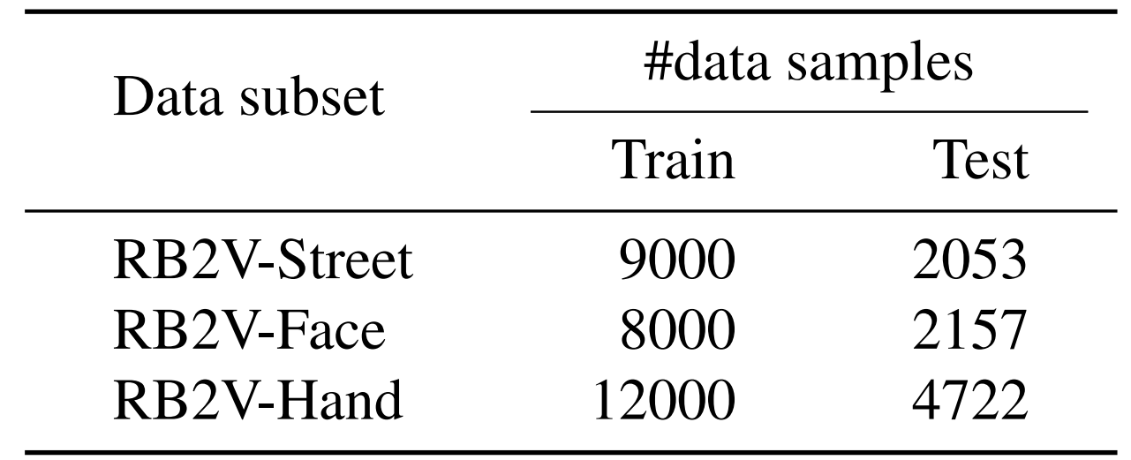
Datasets - Real
We propose a real-world blur2vid dataset
Three categories: Street, Face, and Hand
Notes:
Talk more about camera

Slide 51
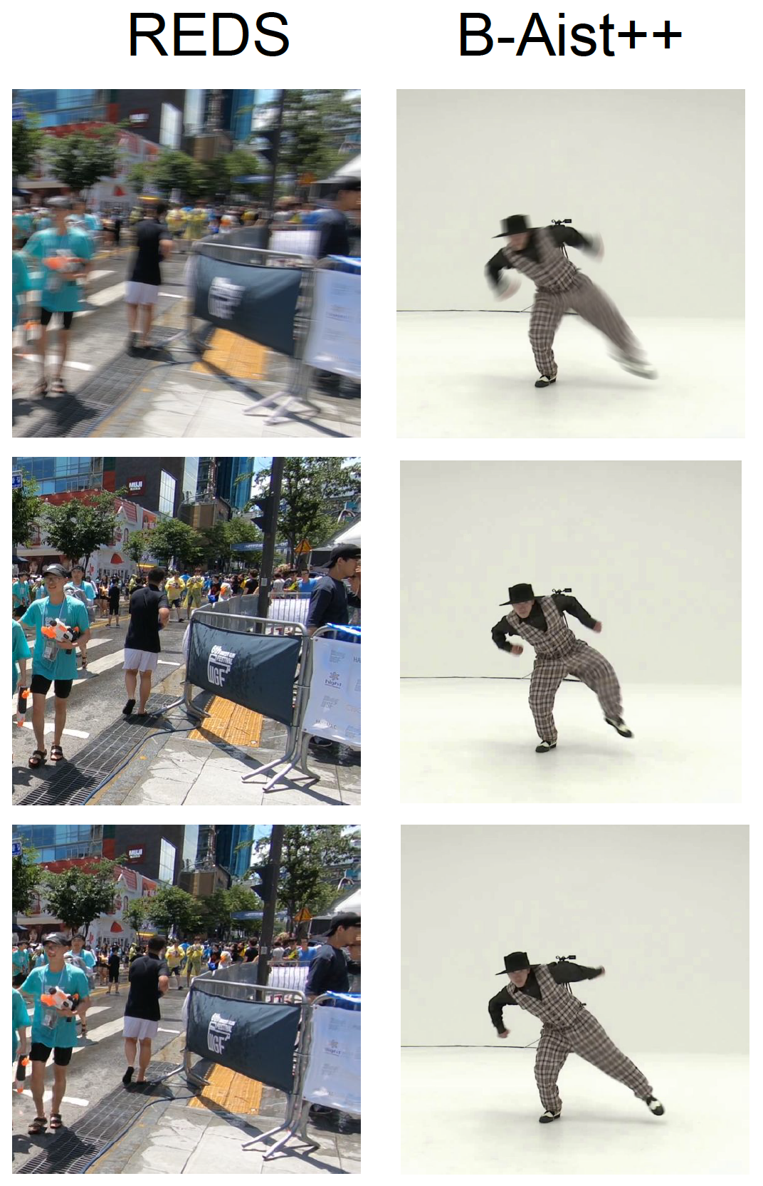
Datasets - Synthetic
REDS
  120fps
  Interpolate frames to form 7 sharp sequences
B-Aist++
  Config augmentation and setting proposed as in [3]
[3] Zhihang Zhong, Xiao Sun, Zhirong Wu, Yinqiang Zheng, Stephen Lin, and Imari Sato. Animation from blur: Multimodal blur decomposition with motion guidance. ECCV, 2022

Slide 52
Results

Slide 53

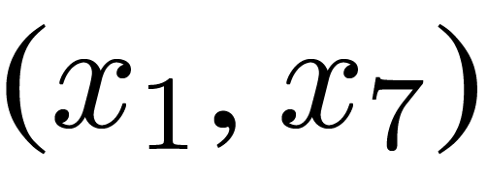
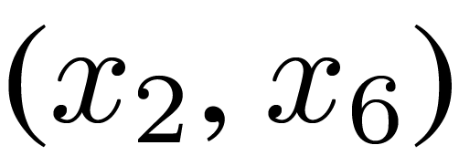
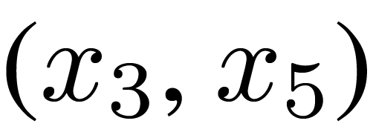
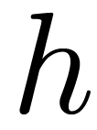
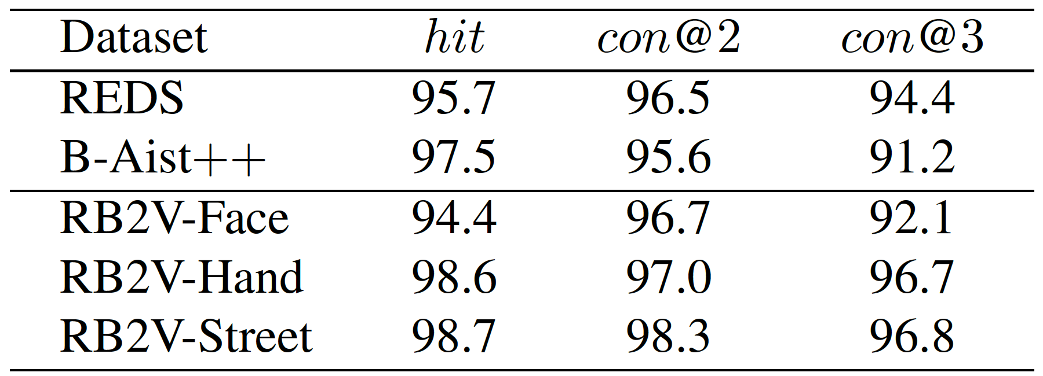
Results - Order Accuracy of HyperCUT
We define 2 metrics for analyzing the effectiveness of HyperCUT:
  hit: is the ratio of frame pairs (xk, xN−k) that satisfy:
  con: measures the consistency ratio that the pairs x1, x7 ), (x2, x6), and (x3, x5) are in the same side of the hyperplane h.

Slide 54
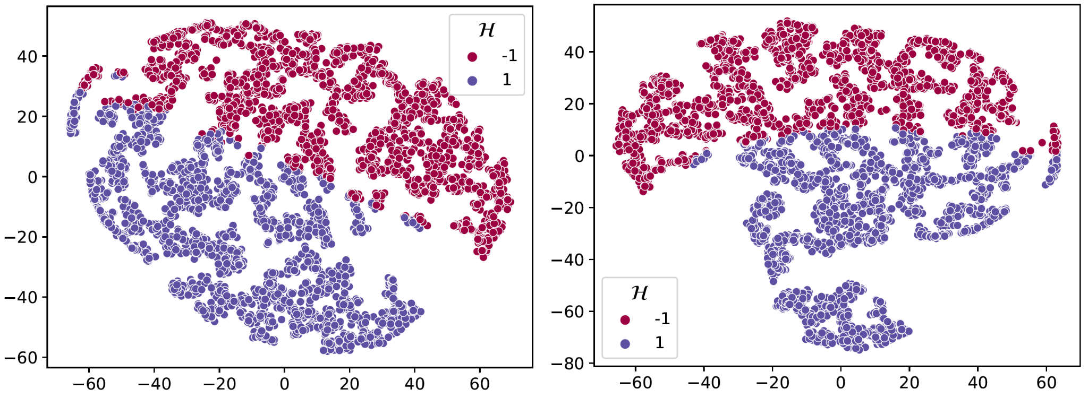
Results - Order Accuracy of HyperCUT
RV2B-Street (Real)
REDS (Synthetic)
The t-SNE visualization of HyperCUT ordering mapping

Slide 55


Results - HyperCUT Effectiveness
For fair comparison, as forward and backward frames are plausible solutions, we define metric where is represented for PSNR, SSIM, LPIPS
[1] Meiguang Jin, Givi Meishvili, and Paolo Favaro. Learning to extract a video sequence from a single motion-blurred image. CVPR, 2018
[2] Kuldeep Purohit, Anshul Shah, and AN Rajagopalan. Bringing alive blurred moments. CVPR, 2019

Slide 56
Results - HyperCUT Effectiveness
The pPSNR↑ scores (dB)
[1] Meiguang Jin, Givi Meishvili, and Paolo Favaro. Learning to extract a video sequence from a single motion-blurred image. CVPR, 2018
[2] Kuldeep Purohit, Anshul Shah, and AN Rajagopalan. Bringing alive blurred moments. CVPR, 2019

Slide 57
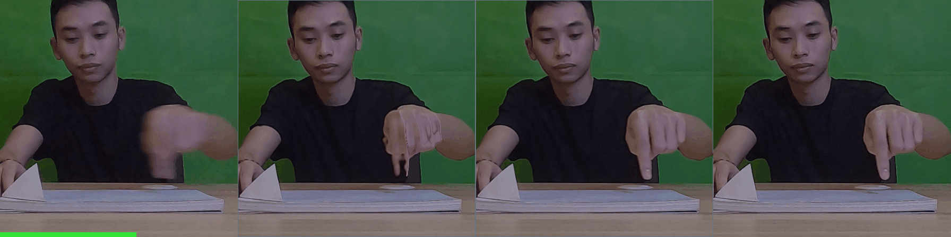
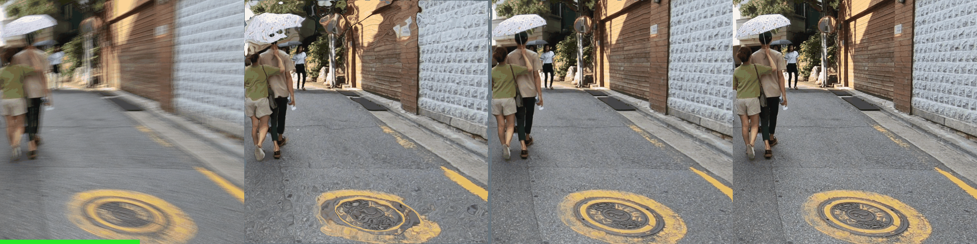
Results - HyperCUT Effectiveness
Blur
[1]
[1] + HyperCUT
GT
RB2V-Hand
REDS
[1] Meiguang Jin, Givi Meishvili, and Paolo Favaro. Learning to extract a video sequence from a single motion-blurred image. CVPR, 2018
[2] Kuldeep Purohit, Anshul Shah, and AN Rajagopalan. Bringing alive blurred moments. CVPR, 2019

Slide 58

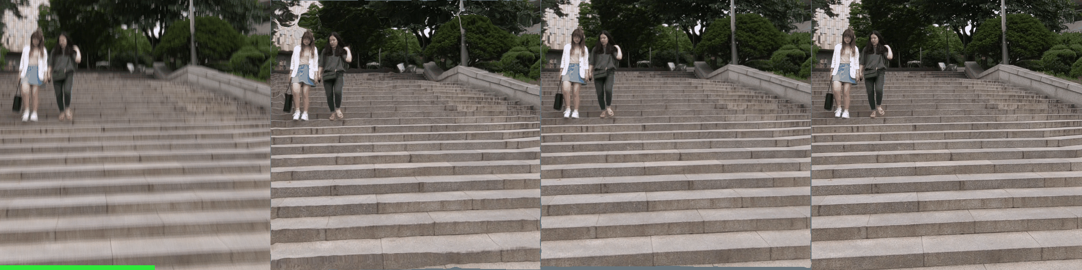
Results - HyperCUT Effectiveness
Blur
[2]
[2] + HyperCUT
GT
RB2V-Street
REDS
[1] Meiguang Jin, Givi Meishvili, and Paolo Favaro. Learning to extract a video sequence from a single motion-blurred image. CVPR, 2018
[2] Kuldeep Purohit, Anshul Shah, and AN Rajagopalan. Bringing alive blurred moments. CVPR, 2019

Slide 59
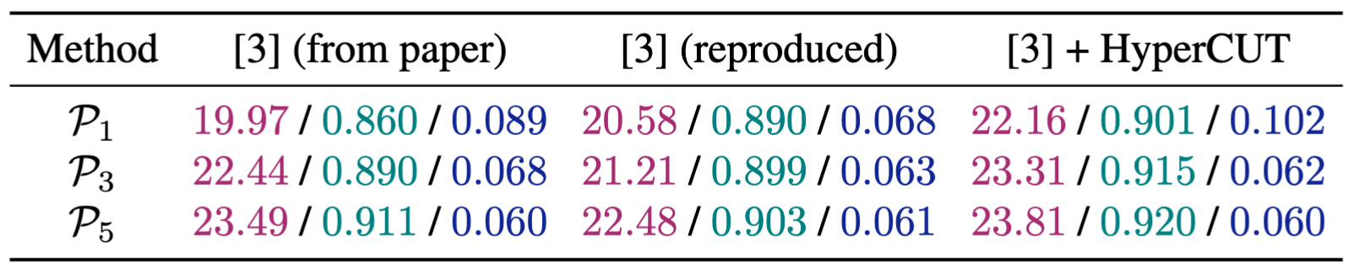
Results - HyperCUT Effectiveness
The pPSNR↑/ pSSIM↑ / pLPIPS↓ scores
[3] Zhihang Zhong, Xiao Sun, Zhirong Wu, Yinqiang Zheng, Stephen Lin, and Imari Sato. Animation from blur: Multimodal blur decomposition with motion guidance. ECCV, 2022

Slide 60


Results - HyperCUT Effectiveness
Blur
Motion Guidance
[3]
[3] + HyperCUT
GT
[3] Zhihang Zhong, Xiao Sun, Zhirong Wu, Yinqiang Zheng, Stephen Lin, and Imari Sato. Animation from blur: Multimodal blur decomposition with motion guidance. ECCV, 2022

Slide 61


Conclusion
We introduce HyperCUT which is used to solve the order-ambiguity issue effectively for the task of extracting a sharp video sequence from a blurry image.
We build a new dataset for the task - RB2V, covering three categories: Street, Face, and Hand. This is the first real and large-scale dataset for image-to-video deblurring.
Our model achieves state-of-the-art performance on both synthetic and real-world benchmarks.
Future research on adapting HyperCUT for handling complex movements and long exposure blur would be an interesting avenue for exploration.
Code
Paper

Slide 62
Results - HyperCUT Application
Motion Guidance
Blur
[3]
[3] + HyperCUT
GT
[3] Zhihang Zhong, Xiao Sun, Zhirong Wu, Yinqiang Zheng, Stephen Lin, and Imari Sato. Animation from blur: Multimodal blur decomposition with motion guidance. In Proceedings of the European Conference on Computer Vision. Springer, 2022

Slide 63
Quick Preview
Image-to-video deblurring (Blur2Vid), which aims to recover a sequence of sharp images corresponding to a given blurry image input
Seq. of sharp images
Blur input

Slide 64
Quick Preview
Image-to-video deblurring (Blur2Vid), which aims to recover a sequence of sharp images corresponding to a given blurry image input
However, both the forward and backward sequences as plausible solutions
Seq. of sharp images
Blur input

Slide 65
Quick Preview
Image-to-video deblurring (Blur2Vid), which aims to recover a sequence of sharp images corresponding to a given blurry image input
However, both the forward and backward sequences as plausible solutions
Seq. of sharp images
Blur input
Other solution

Slide 66
Quick Preview
Image-to-video deblurring (Blur2Vid), which aims to recover a sequence of sharp images corresponding to a given blurry image input
However, both the forward and backward sequences as plausible solutions
Seq. of sharp images
Blur input
Reverse Order
Other solution

Slide 67
Quick Preview
Image-to-video deblurring (Blur2Vid), which aims to recover a sequence of sharp images corresponding to a given blurry image input
However, both the forward and backward sequences as plausible solutions … Order-Ambiguity
Seq. of sharp images
Blur input
Reverse Order
Other solution

Slide 68
Quick Preview
Image-to-video deblurring (Blur2Vid), which aims to recover a sequence of sharp images corresponding to a given blurry image input
However, both the forward and backward sequences as plausible solutions … Order-Ambiguity Training Failure
Seq. of sharp images
Blur input
Reverse Order
Other solution

Slide 69
Quick Preview
Image-to-video deblurring (Blur2Vid), which aims to recover a sequence of sharp images corresponding to a given blurry image input
However, both the forward and backward sequences as plausible solutions … Order-Ambiguity Training Failure
Blur input

Slide 70
Quick Preview
Image-to-video deblurring (Blur2Vid), which aims to recover a sequence of sharp images corresponding to a given blurry image input
However, both the forward and backward sequences as plausible solutions … Order-Ambiguity Training Failure Incorrect Motion Decompose
Blur input
Failure Generated Frames

